Slide 1
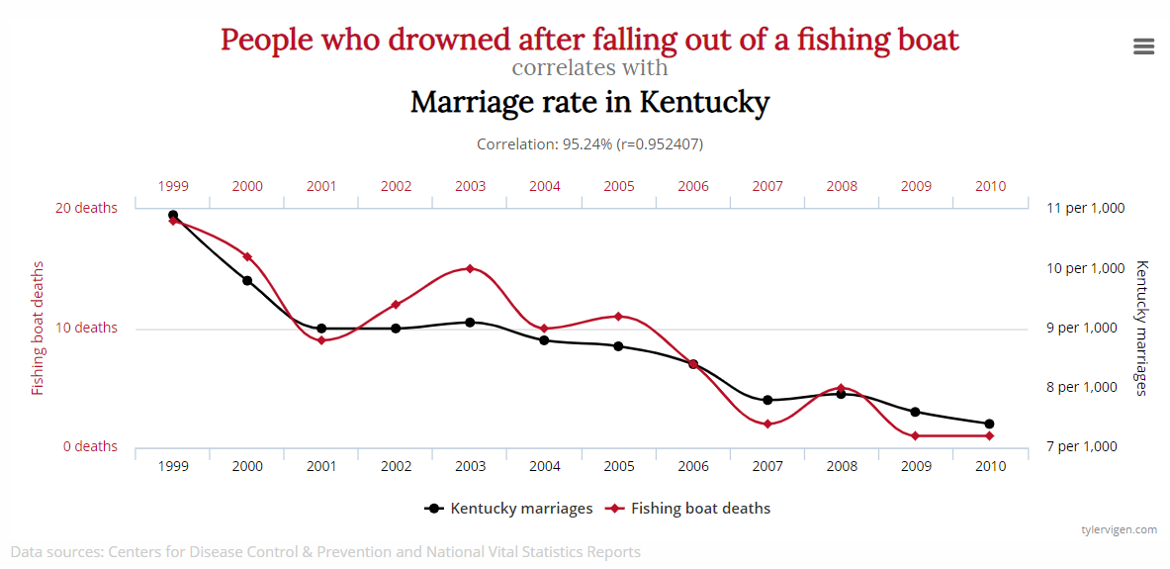
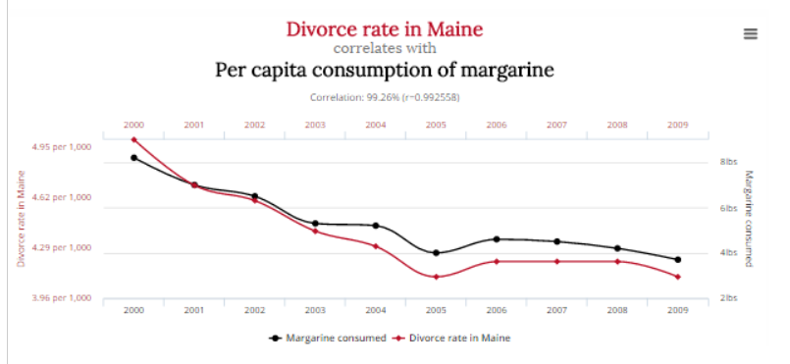

Slide 2

Correlation is not causation
A Turing Award-winning computer scientist and statistician shows how understanding causality has revolutionized science and will revolutionize artificial intelligence.
Notes:
Judea Pearl was the father of Daniel Pearl, who was beheaded by terrorists.

Slide 3
The Harper Fragment
David W. Mantik
JFK Assassination Conference
November 17-18, 2018

Slide 4
Mantik e-book: on Amazon

Slide 5
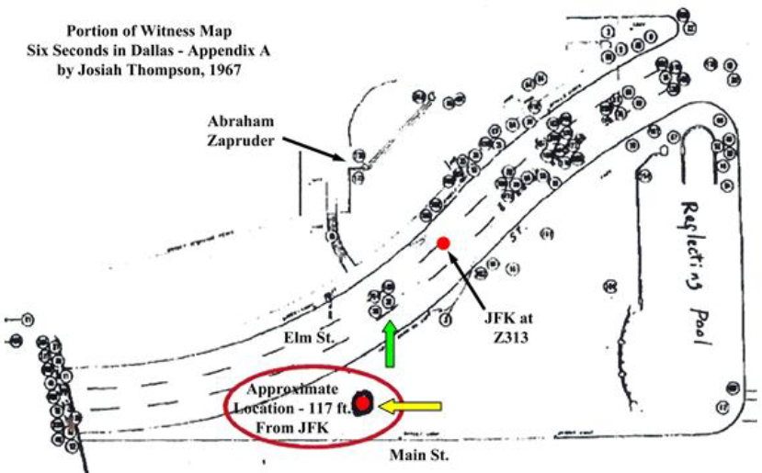
Billy Harper marked this map
Final shot in WC data
Notes:
Circa 1996 via Milicent Cranor. Billy noted his discovery site. Tim Nicholson calculated the distance—and added the solid red circles. Green arrow—final shot in WC data.

Slide 6
The Harper Fragment: Why is it important?
If HF derives from the occiput, then a frontal shot is strongly implied
And that means conspiracy

Slide 7
HF: It’s parietal (or so they claim)!
Randy Robertson, MD
Joe Riley, PhD
J. Lawrence Angel, PhD
Richard Tobias
Pat Speer
HSCA

Slide 8
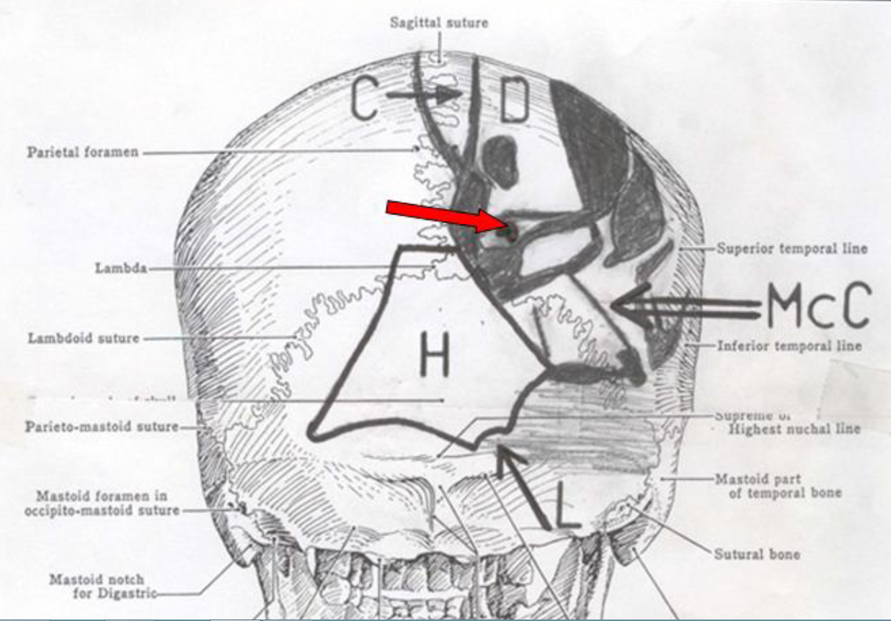
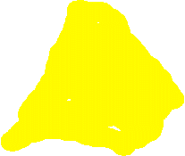
Harper (H) Site of Origin—as viewed from the posterior (per Mantik)
6.5 mm object
EOP entry site
Metallic smear on Harper Fragment
Notes:
Red arrow: “supposed” location of 6.5 mm object.

Slide 9
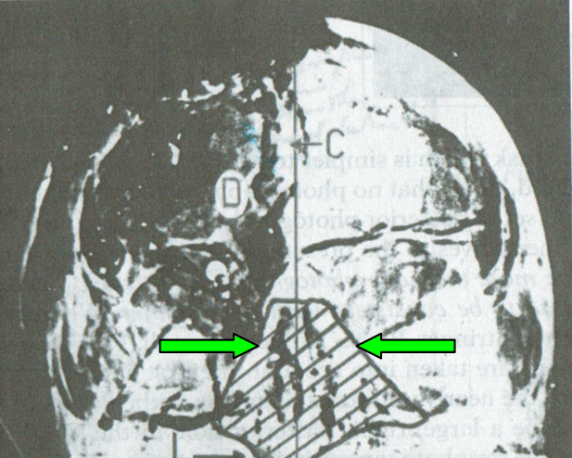
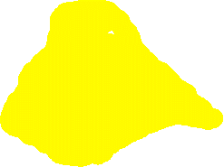
HF Site of Origin—on AP X-ray
(per Mantik).
N
No lambdoid sutures superior to tip of green arrows→ bone is missing there bilaterally
Notes:
The “tail” going into the left occiput is fairly readily visible on the actual X-ray. Chesser has also noted this bone defect. Lambdoid sutures are absent superior to green arrows.

Slide 10
Actual sentences found in patients’ hospital charts
Her lab test indicated abnormal lover function.
body X-rays

Slide 11
Serendipity Strikes
I located HF in the skull, based purely on where it fit—after an extensive radiographic reconstruction in our radiology suite, by precisely matching the bone fragments from the JFK X-rays to my model skull. No one else has done this.
It was pure serendipity that the metallic debris on HF ended up exactly where Humes placed the entry near the EOP. What are these odds?

Slide 12
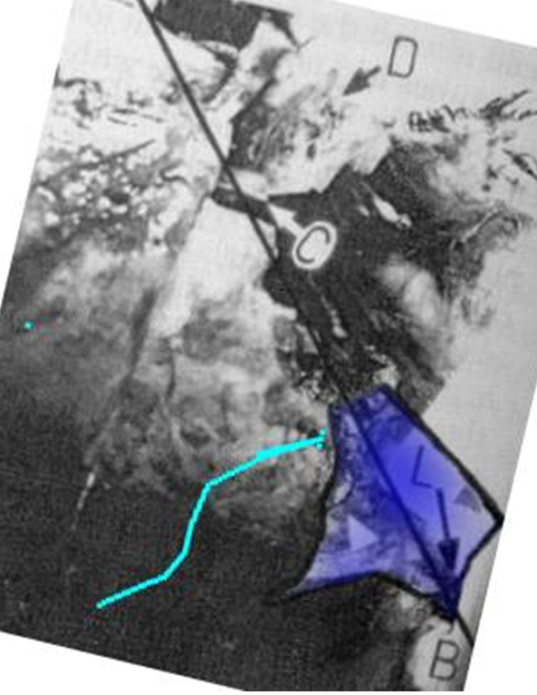
HF Site of Origin—on the mystery photo F8
(per Mantik)
The black line divides the left skull from the right skull
F8 = official autopsy nos. 17, 18, 44, 45
Notes:
The “tail” going into the left occiput is fairly readily visible on the actual X-ray. The line divides left skull from right skull. This is consistent with the X-rays. The cyan line is Paul Seaton’s misplacement of the lambdoid suture (which is not visible here)

Slide 13
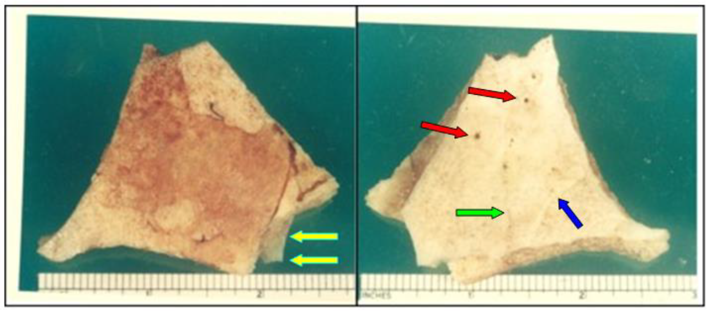
HF--as photographed in Dallas
Exterior Surface
Interior Surface
Notes:
The photographer was Cairms, according to Jack White

Slide 14
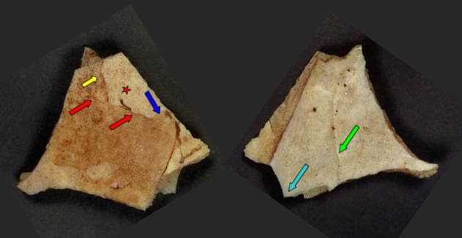
HF--as photographed by the FBI
Exterior Surface
Interior Surface
Metallic smear
Notes:
Red arrows—Angel’s “suture.” Yellow arrow—my mistaken suture. Cyan—metal debris on reverse side. Green—superior sagittal sinus. Star—pale area -->absent periosteum.

Slide 15
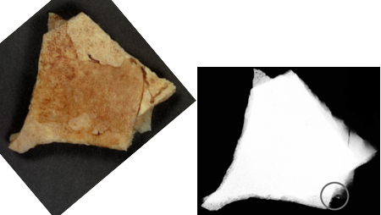

HF Photo vs. X-ray: the metallic debris matches!
HF X-rays

Slide 16
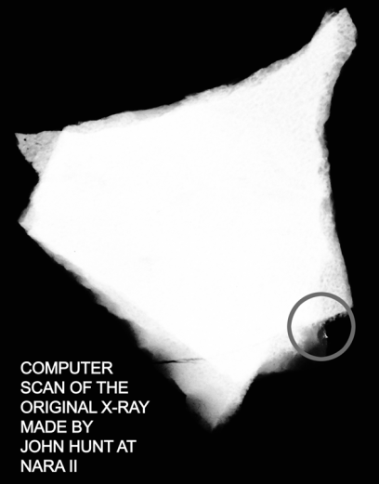
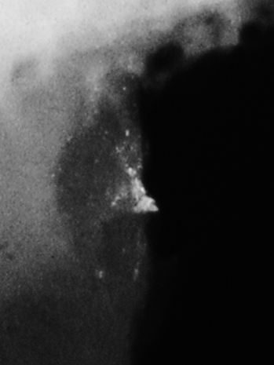

HF X-ray:
1. Notice debris on magnified view (red circle)
2. No suture line! (Dr. Angel was misled.)
Notes:
The image of the X-ray was examined at various levels of intensity—no suture line was detectable.

Slide 17
Actual sentences found in patients’ hospital charts
She has no rigors or shaking chills, but her husband states she was very hot in bed last night.
body X-rays

Slide 18
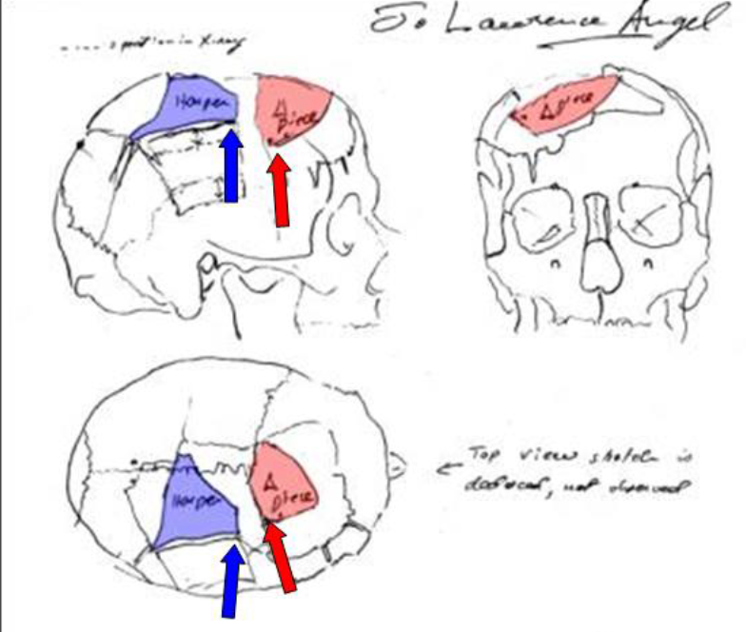
HF: as (mis)located by Angel.
There was no suture!
David W. Mantik
JFK Assassination Conference
November 17-18, 2018
Angel’s “suture” line
Notes:
Angel was not told that occipital bone was missing! Also notice metallic debris at tip of both blue arrow and red arrow!

Slide 19
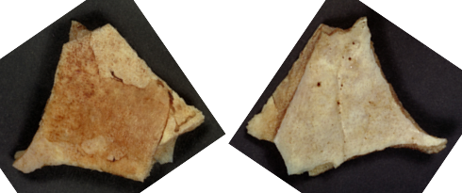

HF: Angel’s “suture” line
Exterior
Interior
Exterior Surface
Interior Surface
No suture!
Notes:
Note: no visible suture on inner surface. And no suture on the X-ray either.

Slide 20
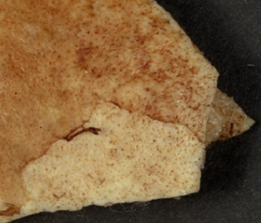
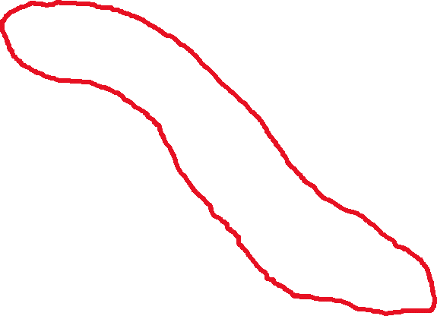
HF Close-up: Angel’s suture line is an optical illusion
Notes:
The pale area is missing periosteum. The rest of the line is merely mirage.

Slide 21
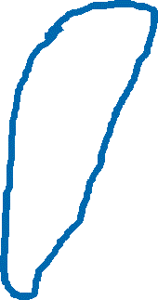
HF Close-up: I was also initially wrong about a suture line
My mistake
Notes:
I was misled, too, before I saw the FBI images—with noticeably better resolution. The site with the yellow arrow misled me.

Slide 22
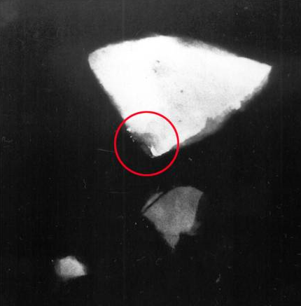
X-ray of the autopsy fragments: metal debris is circled
Notes:
Note metallic debris inside red circle.

Slide 23
HF: Two sites of metallic debris! Did Angel mean to suggest both an entry and an exit?
David W. Mantik
JFK Assassination Conference
November 17-18, 2018
Angel’s suture line
Notes:
Note: Two sites of metallic debris, but the bones don’t match here. Presumably Angel implied an exit on the triangular fragment, but did he mean an entry on HF? After all, the smear is on the outside!

Slide 24
Actual sentences found in patients’ hospital charts
She has been depressed since she began seeing me in 1993.
body X-rays

Slide 25
HF—the metallic debris is on the outside!
Exterior Surface
Interior Surface
Metallic
smear
Notes:
Red arrows—Angel’s “suture.” Yellow arrow—my mistaken suture. Cyan—metal debris on reverse side. Green—superior sagittal sinus. Star—pale area -->absent periosteum.

Slide 26
The metallic smear is on the outside
This clearly implies a bullet entry.
A parietal site for HF implies a bullet entry near the top of the head. This is not the cowlick area.
But the parietal supporters never explain how this is possible—just try asking them!
But if the bullet entered at Humes’s EOP site, then everything fits: the smear is naturally on the outside.

Slide 27
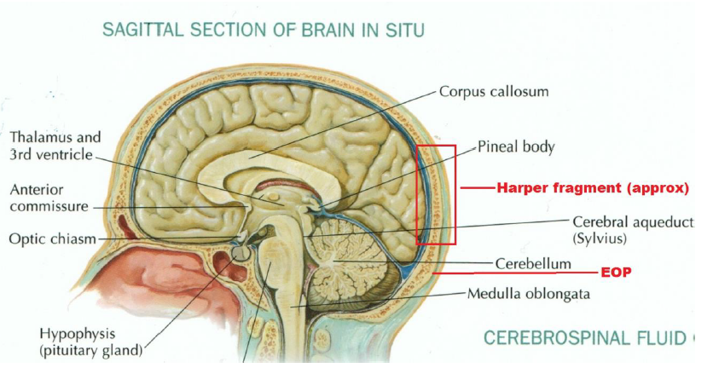
Cerebellum was visible via the HF hole
Insert Groden photo
Notes:
Nine MDs saw traumatized cerebellum, including several neurosurgeons. This is the primary reason that the posterior wound had to be elevated—by the WC and by the HSCA.

Slide 28
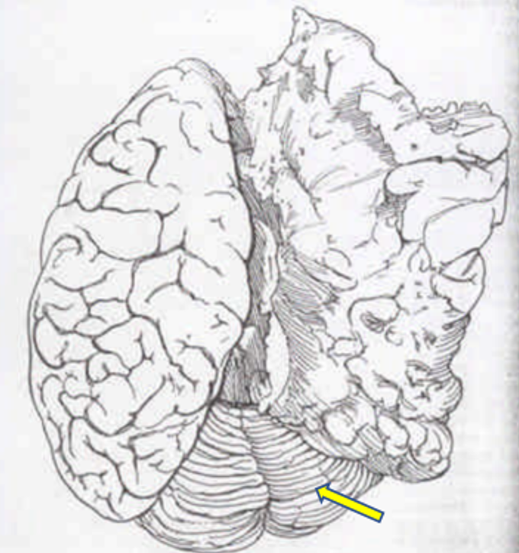
Intact Cerebellum in Brain Drawing
Cerebellum
Notes:
Yellow arrow: cerebellum

Slide 29
The dilemma faced by the HSCA
The HSCA could not admit to a traumatized cerebellum, as McClelland (and many others) recalled. That is because the “brain” photos showed an intact cerebellum.
So the entry wound absolutely had to be elevated (to the “red spot”)
And all the witnesses to the big posterior hole had to be discredited
Notes:
Nine MDs saw traumatized cerebellum, including several neurosurgeons. This is the primary reason that the posterior wound had to be elevated—by the WC and by the HSCA.

Slide 30
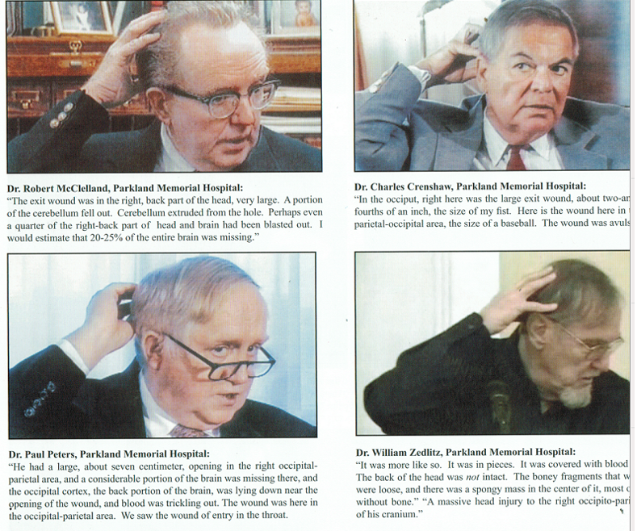
HF: clues to an occipital hole– per Groden photos.
Insert Groden photo
Notes:
Randy Robertson, MD does not accept these occipital witnesses. Nor does Don Thomas or Paul Speer, or Joe Riley—or the HSCA. Groden shows many more corroborating witnesses in ABSOLUTE PROOF.

Slide 31
John Ebersole, the autopsy radiologist: “big” occipital hole
He viewed the X-rays—so he knew where bone was missing on the X-rays!
He told me that he saw a “big” hole in the occiput
He told the HSCA (1978) that the wound was “occipital”
After a large bone fragment arrived at the autopsy, he concluded that it must have come from the occiput (so he obviously knew that occipital bone was missing)
Notes:
Actually, he was in my specialty of radiation oncology!

Slide 32
Actual sentences found in patients’ hospital charts
Rectal examination revealed a normal size thyroid.
body X-rays

Slide 33
HF: Three Dallas pathologists held HF--and perceived occipital bone
In 1977 Andy Purdy (HSCA) interviewed Dr. A. B. Cairns
Cairns recalled that the “…fragment came from an area approximately 2 ½ to 3 inches above the spine area.”
It had the markings of a
“…skull fragment from the lower occipital area, specifically: suture and inner markings where blood vessels run around the base of the skull.”
He also recalled that HF derived from an area close to an entry site.
Notes:
I personally spoke to Dr. Noteboom.

Slide 34
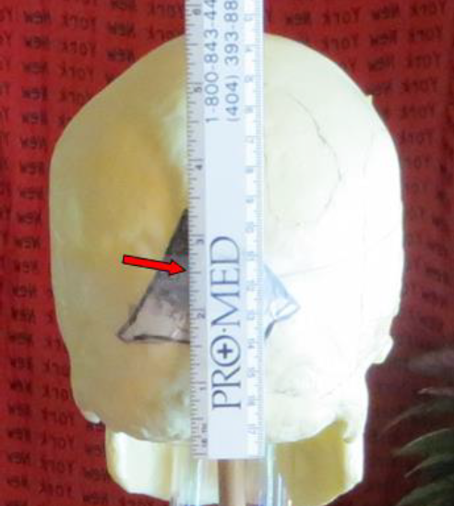
HF location per Dr. Cairns
David W. Mantik
JFK Assassination Conference
November 17-18, 2018
Notes:
Red arrow—center of HF. Ruler is in inches.

Slide 35
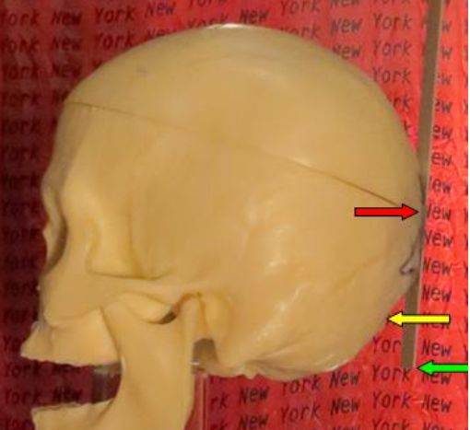
HF location per Dr. Cairns
David W. Mantik
JFK Assassination Conference
November 17-18, 2018
Notes:
Red arrow—center of HF (at about 2 ½ inches). Yellow arrow—EOP. Green arrow—base of skull.

Slide 36
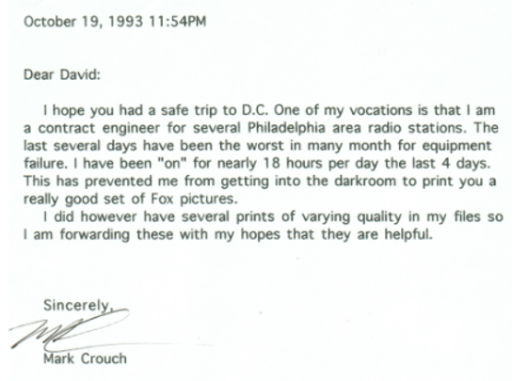
1993: Letter to me from Mark Crouch
Notes:
The history of the Fox photographs is in my e-book.

Slide 37
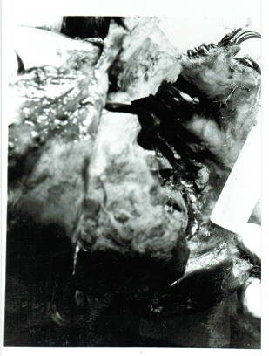

HF: Clues to an occipital hole—visible fat in F8
At NARA: Abdominal fat pads, and even a nipple protruding from the chest (on stereo views)
Robert Kirshner, forensic pathologist (ARRB):
Notes:
Dr. Chesser has made the same observation. That area is not seen in the Fox photo. Kirshner does not describe stereo viewing, which is very useful.

Slide 38
HF Site of Origin—on the mystery photo F8
(per Mantik)
Notes:
The “tail” going into the left occiput is fairly readily visible on the actual X-ray. The line divides left skull from right skull. This is consistent with the X-rays. The cyan line is Paul Seaton’s misplacement of the lambdoid suture (which is not visible here)

Slide 39
Actual sentences found in patients’ hospital charts
Both breasts are equal and reactive to light and accommodation.
body X-rays

Slide 40
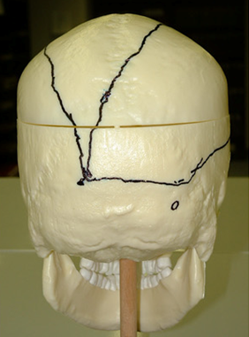
HF: Clues to an occipital hole
Boswell’s sketch
Scalp laceration
Lambdoid suture
Approx entry site
EOP
Notes:
Boswell’s sketch for the ARRB. Note EOP. So even Boswell tells us that occipital bone was missing.

Slide 41

Harper (H) Site of Origin—as viewed from the posterior
(per Mantik)
6.5 mm object
EOP
Metallic smear on HF

Slide 42
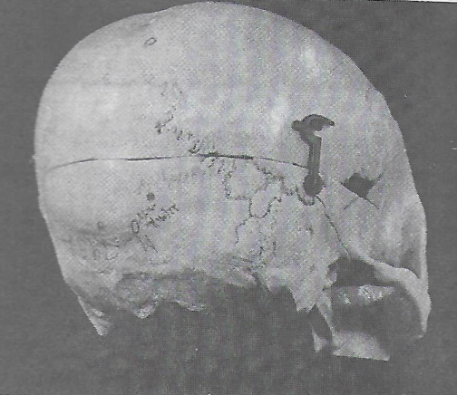

Entry site (circled)—per the pathologists for the HSCA
HSCA entry site: the “Red Spot”
Lambdoid suture
EOP
Pathologists
Notes:
Finck placed his mark independently of Humes and Boswell.

Slide 43
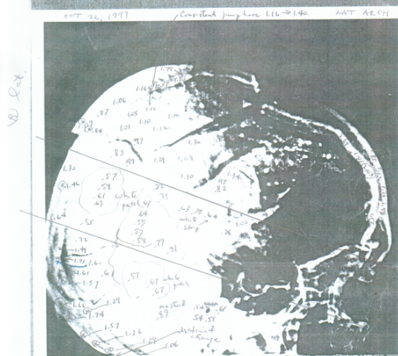
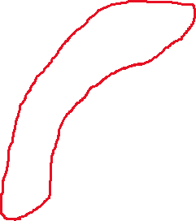
HF: OD clues to an upper occipital hole, due to missing HF
ODs along posterior skull
Notes:
These data were taken before I had located the HF in the skull! Low numbers mean more bone; higher numbers, less bone.

Slide 44
Actual sentences found in patients’ hospital charts
The patient was to have a bowel resection. However, he took a job as a stockbroker instead.
body X-rays

Slide 45
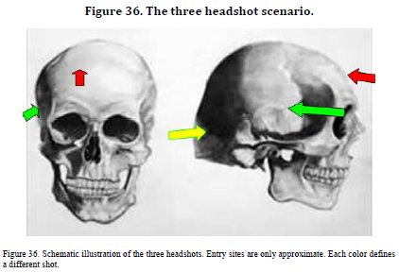
Three Headshots
Sketch of 3 Headshots
Notes:
Doug Horne first proposed this. I was rather slow to accept it.

Slide 46
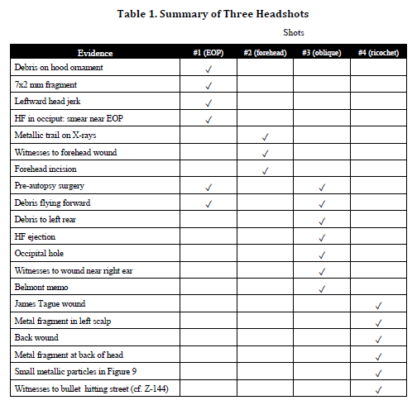
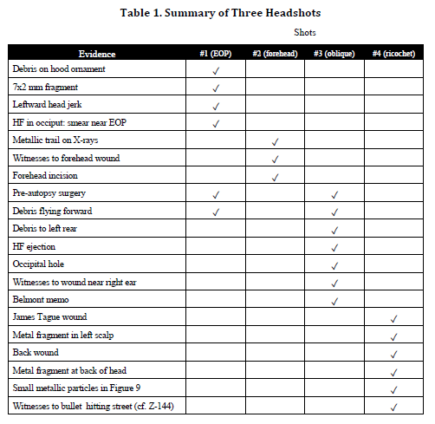

Sherry Fiester: Only one headshot!
“Current forensic research [not cited] supports a single gunshot originating in front of the President, and front is not the Grassy Knoll. All other explanations are myths….”
My Fiester review is at Kennedys & King
Just Google: “Fiester” and “Mantik”
Notes:
Table 1 from my e-book.

Slide 47
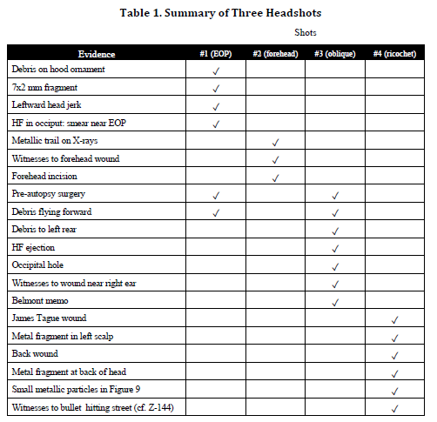
Three Headshots: Table 1 (e-book)
Notes:
Table 1 from my e-book.

Slide 48
HF Conclusion: Some of the 15 clues to the occipital origin of the Harper Fragment
Three Dallas pathologists
John Ebersole, MD
Numerous Parkland witnesses
Eight Bethesda MDs
Cerebellum seen (as traumatized)
Autopsy Report
Boswell sketch—and statement
Metallic smear was on the outside
Mystery photograph (F8)
Optical density data

Slide 49
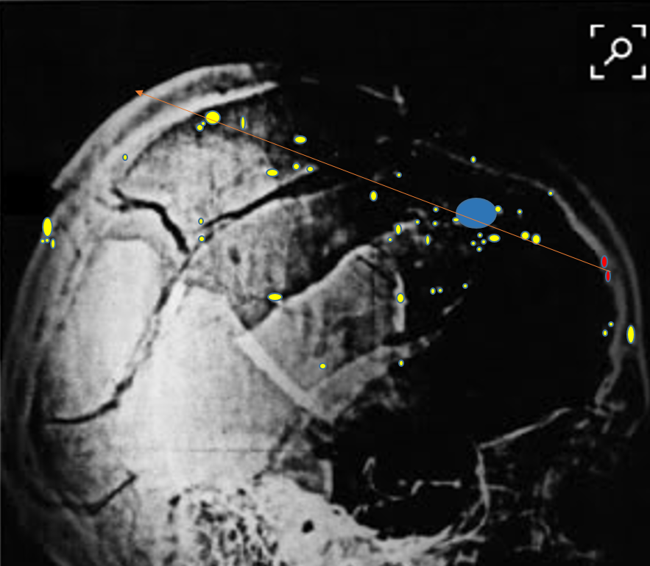
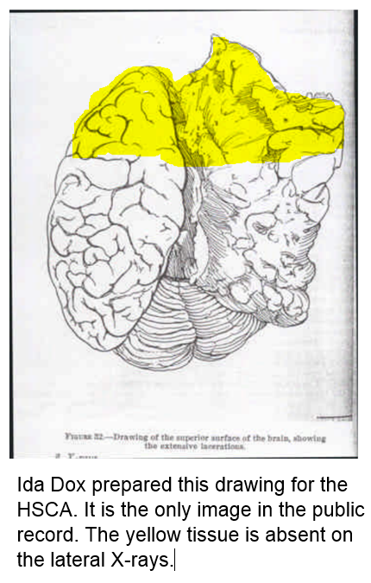
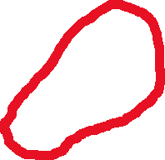
A Few More Paradoxes
Empty Skull

Slide 50
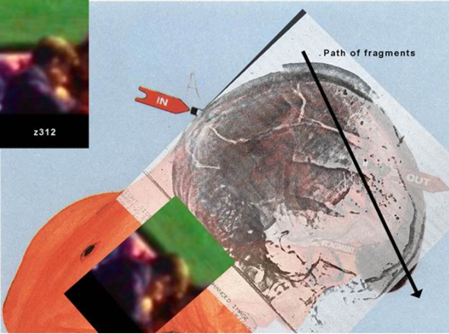
More Paradoxes
JFK lateral X-ray superimposed on Z-312, as composed by David Josephs
Notes:
Note discordance between the WC path vs the metallic fragment trail.

Slide 51
Actual sentences found in patients’ hospital charts
Patient was seen in consultation by Dr. Brooks, who felt we should sit on the abdomen. I agree.
body X-rays

Slide 52
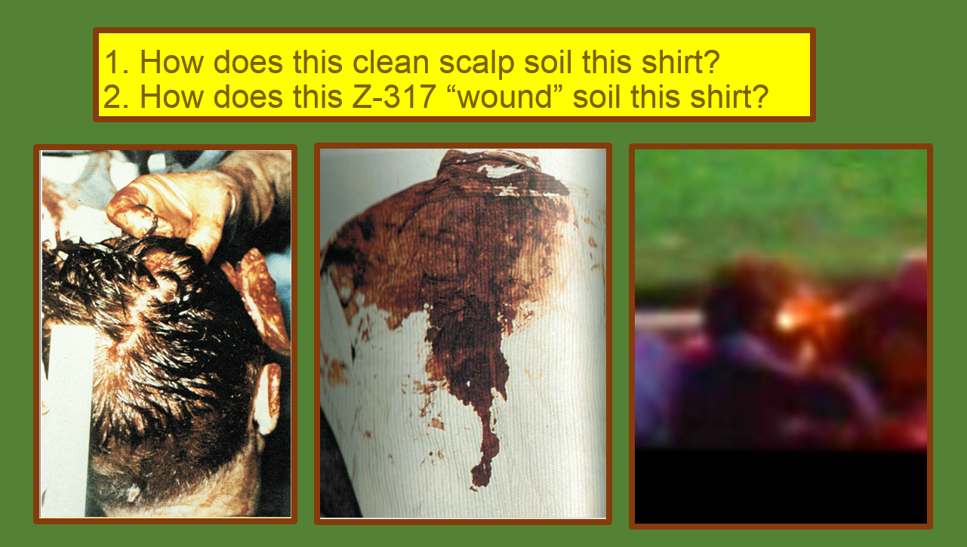
Yet More Paradoxes
Shirt vs posterior scalp
Red Spot

Slide 53
Six Mantik References
1. Twenty Conclusions after 9 Visits (2003):
https://assassinationresearch.com/v2n2/pittsburgh.pdf
2. JFK Lancer Lecture (2009—on how to alter 1963 X-rays):
http://assassinationofjfk.net/jfk-skull-x-rays-evidence-of-forgery-david-mantik/
3. THE JOHN F. KENNEDY AUTOPSY X-RAYS: THE SAGA OF THE LARGEST
“METALLIC” FRAGMENT (2015):
https://www.journals.ke-i.org/index.php/mra/article/view/177/78
4. Houston Mock Trial (2017):
https://statick2k-5f2f.kxcdn.com/images/pdf/david-mantik-houston-2017.pdf
5. JFK Assassination Paradoxes: A Primer for Beginners (2018):
http://escires.com/articles/Health-1-126.pdf
6. The Mantik Website (courtesy of Bernard Wilds in the UK):
http://themantikview.com/

