Slide 1
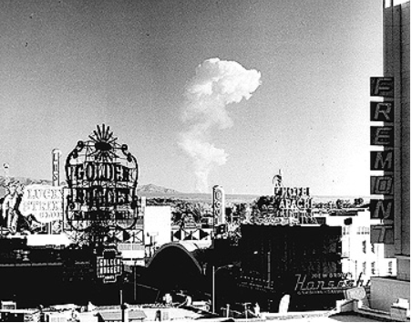
During the 1950s, radioactive clouds could be seen 100 miles from the test sites. Las Vegas, which felt the seismic effects, became a “hot” tourist destination. The last atmospheric test at the Nevada Test Site was on 17 July 1962 (the year before the JFK assassination).
Recall Dr. Chesser’s comments about the role of G. M. McDonnell (one of JFK’s consultant radiologists) in these atomic tests

Slide 2
“When the facts change, I change my opinion. What do you do, sir?”
– John Maynard Keynes –

Slide 3
The Quest for Reality in the JFK Autopsy:
A Status Report 52 Years Later
DAVID W. MANTIK
November 21, 2015
The Hotel Adolphus
Dallas, Texas

Slide 4
The JFK Autopsy Evidence:
After 52 years, is the quest over?
To begin, we must credit the pioneering work of David Lifton and Harry Livingstone, especially their witness interviews.
William Law has provided magnificent interviews with the autopsy personnel—so buy his book and DVD!
Douglas Horne’s work has been absolutely critical, in particular his “Two-Brain Hypothesis,” and his confirmation that the autopsy photographs could not be matched to the only possible candidate camera lens.
Most important of all though was Horne’s breakthrough discovery of the (illicit) activities of chief pathologist James J. Humes in the morgue before 8 PM that night.
The specific steps of the medical cover-up are now well understood; only a few details are missing.

Slide 5
JFK’s head wounds did not change between Dallas and Bethesda
In particular, a large occipital hole was seen at both sites
--eight Bethesda MDs confirmed this
--even Jenkins and McClelland agreed with one other
(My e-book: JFK’s Head Wounds—footnote 32)

Slide 6
But the autopsy report does not agree with these Parkland and Bethesda witnesses!
Autopsy sketches show a much larger defect than either McClelland or Jenkins saw
And the autopsy photos seem to show no occipital hole
Humes performed an illicit sortie before the official autopsy (enlarging the head wound in the process)
His (criminal) purpose was solely to remove bullet fragments
But he was unable to remove metal fragments (possibly mercury) from the forehead shot

Slide 7
The result was a French farce of disappearing and re-appearing metal fragments
Alan Belmont (FBI) reported a bullet behind JFK’s ear
Dennis David received metal fragments from a Secret Service man (i.e., debris from 1-2 bullets)
3. Tom Robinson saw multiple metal fragments being removed from JFK’s brain
4. James Jenkins saw a plastic bag with pieces of metal (and bone fragments) placed next to JFK’s head

Slide 8
So these questions arise…
When were these fragments removed?
Who carried them out of the morgue?
Who showed them to Dennis David?
Who brought them back into the morgue?
5. Why does the official autopsy report not cite them?
6. Where did they go after the autopsy ended?
7. What happened to the memo that Dennis David typed?
The stage manager (per Horne): Roy Kellerman

Slide 9
Humes’s pre-autopsy escapade explains much…
Such as: Why the wound had changed (a lot) from Dallas
The existence of the Belmont FBI memo
Why Tom Robinson saw a forehead wound—and also watched as multiple bullet fragments were removed.
Why no forehead wound was reported (it had been incised—as Boswell actually recalled!)
Why multiple sequences of skull X-rays were taken (i.e., so that Humes had time intervals to confirm that the offending fragments were gone)
Why Sibert and O’Neill missed Humes’s excellent adventure (they had been excluded from the morgue)
It is also consistent with Clarence Israel’s recollection (i.e., a morgue MD had mutilated 3 head wounds)

Slide 10
--Thinking Fast and Slow (2011) by Daniel Kahneman–quotes in red below
(Nobel Prize in Economic Sciences for his seminal work in psychology)
1. The shots that killed President Kennedy and wounded Governor Connally were fired from the sixth floor window.
A reliable way to make people believe in falsehoods is frequent repetition, because familiarity is not easily distinguished from truth.
2. President Kennedy was struck by a bullet that entered the back of his neck and exited through his neck. (BTW, R. Robertson and D. Thomas support a variant of the SBT.)
It is the consistency of the information that matters for a good story, not its completeness. Indeed, you will often find that knowing little makes it easier to fit everything you know into a coherent pattern.
3. The weight of the evidence indicates that three shots were fired.
The confidence we have in our beliefs depends mostly on the quality of the story we can tell, even if we see very little. We often fail to allow for the possibility that critical evidence is missing – what we see is all there is.
4. The shots that killed President Kennedy and wounded Governor Connally were fired by Lee Harvey Oswald.
They didn't want more information; after all, it might spoil their story.

Slide 11
Believers in a Variant of the Single Bullet Theory (SBT)
Don Thomas: “The single bullet theory is consistent with the evidence, though the magic bullet theory is not.”—Hear No Evil, p. 713.
[Per DT: This bullet exited JFK’s throat and then entered JBC.]
Randy Robertson: “…the X-rays and supportive testimony suggest that the bullet that entered the President’s back exited from the front of his neck….”
--http://www.manuscriptservice.com/DPQ/robert~1.htm
For a critique of the SBT, see my e-book, footnote 100.

Slide 12
So much for the appetizers; here is the “Main Course.”
Note that this lecture is merely a summary, not a detailed argument.
The John F. Kennedy X-rays: The Saga of the Largest “Metallic” Fragment
(my peer-reviewed article)
2. My new e-book: JFK’s Head Wounds (and Harper, too)
3. While writing the e-book:
more inescapable (and flagrant) Z-film observations recurred
4. The JFK X-Rays: New OD paradoxes (with Dr. Chesser)

Slide 13
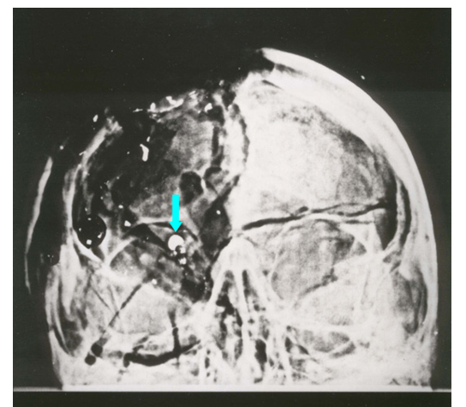
A Peer-Reviewed Article--
The JFK X-rays: The Saga of the Largest “Metallic” Fragment

Slide 14
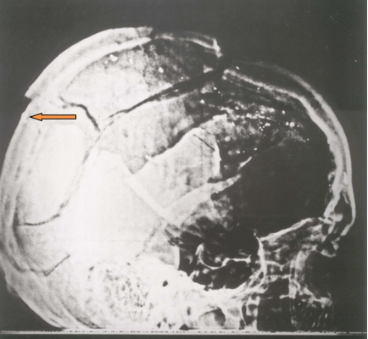
A Peer-Reviewed Article–
The JFK X-rays: The Saga of the Largest “Metallic” Fragment

Slide 15


JFK’s Dental X-rays

Slide 16
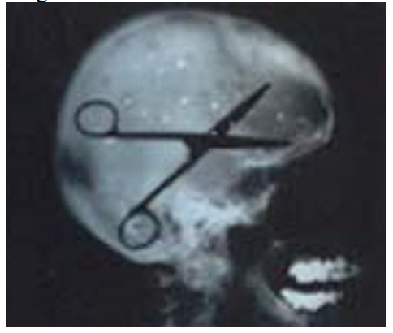
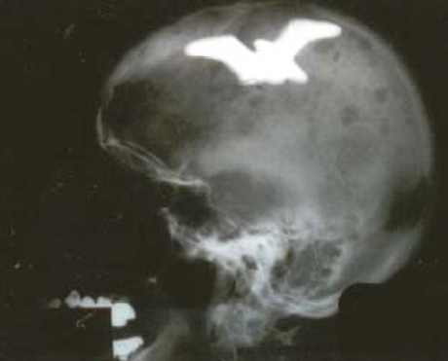
A malpractice case?—No!

Slide 17
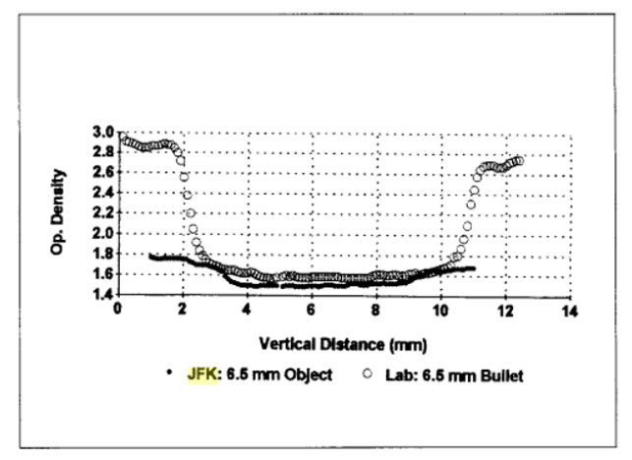
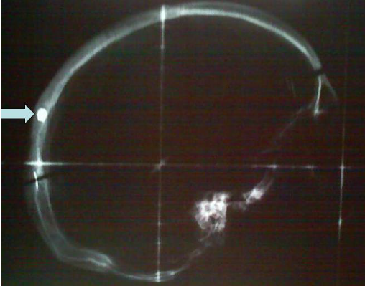
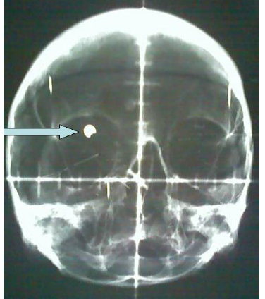
A real bullet cross-section: data from the two lateral X-rays

Slide 18
The Harper Fragment (HF)
Conclusion: HF was occipital, not parietal

Slide 19
Joe Riley’s claim: HF is parietal--because occipital bone does not show grooves or foramina
Anatomy textbooks from 1906 to 2006 decisively refute Riley--many images are shown in my e-book.
The occipital bone can show grooves and foramina.

Slide 20
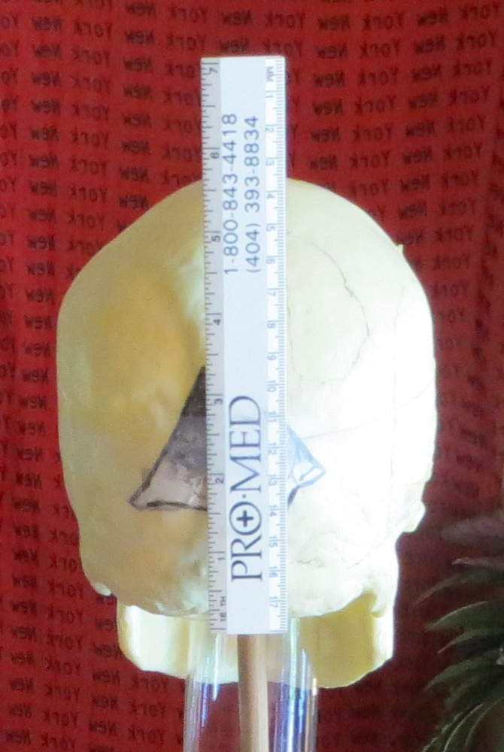
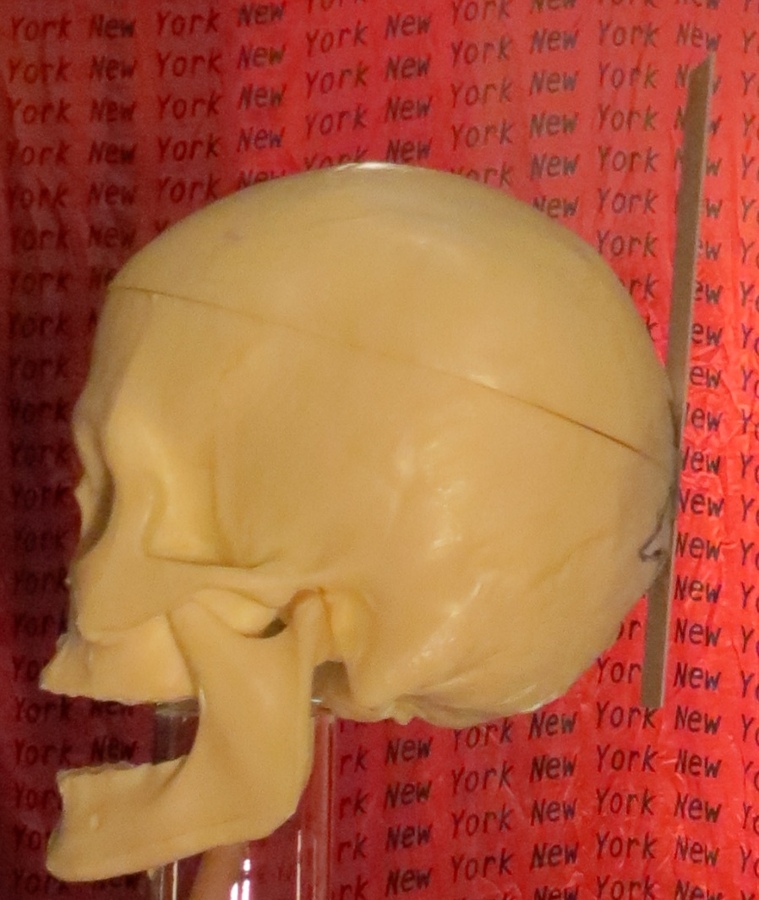
HF as located by Dr. Cairns—
2 ½ - 3 inches above the spine

Slide 21
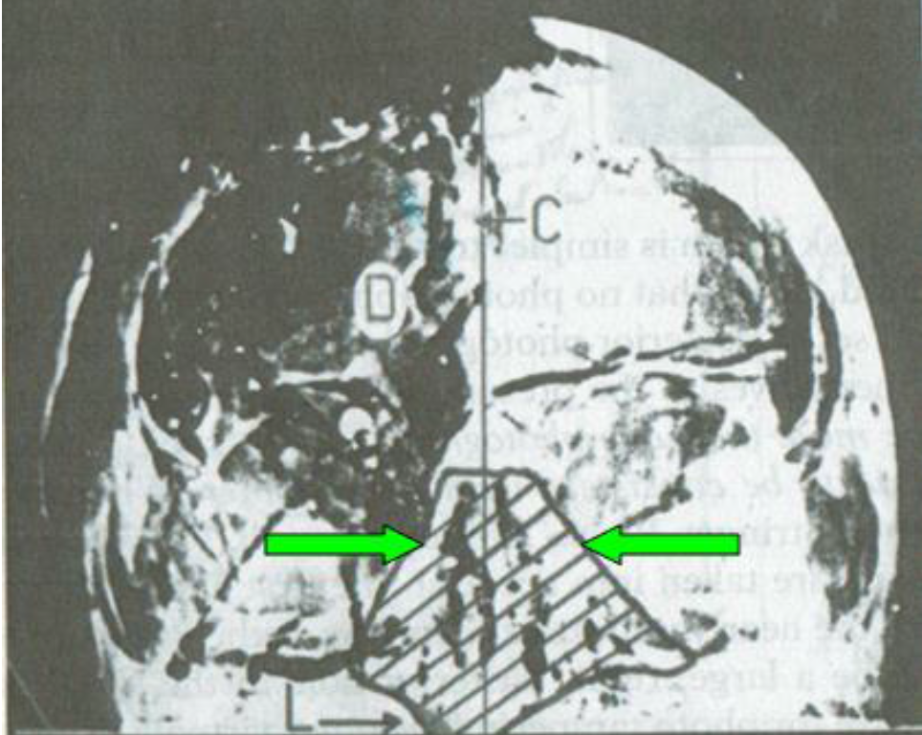
Missing lambdoid sutures
(superior to the green arrows)
HF
Lambdoid suture
Lambdoid suture

Slide 22
Original autopsy catalog description of F8
#17-18. 4x5” negative depicting missile wound over entrance in posterior skull, following reflection of the scalp (2 contact and 2 8x10” prints)

Slide 23
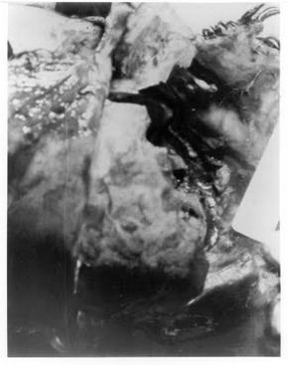
Fat pads are seen in photo F8— confirmed by Kirschner for the ARRB (and now also by Dr. Chesser)
Fat pads are here—easily visible with a stereo viewer.

Slide 24
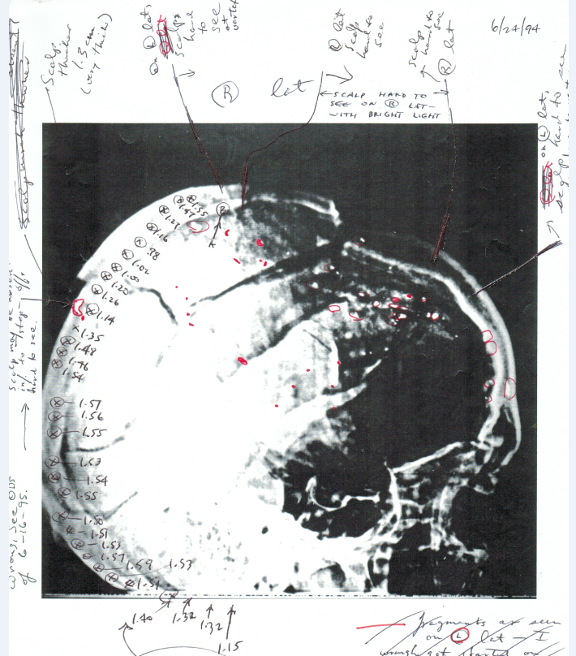
Discontinuity in ODs at the rear (where HF was missing)
OD discontinuity

Slide 25
15 Clues: HF was occipital
Cerebellum was visible via the HF defect
(as reported by nine Parkland MDs)

Slide 26
Three Headshots
(Horne and I agree—so does the data!)
Three Headshots:
--Forehead
--Right ear
--Occiput

Slide 27
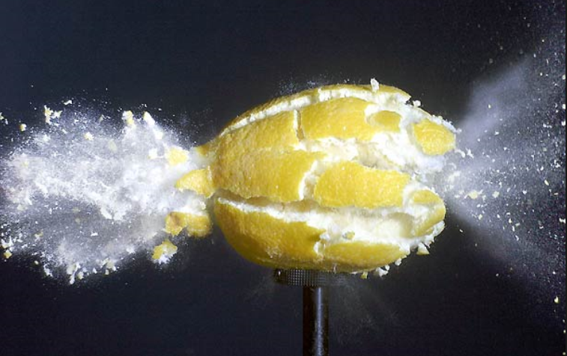
Spatter patterns— note the bipolar exit plumes!
But why don’t we see both in Z-313?
Exploding lemon (Fig. 85)

Slide 28
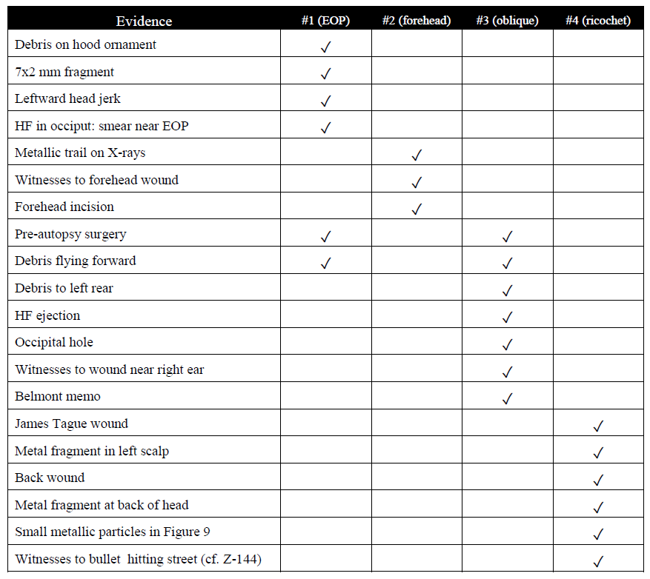
JFK’s Head Wounds
Table 1

Slide 29
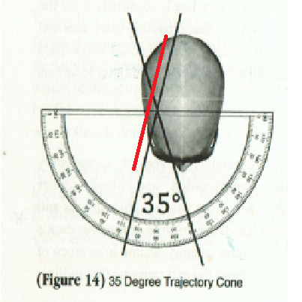
Enemy of the Truth:
Why exclude the red trajectory?
The oblique shot
Per EoT: Trajectories can only occur within this restricted angle!

Slide 30
Quentin Schwinn saw an autopsy photo like this…
Schwinn: Fig 37

Slide 31
The Medical Quest: Conclusions
The “JFK Medical Quest” is nearly over—we are on the 5 yard line and the clock is on our side.
Daniel Kahnenan (Nobel Laureate) was right—for public opinion,
a good story is all that matters. Oliver Stone knew that.
3.JFK’s Head Wounds were not altered before Bethesda.
4. Humes (illicitly) removed bullet fragments (from 1 or 2 bullets).
5. Someone (most likely Ebersole) doctored the X-rays.
6. HF derives from the occiput—expelled by an oblique shot (entry near the right ear).
7. Three headshots in all—entries at right forehead, right ear, and EOP.
8. The forehead shot is required to explain the bullet trail on the X-rays—the oblique shot cannot explain that trail. Furthermore, the forehead shot cannot expel HF.
9. It was sheer madness for the HSCA to elevate the EOP shot by 4 inches.
10. Don’t trust the government.
Most importantly: We now know how and why the medical record lies to us.

Slide 32
Inexplicable (and flagrant) violations of Z-film authenticity (re)surfaced while writing the e-book
Recollections of the motorcycle men: a bone fragment was tossed into the limo after a kid gave it to a SS agent (see Preface)
2. A final shot occurred well after Z-313—SS photos, Newsweek illustration, surveyors’ maps, Speer (footnote 71), recollections of Clint Hill (footnote 213), recollections of Mary Moorman and many others (footnote 75)
3. The head was hit at Z-328: Josiah Thompson’s pending book, the graph of JFK’s head (Six Seconds in Dallas), Groden’s gush of debris (footnote 225)
4. JFK’s head went forward: Dan Rather, Cartha DeLoach, James Altgens (footnote 222)
5. JFK was upright when hit by a headshot (James Altgens)
6. Richard Stolley—could not recall head snap (footnote 222)
7. JFK’s hand went to his head: Gayle Newman, Manchester, Jackie, Rather
8. The halo at Z-313 idoes not look authentic (Dino Brugioni)
9. “Slow-moving” bone fragments (Jackie and Manchester, footnote 84)
10. Milicent Cranor’s Z-film (and other viewers, too—footnote 184)

Slide 33
So we have yet another paradox
Autopsy photographs were altered
Autopsy X-rays were altered
Oswald evidence items were altered
Witness testimonies were altered
Government agencies covered up
(e.g., even during the ARRB, the SS destroyed JFK trip records to Dallas)
So, why would the Z-film remain an immaculate* conception?
*There is even a high priest of Z-film—my good (but misguided) friend, Josiah Thompson

Slide 34
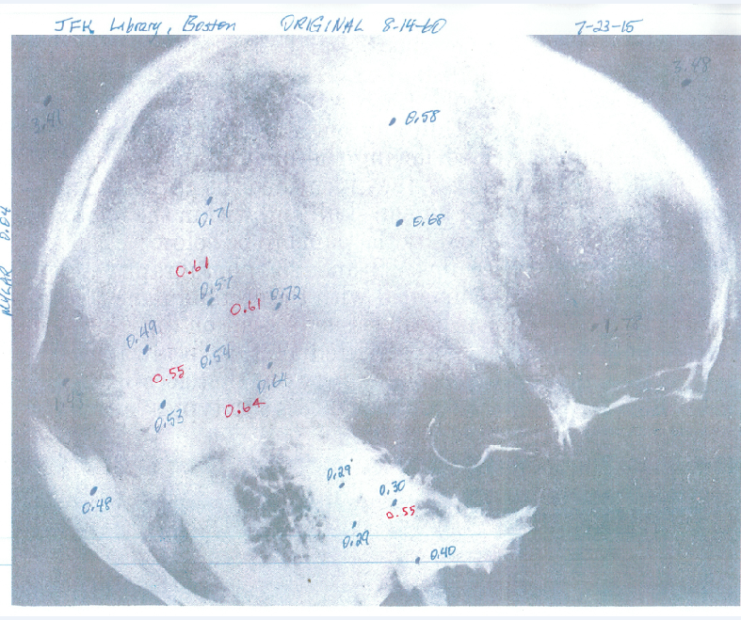
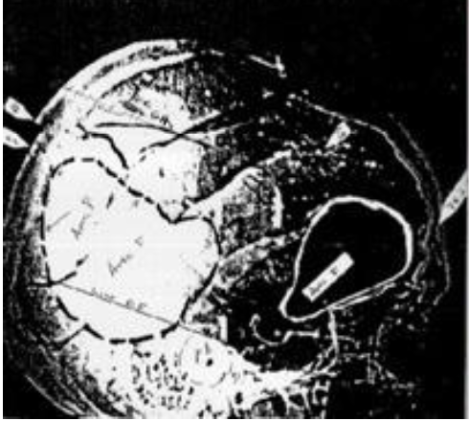
Dr. Michael Chesser causes trouble: the “White Patch” redux
—red data (DM) vs. blue data (MC)—
Date
White Patch
Petrous bone

Slide 35
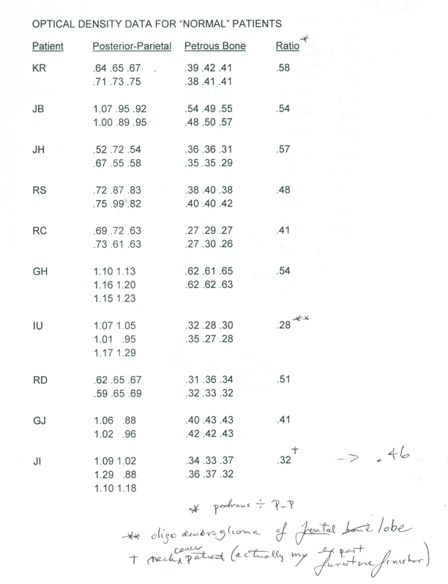
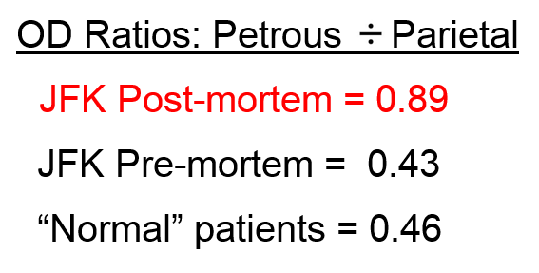
OD ratios: Petrous vs. Parietal-- the White Patch is confirmed
“Science is measurement.”—
physicist Lord Kelvin

Slide 36
But it is even worse than that!
--Given the White Patch, there is no corresponding dense object anywhere on the frontal (AP) X-ray!
--In the real world, there must be one.*
--First public account: NYC press conference (Nov 10, 1993)
"Such an extremely dense object should have been as visible as a T. rex in downtown Manhattan at noon.”
—Assassination Science (1998), pp. 153-158

Slide 37
Kudos for Serious First Aide
Gary Aguilar, Walt Brown, Milicent Cranor, Kathy Evans, Douglas Horne, John Hunt, James Jenkins, Tim Nicholson, Randy Robertson, Albert Rossi, and Jeffrey Sundberg

Slide 38
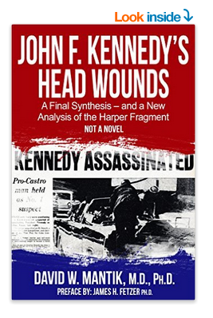
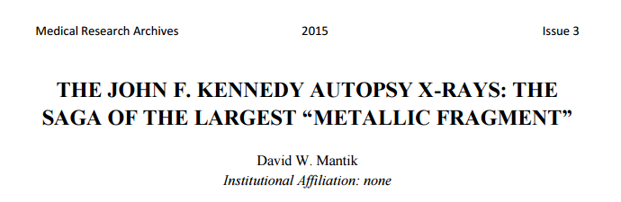
References
e-book (on amazon): http://www.amazon.com/s/ref=nb_sb_noss_1?url=search-alias%3Dstripbooks&field-keywords=jfk%27s+head+wounds
2. Peer-reviewed article: http://www.journals.ke-i.org/index.php/mra/article/view/177/78

