Slide 2
The Gulag Archipelago (1973)—Aleksandr Solzhenitsyn
No, don’t dig up the past! Dwell on the past and you will lose an eye.
But forget the past—and you will lose two eyes.

Slide 3
My colleagues (and occasional critics)
Cyril Wecht
Douglas Horne
Gary Aguilar
Mike Chesser
Jim DiEugenio
Sydney Wilkinson
Thom Whitehead
Josiah Thompson
Roy Schaeffer
Walt Brown
Mildred Cranor
Jeff Sundberg
Greg Burnham
Edward DeFiore
Michael O’Dell
Jim Fetzer
Martin Shackelford
John Armstrong
Doug Weldon (RIP)

Slide 4
Goals for this Lecture
Review prior hapless official investigations
Locate the JFK limousine on November 25, 1963
Summarize the medical evidence

Slide 5
JFK Assassination Paradoxes: Essays and Reviews
Notes:
This full color, 500+ pages with 1000+ footnotes. On Amazon, the Kindle version sells for less than $10. The hardcover price has just been marked down.

Slide 6
The Scope of the 1963 Taxpayer-Supported Cover-up (Based on 30 years of research) David W. Mantik Dallas 20, 2022
The Windshield is a Paradigm
“There is no greater obstacle to learning than to be a prisoner of totally invalid but dogmatic theories.”
—Peter Drucker

Slide 7
Warren Commission (WC) Supporters:
At one time or another, doubters of the lone gunman theory “have accused 42 groups, 82 assassins and 214 people of being involved in the assassination.”
--Vincent Bugliosi (RIP)

Slide 8
By comparison, William of Ockham should be delighted with my Simple Proposal
The new elite in 1963 had to destroy all evidence of conspiracy.

Slide 9
The JFK Assassination: Just one primary motive in the cover-up
At all costs, the new elite had to protect themselves and their futures. Therefore, all potential evidence of conspiracy had to be destroyed. The disappearing limousine windshield is just one more example.

Slide 10
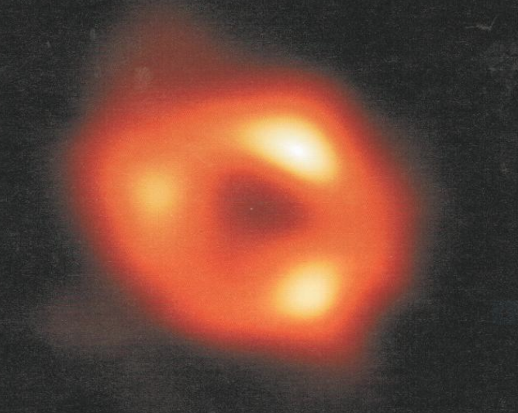
A Related Footnote: the Media, aka The Black Hole
Notes:
This first image of the Black Hole at the center of our own galaxy reminds me of the current Black Hole in the Media—about the JFK assassination.

Slide 11
“The Warren Commission Report: Conspiracy Theories Addressed on the Assassination of President John F. Kennedy” —Samuel Vega, April 11, 2020
Notes:
This prize-winning essay relies on the absurd 2013 essay of Jacob Cohen.

Slide 12
The Blackest of the Black: Jacob Cohen
Jacob Cohen, “Will We Never Be Free of the Kennedy Assassination?”
Commentary, December 2013
(accessed: November 9, 2022)
Cohen cited neutron activation analysis!
Even worse, Samuel Vega—the prize-winning author—failed to notice Cohen’s ignorance!

Slide 13
MANTIK: Will we never be free from the incompetence (and illiteracy) of WC supporters?
Jacob (writing in 2013) had forgotten to read this 2007 article, which showed the futility of NAA:
Clifford Spiegelman et al, ”Chemical and forensic analysis of JFK assassination bullet lots: Is a second shooter possible?”
Annals of Applied Statistics, May 2007. http://www.imstat.org/aoas/next_issue.html
He also missed this decisive article:
“Review of Reclaiming History” by Gary L. Aguilar, 21 Dec 2007
Essay - Review of Reclaiming History (maryferrell.org)

Slide 14
But what does Cohen really believe? History Will Not Absolve Us (1996)—E. Martin Shotz
“Fred, I told him that you had accused him of being a CIA front – and he did not deny it!”
Cohen said, ‘The truth is too terrible.’ The American people would never be able to understand it.”

Slide 15
But Cohen’s collaboration with the CIA should not surprise us
“You could get a journalist cheaper than a call girl, for a couple hundred dollars a month.”
--CIA operative, discussing the availability and prices of journalists willing to peddle CIA propaganda pieces and cover stories
Katherine the Great, Katherine Graham and Her Washington Post Empire by Deborah Davis

Slide 16
Here is the problem
"But nobody reads. Don't believe people read in this country. There will be a few professors that will read the record…. The public will read very little."
--Allen Dulles

Slide 17
From: Martin Shackelford To: 'DAVID W MANTIK' Tue, Nov 8, 2022, at 10:47 PM
Martin: “This was reportedly said at a Warren Commission meeting of July 9, 1964 (but there is no executive session with that date). It has also been attributed to a September 6 Warren Commission internal memo (which I haven't seen). I saw it in a group of quotes in the book Encyclopedia of the JFK Assassination by Michael Benson.”

Slide 18
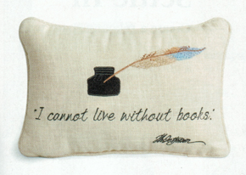
Dulles was right!
My cousin (October 2022): “We don’t read.”
Jacob Cohen does not read.
Samuel Vega does not read.
I vote for Jefferson.

Slide 19
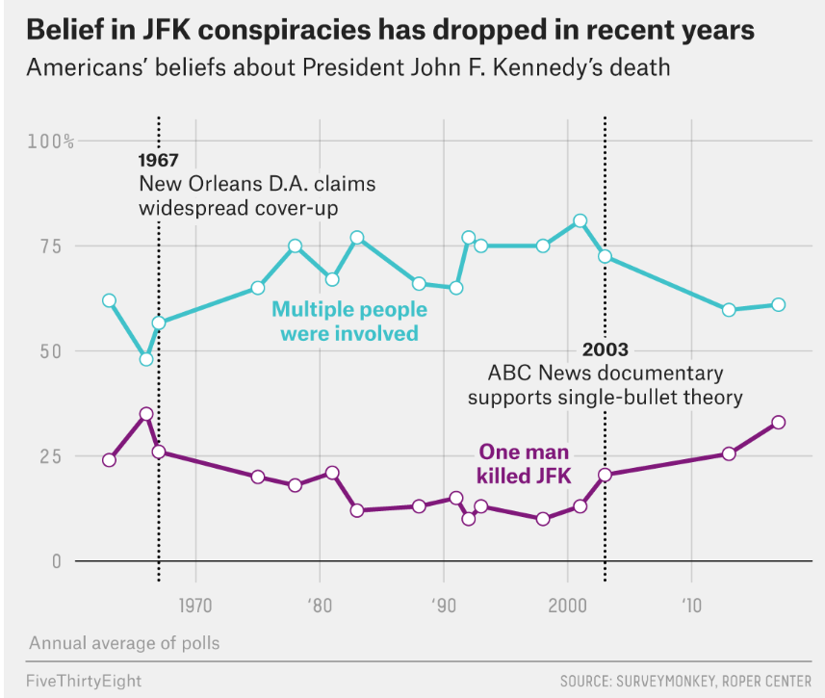
The Media (and the CIA)—are Winning
Most People Believe In JFK Conspiracy Theories | FiveThirtyEight

Slide 20
Notes:
Note the arrow in November 1963.

Slide 21
The value of a higher education
42% of Americans with a college degree believe Oswald acted alone.
Only 29% with less than a college degree believe Oswald acted alone.
Over 10 years, during my journeys around the USA, I have yet to find one WC supporter (among my typical 60+ year-old patients).

Slide 22
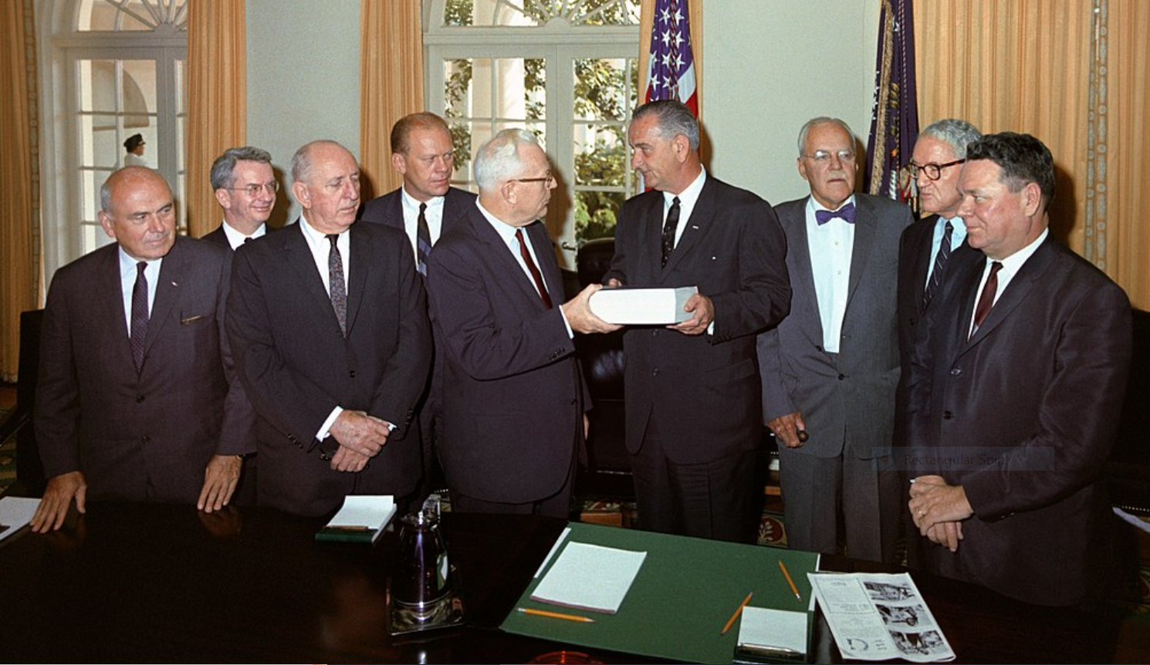
What did the Warren Report admit about conspiracy?
Notes:
MASTERS OF THE UNIVERSE (1964): McCloy, J. Lee Rankin (General Counsel—circled), Russell, Ford, Warren, LBJ, Dulles, Cooper, Boggs

Slide 23
The Eternal Wisdom of Earl Warren
Truth is our only client.* [DM: Perhaps it was really the CIA?]
We may not know the whole story in our lifetime.
…an apostle of peace has been snatched from our midst by the bullet of an assassin. What moved some misguided wretch [DM: singular] to do this horrible deed may never be known to us….**
*RICHARD M.MOSK: Warren Commission: 'Truth is our only client' (tulsaworld.com)
**Capitol rotunda eulogy (11-24-1963)

Slide 24
Bible Believers at CIA
“And Ye Shall Know the Truth and the Truth Shall Make You Free” – John 8:32.
Dulles, the son of a Presbyterian minister, felt strongly that a Bible verse needed to guide the work of his officers.
On learning of the role of Joannides with the HSCA, John Tunheim remarked to Jeff Morley:
“[This] shows that the CIA was not interested in the truth….”
MANTIK: Did Dulles just forget to read his own motto?

Slide 25
What did the Warren Report admit about conspiracy?
Bugliosi: “Perhaps they should have considered conspiracy more than they did.”
But they decided to omit this:
One very long document (June 1964) was titled:
“Oswald’s Foreign Activities: Summary of Evidence Which Might Be Said to Show That There Was Foreign Involvement in the Assassination of President Kennedy.”

Slide 26
So, what might have given the conspiracy away? Let’s critique the WC.
For starters:
The WC should have asked Allen Dulles why he failed to tell his colleagues about the Castro assassination plots.
Witnesses should have been allowed to review their (often deliberately altered) testimony.
Someone might have investigated 544 Camp St.
CIA might have explained why Oswald was a “witting participant.”*
* Pete Bagley to Malcolm Blunt (my book, p. 233)

Slide 27
So, what might have given the conspiracy away? Let’s critique the WC.
Furthermore:
5. The WC should have hired their own investigators, rather than genuflecting to the FBI.
6. They might have examined the autopsy photographs and X-rays.
7. They should have asked Jim Angleton why J. Edgar Hoover had sent him a memo on Oswald in early November 1963.
8. They could have asked Jane Roman why the CIA had a “keen interest” in Oswald.*
* WHAT JANE ROMAN SAID (history-matters.com)

Slide 28
So, what might have given the conspiracy away? Maybe they should just have asked LBJ.
“The President [LBJ] felt that the CIA had something to do with this plot.”
--White House aide Marvin Watson (McKnight, p. 449)

Slide 29
“The President directed the Commission to evaluate all the facts….” --Warren Report, ix.
So, is that what they did?

Slide 30
So, what might have given the conspiracy away? These chapters are all missing in the WR.
Assassination planning documents
Travel schedules and diaries of participants
Witnesses with foreknowledge
Oswald items, e.g., the Minox camera
Photographs of the motorcade
Dealey Plaza witnesses
Photographs of the limousine (in Dallas & DC)
Parkland medical personnel
Bethesda autopsy para-professionals
Bethesda physicians
Three autopsy pathologists and one radiologist
Autopsy report
Autopsy photographs
Autopsy X-rays
Participants in the cover-up (e.g., SS & FBI)

Slide 31
So, what might have given the conspiracy away?
Assassination planning documents
Three official government investigations failed.
Unless the CIA is totally incompetent, I expect that more released documents will help very little.
The current release deadline is December 15, 2022.

Slide 32
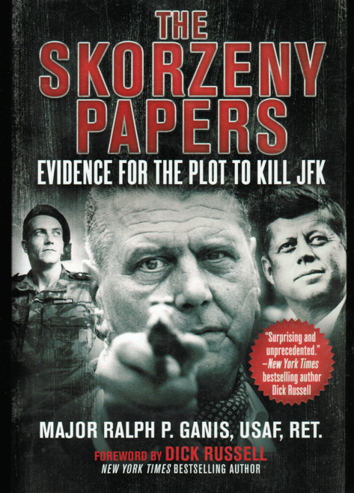
So, what might have given the conspiracy away?
2. Travel schedules and diaries of participants
Ralph Ganis has published The Skorzeny Papers: Evidence for the Plot to Kill JFK
Coup in Dallas by H. P. Albarelli provides meeting sites and dates for potential conspirators.
Travel records for William King Harvey during the summer of 1963 are still unavailable!

Slide 33
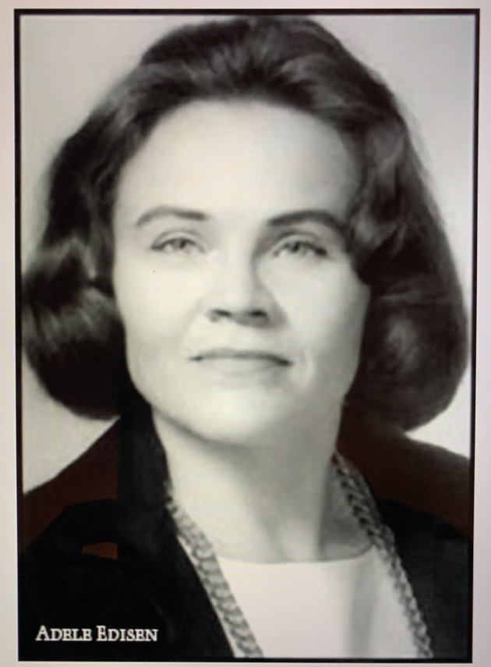
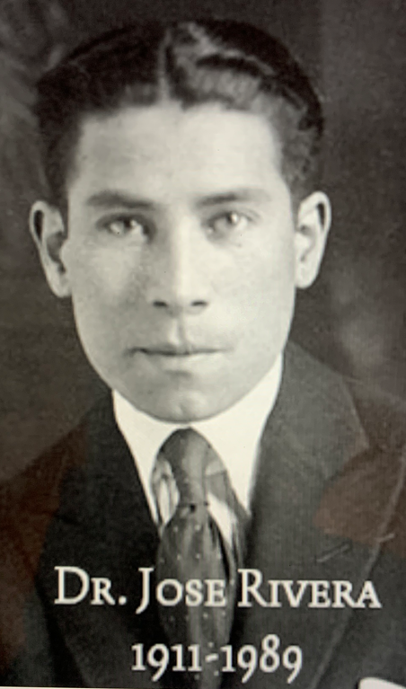
So, what might have given the conspiracy away?
3. Witnesses with foreknowledge
In 1994, Adele Edisen testified before the ARRB.
She had a PhD in physiology from the U. of Chicago, and her research was supported by the NIH.
April 23, 1963, Raleigh Hotel, DC.
Jose Rivera asked her if she knew John Abt.
Rivera: “Write down this name: Lee Harvey Oswald. Tell him to kill the chief.”
Edisen: “He said if I went anywhere, the FBI or anyone else, I would be very, very sorry.”
A Secret Order: Investigating the High Strangeness and Synchronicity in the JFK Assassination
--H.P. Albarelli (based on 11 interviews with Adele)

Slide 34
So, what might have given the conspiracy away?
4. Oswald items, e.g., the Minox camera
November 26, 1963, joint FBI/DPD inventory: the Minox camera is Item #375.
Soon at FBI headquarters, Vincent Drain and Warren DeBruey: Item #375 is now a light meter.
But Captain Fritz (DPD) refused to change his inventory to a light meter.
January 31, 1964. FBI agent Bardwell Odum allegedly obtained a Minox II camera (serial no. 27259) from Michael Paine.
The FBI then announced that the camera belonged to Paine—but not to Oswald. [But God only knows what happened to the Minox light meter!]

Slide 35
So, what might have given the conspiracy away?
4. The Minox camera (continued)
Today, NARA has a Minox III camera--but no light meter! It was supposedly found in Ruth Paine’s garage. But the camera does not work—and cannot even be opened (John Armstrong tried—but failed), so no one knows the serial number!
The Minox Corporation claims that Minox III cameras had serial nos. 31275 - 58499. But Michael Paine’s camera (a Minox II) had serial no. 27259, so what does NARA have?
--John Armstrong provided this summary.
Also see: (484) Hemming: The Minox Camera - YouTube

Slide 37
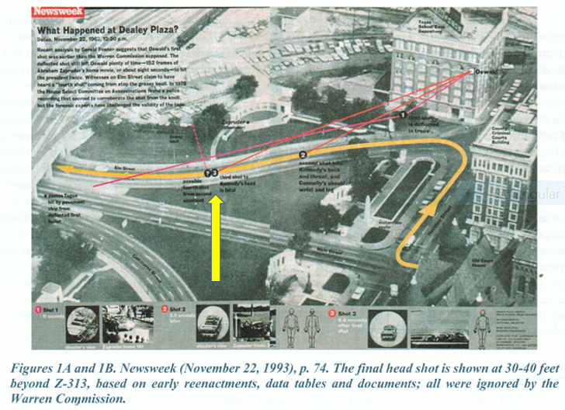
So, what might have given the conspiracy away?
5. Dealey Plaza Maps—a Final Shot well after Z-313
Notes:
Note the yellow arrow.

Slide 38
So, what might have given the conspiracy away?
6. Dealey Plaza witnesses
The bizarre fact is that (virtually) no one reported a head snap. (Some did, but usually only after watching the Z-film.)
According to Vince Palamara, 50+ witnesses reported that the limousine stopped (or almost did).
Many witnesses reported shots after the so-called headshot at Z-313. (Josiah Thompson concurs.)

Slide 39
So, what might have given the conspiracy away?
7. Photographs of the limousine in Dealey Plaza
Officially, only one headshot occurred.
The Single Bullet Theory accounts for one more shot.
And one shot missed.
So, which shot caused the windshield damage?
Official Answer: the Headshot.
BUT: The windshield is already damaged at Z-230!

Slide 40
So, what might have given the conspiracy away?

Slide 41
So, what might have given the conspiracy away?
7. Photographs of the limousine in Dealey Plaza.
This windshield damage was obvious in many frames, beginning at Z-193 (on the first generation of the Z-film), as viewed by Wilkinson and me at the Sixth Floor Museum (November 2009).
Even NPIC had recognized a throat shot at Z-190.

Slide 42
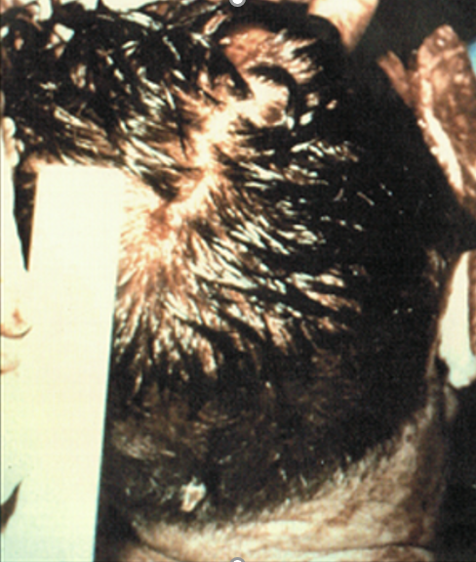
So, what might have given the conspiracy away?
Kemp Clark
Joe Goldsmith
Gene Akin
Richard Dulaney
Marion Jenkins
Jim Carrico
Paul Peters
Fouad Basour
Jackie Hunt
Ronald Jones
Charles Baxter
Kenneth Salyer
Malcom Perry
Robert McClelland
Charles Crenshaw
Adolph Gieseke
8. Parkland medical personnel
16 Parkland MDs did not recognize this photo

Slide 43
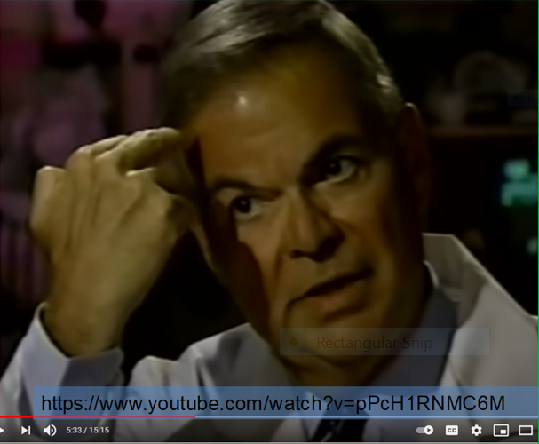
So, what might have given the conspiracy away?
8. Parkland: Dr. Charles Crenshaw recalls

Slide 44
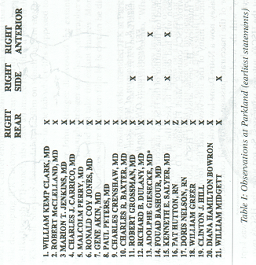
So, what might have given the conspiracy away?
8. Parkland: Dr. Gary Aguilar reports

Slide 45
So, what might have given the conspiracy away?
9. Bethesda autopsy para-professionals
None were interviewed by the WC, but all suspected conspiracy.
Read In the Eye of History by William Law.

Slide 46
So, what might have given the conspiracy away?
10. Bethesda physicians
Michael Kurtz cites eight Bethesda MDs who described the same posterior head wound that the Parkland MDs had seen:
George Burkley, Robert Canada, John Ebersole, Calvin Galloway, Robert Karnei, Edward Kenny, David Osborne, John Stover.

Slide 47
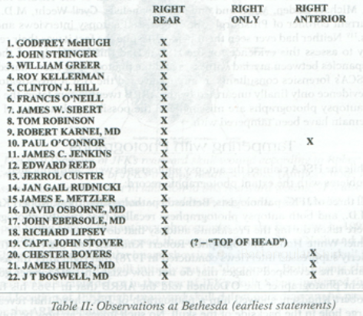
So, what might have given the conspiracy away?
10. Bethesda: Dr. Gary Aguilar reports
13. Parkland: Dr. Gary Aguilar reports

Slide 48
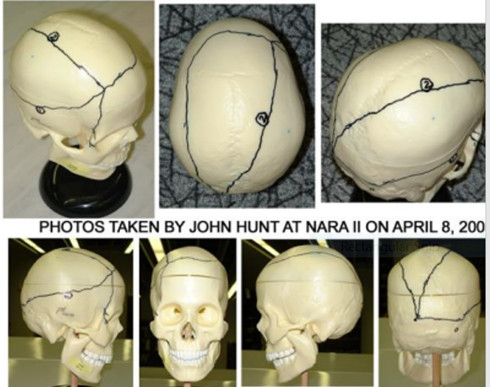
So, what might have given the conspiracy away?
11. Three autopsy pathologists:
Boswell outlined the skull defect.
Notes:
The central line represents a scalp laceration (said Boswell), so ignore that!

Slide 49
So, what might have given the conspiracy away?
11. Three autopsy pathologists and one radiologist
John Ebersole, the radiologist, told me that the big defect was at the back of the head.
NOTE: He said this despite seeing the skull X-rays. Therefore, Ebersole regarded the skull X-rays as consistent with a large hole in the posterior skull.

Slide 50
So, what might have given the conspiracy away?
12. The autopsy report
“There is a large irregular defect of the scalp and skull on the right involving chiefly the parietal bone but extending somewhat into the temporal and occipital regions.”
They confirmed this in subsequent official interviews.

Slide 51
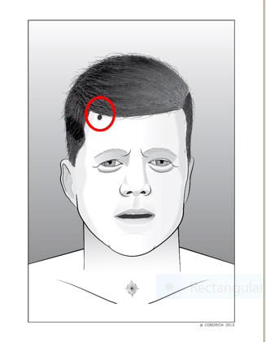
So, what might have given the conspiracy away?
13. Autopsy photographs: The Quinton Schwinn encounter
Notes:
Other Bethesda witnesses recall such a forehead shot. Also recall where Crenshaw pointed.

Slide 52
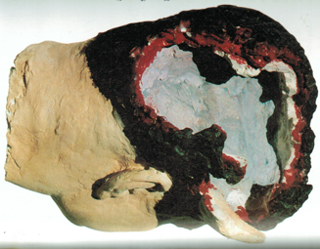
So, what might have given the conspiracy away?
13. Autopsy photographs: the Robert Groden reconstruction
Notes:
This is fairly accurate.

Slide 53
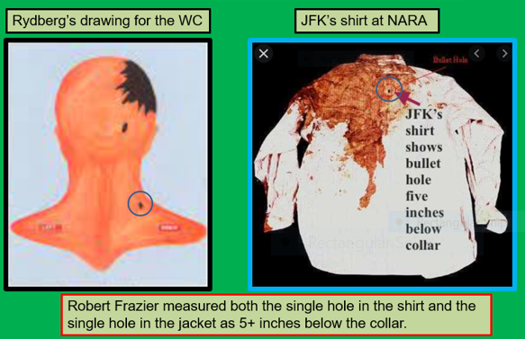
So, what might have given the conspiracy away?
13. Autopsy photographs:
These are identical wounds (circled in blue)?

Slide 54
So, what might have given the conspiracy away?
14. Autopsy X-rays

Slide 55
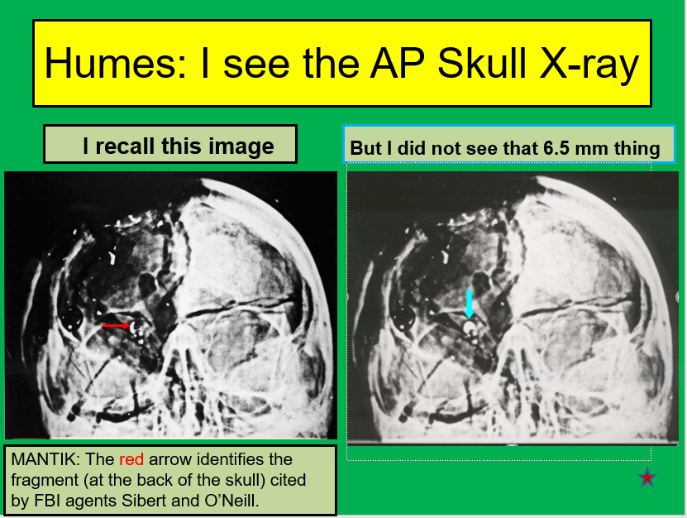
So, what might have given the conspiracy away?
14. Autopsy X-rays

Slide 56
So, what might have iven the assassination plot away?
14. Autopsy X-rays
The oblique X-rays would not have shown the 6.5 mm bogus object
Notes:
It would have been a technical nightmare to accurately place the 6.5 mm object on an oblique X-ray film.

Slide 57
So, what might have given the conspiracy away?
15. Participants in the cover-up (e.g., SS, FBI, CIA, NSA)
Large posterior skull defect—Kinney, Kellerman, Hill, Sibert, O’Neill, etc.
More than 3 shots—Kellerman.
Can you even imagine interviewing Kellerman’s family—about his true beliefs?

Slide 58
So, what might have given the conspiracy away?
15. Participants in the cover-up—a small sample
(e.g., SS, FBI, CIA, NSA)
"Roy accepted that there was a conspiracy—I'll accept that."
--June Kellerman.
“I hope the day will come when these men (Kellerman and Greer) will be able to say what they've told their families."
--Roy Kellerman’s daughter.
"He was puzzled about the single bullet theory. He could not see how one bullet could have caused both Kennedy and Connally such extensive wounds."
--HSCA interview with Greer.
"My reaction at this time was that the shot came from somewhere towards the front.“
–Paul Landis
Conspiracy Beliefs (and Denials) In High Places (jfk-assassination.net)
Notes:
Reference for Landis: 11/27/63: 18 H 758-759

Slide 59
So, what might have given the conspiracy away? These chapters are all missing in the WR.
Assassination planning documents
Travel schedules and diaries of participants
Witnesses with foreknowledge
Oswald items, e.g., the Minox camera
Photographs of the motorcade
Dealey Plaza witnesses
Photographs of the limousine (in Dallas & DC)
Parkland medical personnel
Bethesda autopsy para-professionals
Bethesda physicians
Three autopsy pathologists and one radiologist
Autopsy report
Autopsy photographs
Autopsy X-rays
Participants in the cover-up (e.g., SS & FBI)

Slide 60
A Warren Commission Report Card
“…the Warren Commission went through the motions of an investigation that was little more than an improvised exercise in public relations.”
--Gerald McKnight
“The Warren Commission had broad investigative powers that they did not use.”
--Walt Brown
“The seven commissioners asked only 6.3% of all of the questions.”
--Walt Brown

Slide 61
Mantik on the Warren Commission
“…all assertions or rumors relating to a possible conspiracy, or the complicity of others than Oswald, which have come to the attention of the Commission, were investigated.”
--Warren Report, x.
MANTIK: Notice that they do not tell us what they did when they found facts that pointed toward conspiracy.
MANTIK: And they disobeyed LBJ—they did not evaluate all the facts!

Slide 62
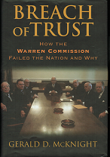
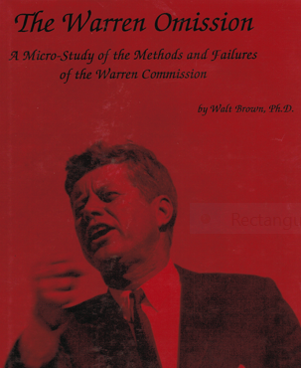
How the WC Failed the Nation and Why (2005) and The Warren Omission (1996)
Two Excellent Resources
Notes:
Walt still has a few copies of his book Let me know if you want one.

Slide 63
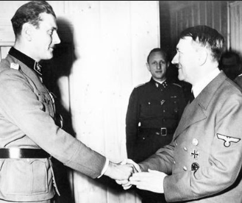
A Current Netflix Documentary
Europe's Most Dangerous Man: Otto Skorzeny in Spain
Otto Skorzeny, Hitler’s top commando, escaped to Madrid, Spain, where he built a global assassination training center.
He created a global business network, including a company in Dallas, TX.
Soutre was his French hitman and trainer (of assassins), who was reported in Dallas on Nov. 22, 1963.

Slide 64
X-100: The JFK Limousine Windshield
This is just one more clue to
the systemic cover-up.

Slide 65
Vaughan Ferguson: The limousine liaison to the White House
He is implicated in a major cover-up of the limousine’s whereabouts. His reported dates are inconsistent, and James Rowley reported that Ferguson drove the limousine from DC to Dearborn on December 20, 1963—when the weather was abysmal. Furthermore, official company records show that the limousine was already in Cincinnati by Friday, December 13. Ferguson concurred with this bizarre story.

Slide 66
Vaughan Ferguson: The limousine liaison to the White House
Here is my new proposal:
The limousine was flown to Dearborn late on Sunday evening, November 24, accompanied by Ferguson.
After a new windshield was installed (on Monday, November 25—the day of JFK’s funeral), it returned to Andrews Air Force Base within 24 hours.
Over an interval of several weeks a total of three windshield replacements occurred.

Slide 67
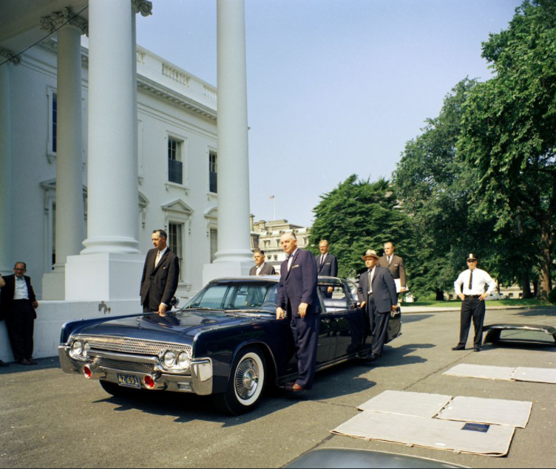
Vaughan Ferguson poses with the X-100

Slide 68
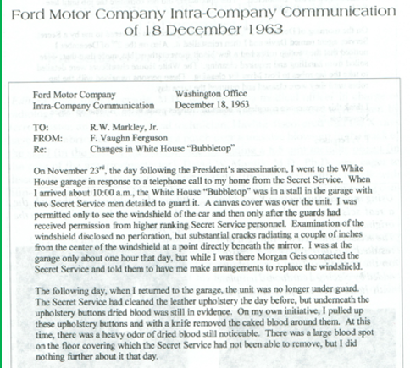
Vaughan Ferguson Memo (Dec. 18, 1963)

Slide 69
George Whitaker, Sr., a Ford Motor Company employee
He saw the limousine in Dearborn on Monday, November 25, the same day that no investigator logged into the White House garage to see the limousine.
Whitaker saw a hole in the windshield—from a frontal shot.

Slide 70
George Whitaker Statement (edited)
November 22, 1993.
On Monday morning (November 25th) the Lincoln was in the Rouge Plant of the Ford Motor Co…. at about 9:00 I was called to report to [the] glass laboratory.
There were two glass engineers there. They had a car windshield that had a bullet hole in it. The hole [was] about 4 or 6 inches to the right of the rear-view mirror [as viewed from the front].
The impact had come from the front of the windshield. (If you have spent 40 years in the glass [illegible] you know which way the impack [sic] was from.)

Slide 71
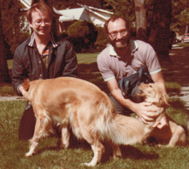
Robert Harrison: Automotive engineer at the Ford Plant in Dearborn
A second Dearborn witness (the father of my University of Michigan Medical School roommate) had confirmed his viewing of the windshield perforation to his Detroit family. He is cited here for the first time.
Notes:
Duane and me—sometime after we had both gone to the dogs. We both loved Golden Retrievers.

Slide 72
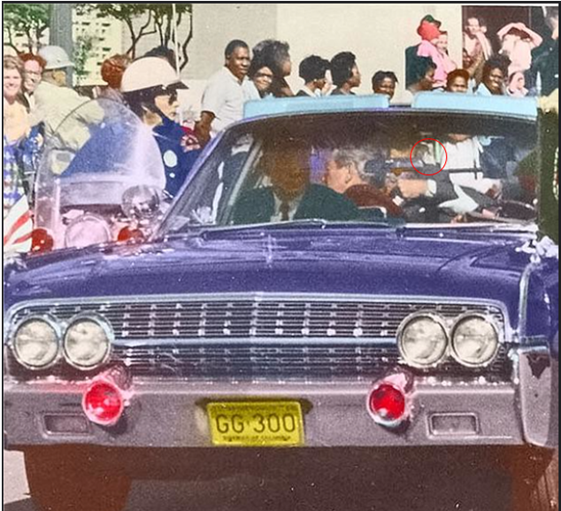
Altgens 6 (c. Z-255)

Slide 73
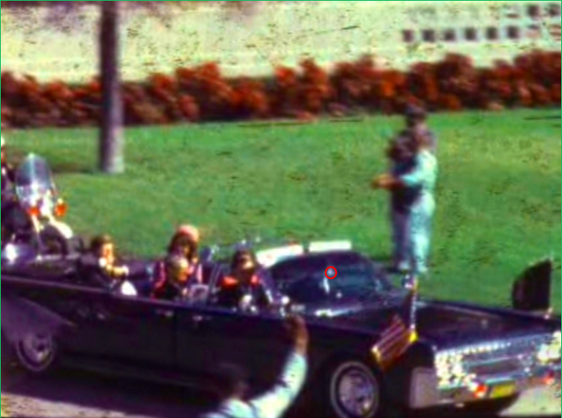
Z-230
Notes:
Costella’s combined edit: At the 6FM, the windshield damage was persistent and obvious—in generation 1. This is uncannily consistent with the NPIC conclusion that JFK was hit in the throat at Z-190

Slide 74
Bullets produce star-like and circumferential cracks. The damage looks like a spider web.
“The Fractography and Crack Patterns of Broken Glass,” by Richard Bradt, Journal of Failure Analysis and Prevention (2011), Volume 11, pp. 79–96: https://link.springer.com/article/10.1007/s11668-011-9432-5.

Slide 75
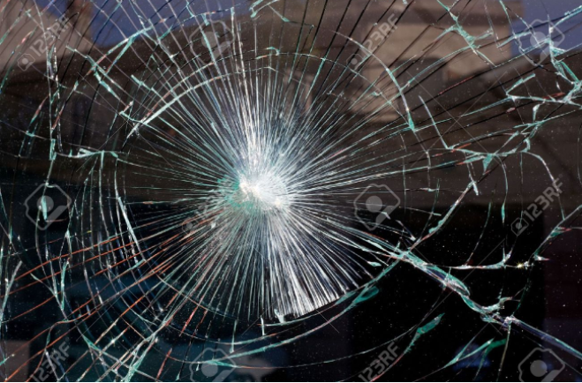
Bullets produce star-like and circumferential cracks. The damage looks like a spider web.
Notes:
From an online site.

Slide 76
Bullets produce star-like and circumferential cracks. The damage looks like a spider web.
Upon arrival at the White House garage, SA Hickey noticed ‘spidering.’
Notes:
This spidering is not seen in any official White House garage photographs—even though some are close-ups—but they are all undated!

Slide 77
Notes:
January 6, 2021, at the Capitol.

Slide 78
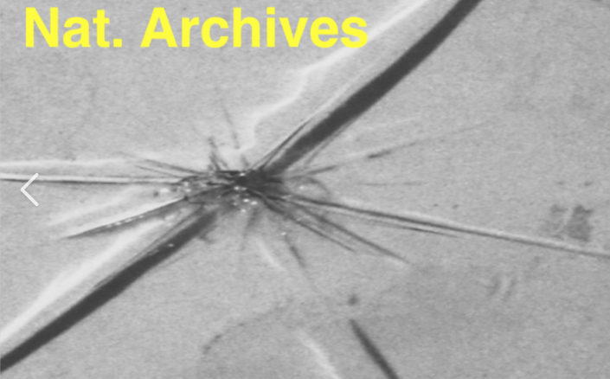
When the impact is by a blunt object, there is a crush zone from which the radial cracks emanate. Do you see spidering?
Notes:
The official photographs of the windshield are undated—and Robert Frazier did not offer to date them, even after Pamela Brown asked NARA to date them.

Slide 79
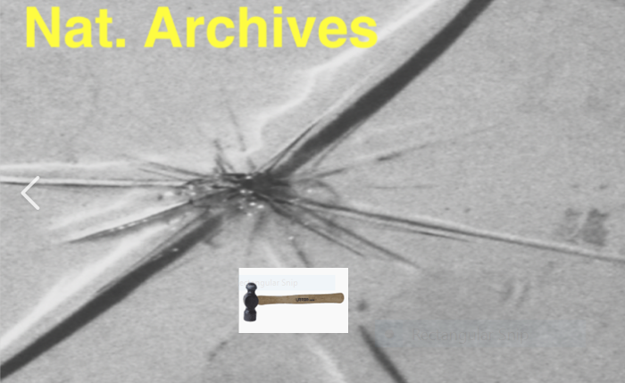
Was this damage deliberately produced on the morning of November 27?
Notes:
The strike was not firm enough to produce spidering. The perpetrator was obviously afraid of causing too much (illegal) damage. I would have used the round head of a ball peen hammer for this job.

Slide 80
Notes:
The windshield damage is consistent with a shot from the South Knoll—through the windshield.

Slide 81
The medical evidence closes the case.
The JFK wounds:
The right lung apex showed bruising.
Therefore, this wound occurred on Elm St. It did not occur during the tracheotomy.

Slide 82
The medical evidence closes the case.
JFK wounds:
The right lung apex showed bruising—and the projectile did not exit.
Therefore, this was not caused by a frontal bullet.

Slide 83
The medical evidence closes the case.
JFK wounds:
The right lung apex showed bruising—and the projectile did not exit.
Therefore, it was caused by either a bullet fragment—or by a glass shard.

Slide 84
The medical evidence closes the case.
However,
No such bullet fragment was seen in the X-rays, so either
The fragment was surreptitiously removed, or
The bruising was caused by a glass shard (invisible on X-rays).

Slide 85
The medical evidence closes the case.
But, even if it was a bullet fragment, this does not explain the two leaking holes in JFK’s cheek.
But glass shards can explain both the throat and the cheek wounds.

Slide 86
The medical evidence closes the case.
Of course, even if the windshield was not perforated, glass shards might have arisen from the inside), but there is now too much circumstantial—and eyewitness—evidence.
A windshield perforation must have occurred.

Slide 87
The Limousine: Conclusion
So finally, we have reached a two-way conclusion:
We know that the X-100 was in Dearborn on Monday, November 25, 1963, because we have two independent eyewitnesses, as well as much circumstantial evidence.
2. We also know that there was a through and through (perforated) hole in the windshield—because the X-100 was in Dearborn on Monday, November 25, 1963. After all, there is no other reason for its presence there—except to remove the incriminating windshield. Furthermore, if its Dearborn visit had been appropriate, it would not have been so surreptitious.

Slide 88
Summary of the Medical Evidence-1
The medical evidence is the Rosetta Stone (not Oliver Stone) in the JFK cover-up. That stone is the most famous item in the British Museum. It was deciphered 200 years ago by Dr. Thomas Young,* who was attached to St. George’s Hospital, at Hyde Park corner.
* Like me, Young was a physician-physicist. In 1801, he proved—contrary to Newton—that light was a wave. Einstein later proved that both geniuses were correct.

Slide 89
Summary of the Medical Evidence-2
As we now finally know, JFK’s autopsy was not merely a fraud—it was a French farce. In their report, the three pathologists, under orders to avoid multiple headshots and conspiracy, deliberately lowered the trail of metallic debris by 4 inches (over half the height of the head). They purposefully incised the forehead wound—or someone else did—(this incision in the autopsy photograph was not seen in Dallas) in order to obscure a frontal bullet entry, which many witnesses had observed. The autopsy report obfuscated the exact size and location of the large posterior exit hole, which was seen by virtually all observers in Dealey Plaza, at Parkland Hospital and at the Bethesda Naval Medical Center. Humes and Boswell promptly examined the real brain (in the absence of their colleague Finck), but then later examined a substitute brain—with Finck. My optical density data, from the extant skull X-rays at NARA, are consistent with the real brain—but they are inconsistent with the fake brain.

Slide 90
Summary of the Medical Evidence-3
In turn, however, these same pathologists were later themselves unexpectedly victimized by (illegal—but federally authorized) alterations to the autopsy photographs and to the skull X-rays. Under oath, all three denied seeing these fake images on the body or in the X-rays. On the other hand, subsequent forensic experts accepted these falsified images and so displayed no faith in the pathologists (or in the radiologist—to whom I have twice spoken), even though the autopsy photographs had no legal provenance. The HSCA proved that this was true—by locating the actual camera and lens combination. These details are dissected in my book, JFK Assassination Paradoxes, a 500+ page, color-illustrated, hardcover anthology with 1000+ footnotes. The veil has now been lifted in the land of Oz.

Slide 91
Summary of the Medical Evidence-4
Oswald did not fire any shots.
He was a patsy—as he recognized.

Slide 92
And so, the systemic cover-up succeeded—and the history books curtsied
With the destruction of the original windshield, and the overt muzzling of Dr. Malcolm Perry, and the Secret Service control over the autopsy photographs (and the X-rays)—via James Rowley, and LIFE’s control of the Z-film, and the FBI’s control of the Oswald items, as well as control of input to the Warren Commission (via Allen Dulles, James Angleton, and George Joannides), the new elite now controlled the entire history of the JFK assassination.

Slide 93
Summary of the Medical Evidence-4
Oswald did not fire any shots.
Notes:
No amateurs for DeGaulle--just world-class snipers! In 1963, Jean Rene Soutre may have met (separately) with each of William Harvey, E. Howard Hunt, and General Walker. But remember--it was the CIA who rescued Otto Skorzeny from prison after WWII.

Slide 94
Who ordered this? —My simplified scheme
Joint Chiefs of Staff
CIA (-->LBJ)
Assassins

Slide 95
Who ordered this? —My simplified scheme
After the Cuban Missile Crisis, General Curtis LeMay told JFK:
“This is almost as bad as the appeasement at Munich.”
In 1965, Allen Dulles (Director of the CIA) purportedly said,
“That little JFK—he thought he was a god.”

Slide 96
My Contributions— and my Good Fortune
All three (remaining) skull X-rays were altered.
Mother Nature made me extremely myopic.
The red spot and hairpiece are fake.
The skull X-rays do not match the fake brain.
The apical bruise did not result from the tracheotomy.
I was able to visit the 6th Floor Museum (in time).
I had a roommate with an entangled father.
Notes:
While at NARA, due to my extreme myopia, I immediately recognized that the 6.5 mm fake was a double exposure.

Slide 97
DAVID W. MANTIK
Wisconsin—Ph.D. thesis in X-ray scattering from proteins
Stanford: Post-doctoral fellowship
Michigan—Physics faculty, then an M.D.
USC—Radiation oncology residency, then Board certification
Loma Linda University—Director of the residency program
At LLU—treated cancers with the new proton beam
Years treating cancer: 40
Number of visits to the National Archives: 9
Years investigating the JFK case: 30

Slide 98
It is time to salute the audience!
Although your time is valuable, you have sailed into treacherous seas with me. So far, we have survived.
I wish you Godspeed!

Slide 99
A Final Lesson for Adults
-

Slide 100
JFK Assassination Paradoxes: Essays and Reviews
Notes:
The Kindle version sells for less than $10 on Amazon. The hardcover is now on discount.

Slide 102
Horne’s Three-Headshot Scenario
Notes:
I concur with Doug Horne’s proposal.

Slide 103
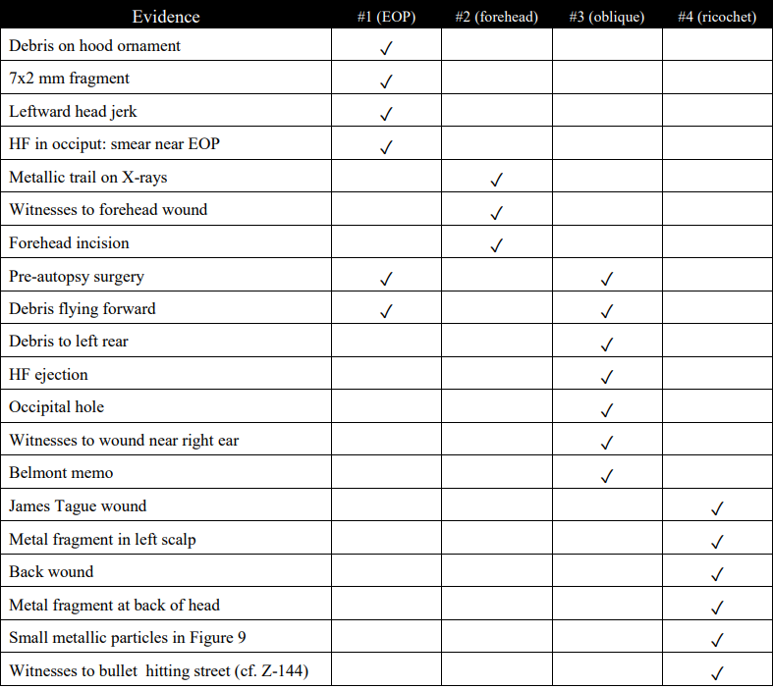
Summary Table for Three Headshots

Slide 104
Last Second in Dallas —Josiah Thompson
My book devotes 54 pages to this review (more than 10% of the book).
The following critique is sufficient.

Slide 105
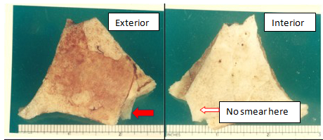
For Thompson: When did the smear appear on the Harper Fragment (HF)?

Slide 106
Thompson: re. Z-313 (LSID, p. 356)
“The force of the impact ranged rearward but largely up, throwing blood and brain debris over Mrs. Kennedy’s right shoulder onto Clint Hill and the motorcycle outriders.”
MANTIK: The HF is not cited at p. 356. In fact, it only appears in a footnote (p. 426n52). But in his lecture (11-20-2022) he clearly described HF as in the air above JFK.

Slide 107
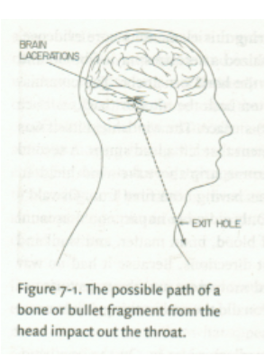
JT’s Five-Shot Sequence --LSID, pp. 357-359
Z-328
Z-175 JFK’s elbows elevate (not a headshot)
Z-204 TSBD shot (no JFK hit)
Z-224 Connally (JBC) hit in chest (no JFK hit)
Z-313 JFK hit in right temple (from Grassy Knoll)
Z-328 JFK hit near cowlick site (from TSBD)
+JFK throat wound and JBC wrist wound
+windshield hit
Notes:
Thompson’s headshots are in red. Figure 7.1 is from Thompson’s book.

Slide 108
When did the smear appear on the HF?
Z-175 JFK’s elbows elevate (not a headshot)
Z-204 TSBD shot (no JFK hit)
Z-224 Connally (JBC) hit in chest (no JFK hit)
Z-313 JFK hit in right temple (from Grassy Knoll)
Z-328 JFK hit near cowlick site (from TSBD)
Mantik Answer: The smear could only result from
a posterior shot (which Thompson puts at Z-328).
BUT: Thompson claims that HF exited at Z-313—from a frontal shot!
Notes:
Thompsons’s only headshots are in red here.

Slide 109
Thompson and the Forehead Shot
A forehead shot is confirmed by the fragment trail across the top of the skull.
Thompson totally ignores this obvious trail.
Notes:
Thompson needs to rethink his scenario—after looking at the HF and the X-ray trail.

Slide 110
THE END

