Slide 1
Doug Horne’s final question
If the JFK assassination was a “simple murder,” as the WC concluded, why was evidence suppression and alteration required?
Notes:
My initial slides refer to the comments of the prior speakers in this series.

Slide 3
James J. Humes, MD
If a single gunman succeeded, why perform two separate brain exams—and then hide this from us?

Slide 6
The Puzzling Autopsy Photo
16 Parkland MDs did not recognize this photo
Is this authentic?
Kemp Clark
Joe Goldsmith
Gene Akin
Richard Dulaney
Marion Jenkins
Jim Carrico
Paul Peters
Fouad Basour
Jackie Hunt
Ronald Jones
Charles Baxter
Kenneth Salyer
Malcom Perry
Robert McClelland
Charles Crenshaw
Adolph Gieseke

Slide 7
Were all the doctors wrong?
Michael Kurtz cites eight Bethesda MDs who described the same posterior head wound that the Parkland MDs had seen:
George Burkley, Robert Canada, John Ebersole, Calvin Galloway, Robert Karnei, Edward Kenny, David Osborne, John Stover.

Slide 8
Government Secrets
“The reality unknown to the public and to most members of Congress and the press is that secrets that would be of the greatest import to many of them can be kept from them reliably for decades by the executive branch, even though they are known to thousands of insiders.”
Daniel Ellsberg (who gave the Pentagon Papers to the NY Times)
https://www.dailykos.com/stories/2006/1/22/180382/-

Slide 9
JFK: The Medical Quest --David W. Mantik, MD, PhD--
Imagine: The multiple dilemmas faced by the autopsy pathologists
Their Solutions
What the pathologists did not know at the autopsy
The Official Radiologists:
--How they misled us
--What they missed
The Harper Fragment: 15 Clues for its Occipital Origin
Persistent Preposterous Paradoxes
Conclusion: Stanley Milgram and Obedience to Authority

Slide 11
James Humes occupies center stage (1963)

Slide 12
JAMA (1992): JFK's death--the plain truth from the MDs who did the autopsy (by Dennis Breo)
Humes signed on with the US Navy in 1943 to complete his undergraduate work at Villanova University, Villanova, PA, as part of the Navy's V-12 enlistment program. After earning his medical degree at Jefferson Medical College, Philadelphia, in 1948, he completed his internship and residency in anatomic and clinical pathology at the Bethesda Medical Center; the US Naval Hospital in Philadelphia; and the Armed Forces Institute of Pathology in Washington, DC. He was certified by the American Board of Pathology in anatomic and clinical pathology in 1955. His postings included military hospitals in the Canal Zone, Hawaii, and San Diego. He was appointed chief of pathology at the Naval Medical School in 1960 and promoted to director of labs for the medical school in 1961. By 1963, he had performed several autopsies on military personnel killed by gunshots, and he had also spent seven years at the Bethesda facility, which he "knew like the back of my hand." Boswell, a graduate of the Ohio State University Medical School, received his certification in anatomic pathology in 1957 and clinical pathology in 1959. He, too, had previously autopsied several gunshot wounds, and most of his military experience was at the naval hospital in Bethesda.
MANTIK: Humes was completing 20 years of military service in 1963.
Online (2017): The US military offers very generous pension benefits—after 20 years of service, members can retire with 50% of their final salary for the rest of their lives.

Slide 13
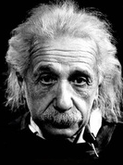
Albert Einstein
“Imagination is more important than knowledge. For knowledge is limited to all we now know and understand, while imagination embraces the entire world….”

Slide 14
IMAGINE: https://www.youtube.com/watch?v=iUuZZsqcBpw
https://www.youtube.com/watch?v=l1uVgOX0xT4

Slide 15
Imagine…
…being a pathologist at the JFK autopsy—and having just been told that three shots were fired—all from behind.
So, for a few moments, let’s imagine the scene as I play the role of Humes at the autopsy

Slide 16
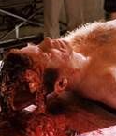
I see a large hole in the right occiput*
*This image was prepared for the movie, JFK

Slide 17
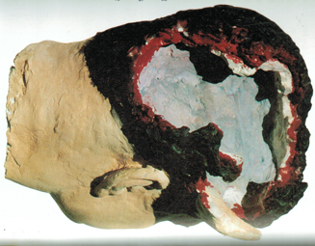
MANTIK: Robert Groden’s…
…reconstruction is fairly accurate. This is close to what Humes saw.

Slide 18
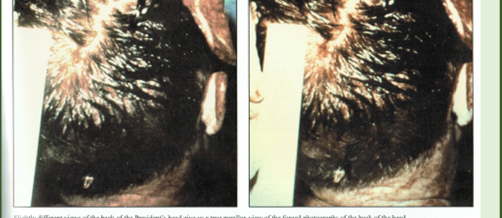
Humes: I saw the back of the head, but—I did not see the red spot, and I did not wash the hair. The large hole extended into the occiput (as I stated).
Red Spot
MANTIK: You can do your own stereo viewing with these two images!

Slide 19
Mantik: A Common Myth
Contrary to a common myth, the scalp was not being stretched over a gaping hole here.
I know that from my stereo viewing at the Archives—the image is not 3D, as it should be. It is only 2D—because the same fake image was inserted into each member of the paired photographs shown here. Look for yourself!
The pathologists were unable to completely cover the defect with the scalp—as they themselves admitted.

Slide 20
Humes: In the posterior skull I originally identify a portion of a bullet entry hole, several centimeters (2.5) to the right and “slightly” above the external occipital protuberance (EOP).

Slide 21
Humes: I invented a new definition!
“Slightly” ≡ 4 inches

Slide 22
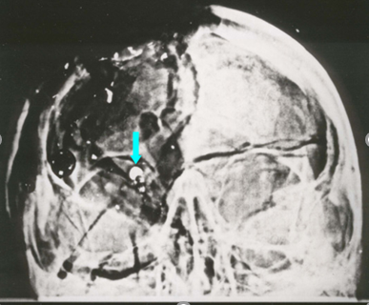
Humes: I see the AP Skull X-ray
I recall this image
But I did not see that 6.5 mm thing
MANTIK: The red arrow identifies the fragment (at the back of the skull) cited by FBI agents Sibert and O’Neill.
Notes:
Thanks to Phil Dragoo for his Photoshop work here, and to Larry Rivera for his offer of assistance. Larry Sturdivan, the HSCA physics expert, claimed that this thing cannot be metal!

Slide 23
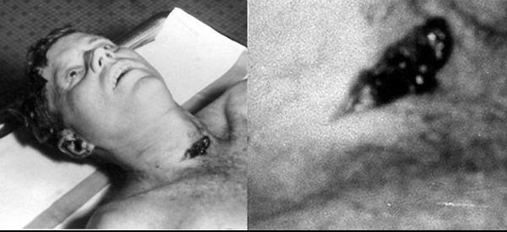
Humes: I see the throat wound

Slide 24
Near the throat, I (Humes) note tissue damage…
…to the following:
--lung apex (5 cm contusion)
--strap muscles of the neck
I immediately recognized that this meant trauma on Elm St.
Damage to these sites could NOT be caused by a tracheotomy.
Dr. Perry would surely not accidentally cause a 5 cm contusion.
So, I promptly know—DURING THE AUTOPSY—that a projectile had passed through the throat. I did not need to speak to Dallas to learn this.
MANTIK: Boswell later confirmed this: WHILE AT THE AUTOPSY, they knew about the throat wound. Ebersole told me the same story.
Notes:
As expected, the chest tube incisions had no bruising. JFK’s heart had stopped by then. During the tracheotomy, Perry could not have caused a 5 cm contusion to the lung!

Slide 25
MANTIK: 1977, Boswell had an epiphany for the HSCA. He raised the back wound (from the 7x4 mm site) into the neck, as shown here by the red arrow. Gerald R. Ford concurred with this. Even though he was not at the autopsy, Ford nevertheless claimed to know this.

Slide 26
These are identical wounds? (circled in blue)
Rydberg’s drawing for the WC
JFK’s shirt at NARA
Robert Frazier measured both the single hole in the shirt and the single hole in the jacket as 5+ inches below the collar.

Slide 27
The Back Wound at the Autopsy
Glen Bennett:
“I saw the shot hit the President about four inches down from the right shoulder.”

Slide 28
MANTIK: Rydberg later expressed regret for his misleading JFK diagrams. But the Archives refused his request to view the JFK evidence. So, he published his own book.

Slide 29
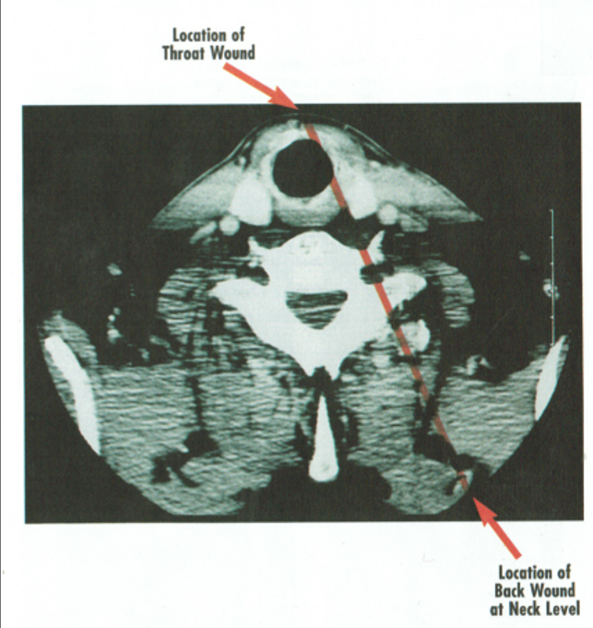
thoghwe had no CT scans, I should have known bter.
Humes on the SBT:
Even though we had no CT scans, I knew that this trajectory was unlikely.
MANTIK: It would have fractured the spine or punctured the lung (at a lower level), but the X-rays did not show either event.

Slide 30
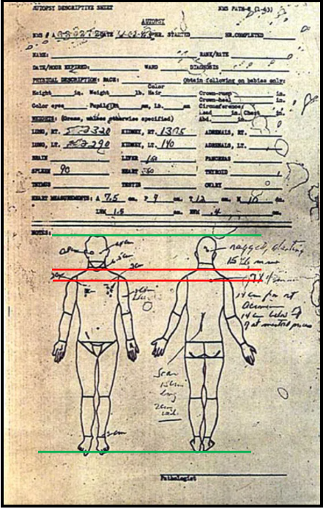
The Autopsy Facesheet
Humes: Of course, from our facesheet, I knew that the back wound was much lower than the throat wound—which made the SBT quite implausible.
Notes:
Note the two green lines. The two red lines illustrate the impossibility of the SBT.

Slide 31
Weeks later, I (Humes) write the supplementary brain exam…
Laceration
…even though Boswell and I both believed JFK’s brain was buried with his body.
Intact cerebellum
Notes:
Humes: I had only a limited supply of spare brains. What can I say?—I did the best I could with this brain. But we should get credit for omitting the date!

Slide 32
Humes: I describe a “4.5 cm deep” laceration (yellow)
I was lucky that Cornwell did not nail me for the huge discrepancy between this laceration (described in our brain report) and the EOP entry).
Fragment trail
Laceration
EOP
I imply that this brain was mostly intact below the yellow line—even though my entry was near the EOP.
Notes:
The dark area merely means absent brain, not missing forehead or eye, which are all well seen in the photographs. NOTE THE FRAGMENT TRAIL!

Slide 33
The Cerebellum
Humes: At the autopsy, we saw cerebellar damage, but the brain we examined later had an intact cerebellum.
The high fragment trail on the X-rays would have meant a second headshot, so we had to rewrite the autopsy report—and describe the cerebellum as intact.

Slide 34
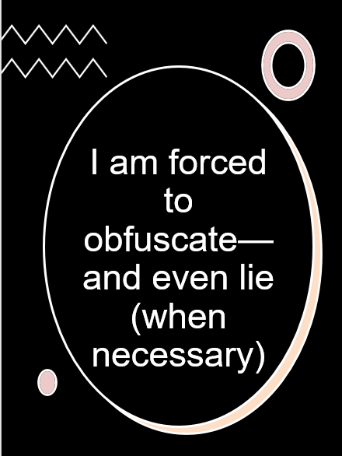
I see the large occipital hole—so I OBFUSCATE.
On the X-rays, the fragment trail is too high (it implies another headshot)—so I LIE and describe it as 10 cm lower.
The autopsy cerebellum was damaged (it disagrees with the fake brain)—so I IGNORE the cerebellum.
On the X-rays, I see metallic debris near the forehead. I also see the forehead entry wound (in the skin)—so I INCISE the wound and IGNORE the metallic debris.
I see bruising in the throat tissues. I know this means trauma while JFK was still alive—so I must LIE and claim that the tracheotomy hid this damage.
I had two phone calls with Dallas during the autopsy so I LIE—or else everyone would know I knew about the frontal throat entry.
I see a temporal bone entry (near the right
ear)—so I IGNORE it.
I correctly identify a right EOP entry—
but I later MISLOCATE it (on video) for the
HSCA. I had no choice—that entry had to
match the high fragment trail.
9. To cover my tracks, I had to write different
autopsy reports at different times—after the
exam of the fake brain I had no choice.

Slide 35
Robert Karnei, MD*
May 19, 2019
If this had not been JFK, Karnei would
have performed the autopsy.
Like James Jenkins and Dr. Robert Walker**
(who knew bullet wounds), Dr. Karnei recalled a wound on the right side of the head (the temporal area) approximately above the right ear.
*http://www.kenrahn.com/Marsh/ARRB/Karnie.txt
** May 19, 2019, e-mail from Dr. Don Curtis
Notes:
Many other witnesses described the temple entry—even in Dealey Plaza. See my e-book.

Slide 36
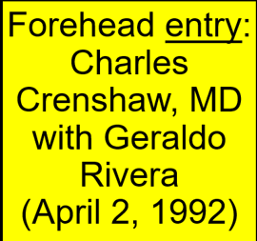
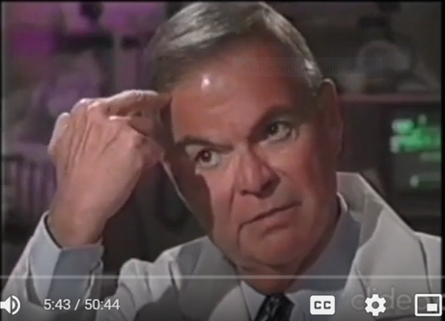
Dr. Charles Crenshaw at Parkland
Charles Crenshaw on JFK: 20/20 Interview - YouTube

Slide 37
MANTIK: Artist’s rendering of a photograph seen by Quentin Schwinn in Rochester, NY (the home of Eastman Kodak). Rochester was also home to Hawkeye-Works—where the Z-film may have been modified.

Slide 38
Denise Hazelwood Composite

Slide 39
Now I (Humes) hope for the best
And I succeeded until the HSCA (1977) and the ARRB (1996).
Then all hell broke loose—especially in front of the ARRB with Doug Horne.
But I got to play golf in Florida for three more years (until 1999), when I died of lung cancer (just like Ebersole) and took all my secrets to the Catholic Corner in heaven—and got to meet my fellow Catholic, JFK. But meanwhile I kept my pension and even got a military promotion. Later LBJ even gave me presidential cuff links after I served as his pathologist.

Slide 40
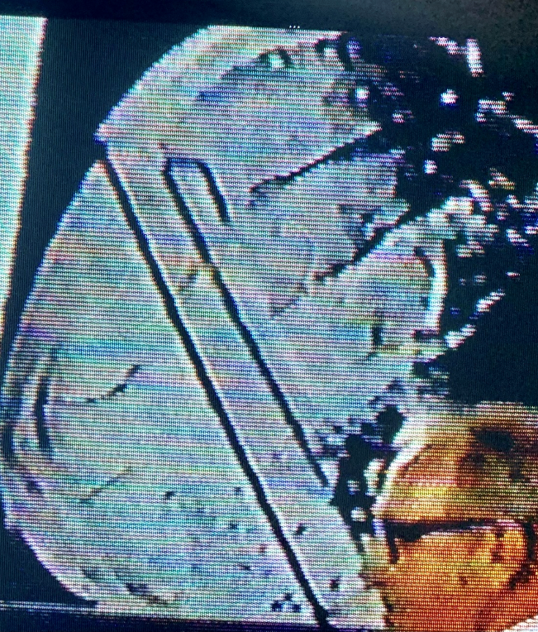
The HSCA interviewed me in 1977
They wanted to know about that entry wound, so I changed my mind and pointed to the cowlick area. After all, that’s closer to where the fragment trail was.

Slide 41
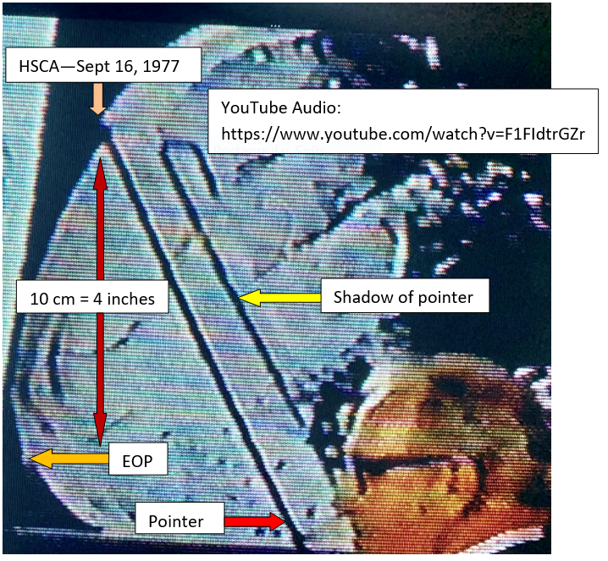

Slide 42
Humes: Before the HSCA: Gary Cornwell asked me some tough questions—and he took all the credit for my 4-inch move
Cornwell [regarding the posterior skull entry]: “Do you now have a more well-considered—or a different—opinion?”
Humes: “I think I do have a different opinion…. I erroneously previously identified the entry site.”
Cornwell: “Is this [4 inch] discrepancy explainable?”
Humes: “I have a little trouble with that.”
Mantik: See Cornwell’s Real Answers, pp. 69-74.

Slide 43
Humes: My final statement to the HSCA
Humes: “I and my associates are quite elated, in fact, that all the substantive findings [of the Panel] are in basic concordance with [our findings].”
MANTIK: In other words, don’t worry about 4 inches.

Slide 44
Video of Humes with the HSCA*
YouTube Audio: https://www.youtube.com/watch?v=
*This video is not on YouTube, but a video snippet will be played here right after this lecture.

Slide 45
Humes: I was blindsided
I did not know (in time)…
That critical autopsy photographs would be destroyed;
That critical autopsy photographs would be altered;
That some skull X-rays would be deliberately lost, and that the three extant skull X-rays would be decisively altered.

Slide 46
MANTIK: In 1992, Humes recanted his HSCA testimony—and JAMA ignored his backsliding!
"The fatal wound was blatantly obvious," Humes recalls. "The entrance wound was elliptical, 15 millimeters long and 6 millimeters wide, and located 2.5 centimeters to the right and slightly above the external occipital protuberance.”
--JAMA, May 27, 1992—Volume 267, No. 20
MANTIK: Humes’s 4 inch move (for the HSCA) just went up in smoke.

Slide 47
Mantik: My excuses for Humes
1. Humes was placed into a straight jacket—he had no choice but to write misleading autopsy reports. If he had refused, conspiracy would have been apparent to all—due to the obvious frontal shots.
2. He inserted misleading eyewitness statements into the autopsy report. (Eyewitness statements are virtually never included.)
3. He did not have JFK’s clothing.
4. He did not know about the Harper fragment, which was not even cited by the WC.
5. He did not know that the Magic Bullet was bogus— or that the FBI had two bullets that night.
6. But he did know (and he never told us) about the two brain exams. For that, he is culpable.

Slide 48
Mantik: Humes was a respected professional
1. He directed the weekly brain cutting sessions at Bethesda.
2. Gary Cornwell (in Real Answers) cites the strong respect he got from the Forensic Pathology Panel of the HSCA.

Slide 49
The Radiologist, John Ebersole: Like me, he was a radiation oncologist
He recalled (to me) two phone calls with Dallas during the autopsy, the first one at about 10:30 PM.*
Malcolm Perry originally also recalled two phone calls—and he initially stated they were on Nov 22.
William Manchester (The Death of a President) cites two phone calls during the autopsy.
Karnei (ARRB Summary): “He told the ARRB staff that he was aware of hearsay that Dr. Humes had called Dallas to talk to a surgeon later in the evening before the body left the morgue.”
Ebersole also recalled (to me) 5-6 skull X-rays; Jerrol Custer, the technologist, also confirmed this to me. He specifically recalled two oblique skull X-rays.
*https://themantikview.com/pdf/Conversation_with_John_Ebersole.pdf

Slide 50
Later Government Experts: How they misled us
The HSCA Forensic Pathology Panel trusted the photographs—and they ignored the autopsy pathologists.
But they were not told that there was no provenance for the photographs—that the camera did not match the photographs.
And another myth—they all believed that X-rays were as immutable as God himself.
Of course, the real problem was that they had never actually worked in a darkroom, so they did not know how X-ray copying was done.

Slide 51
Later Government Radiologists: What they missed (or deliberately ignored)*
1. The fragment trail is centered at the front of the skull—with many tiny pieces right at the forehead
2. The forehead wound (on the photos)
3. The magical materialization of the 6.5 mm object
4. The absence of the 6.5 mm object on the lateral X-ray
5. The missing upper temporal bone (on the X-rays)
*The WC did not utilize the autopsy materials.
7. The absence of emulsion under the T-shaped inscription.
6. The White Patch

Slide 52
Later Government Radiologists: They missed all 3 clues to X-ray alteration
Optical density was outside their world view—and the White Patch is indeed other worldly.
The 6.5 mm object simply cannot materialize (like a magician’s rabbit) between 1963 and 1967—nor can it be absent from JFK’s lateral X-ray.
Furthermore, the forehead shot was obvious—tiny metal fragments precisely at the forehead cannot possibly imply a posterior shot.
These “experts” were too obtuse to look for missing emulsion (under the T-shaped inscription).

Slide 53
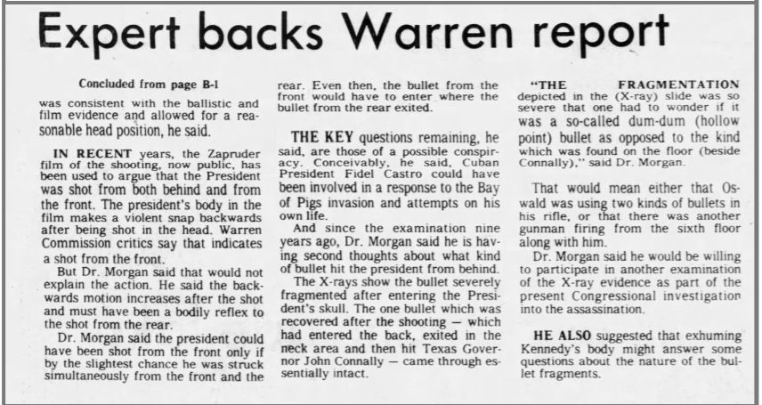
Russell Morgan, the Sole Radiologist for the Clark Panel Confesses
Insert his comment
questions

Slide 54
Russell Morgan has his own Ground Hog day

Slide 55
Russell Morgan: A last ditch effort to CYA
The above article appeared in the…
Lansing State Journal (Lansing, Michigan) 16 Sept 1977, Friday, p. 9.
Now recall this: Humes’s (above) testimony occurred on 16 Sept 1977—the very same day that Dr. Morgan almost recanted!
Was this a coincidence? It was the same day that the American public saw the skull X-rays!

Slide 56
A Forensic Radiologist: The “Ultimate” Expert
Even John Fitzpatrick, the forensic radiologist for the ARRB, confessed that he could not solve the paradox of the 6.5 mm object—but he ignored my OD data and, in response to my letter, he offered only clichés.
Instead, for the ARRB, he returned for a second day just to stare (helplessly) at the 6.5 mm fake. He never explained it.
Ironically, his expertise was in childhood brain trauma—not in X-ray forgery.

Slide 57
Persistent and Preposterous Paradoxes (not quite the Perpetual Peter Principle—but close)
Two FBI bullets—not one Magic Bullet
The lateral skull X-rays do not match the brain photographs.
The lateral skull X-ray does not match Z-312.
No blood is seen on the hair, but the shirt is soaked.
Lateral skull X-ray: the 6.5 mm object is missing.
The White Patch is absent from JFK’s pre-mortem X-ray (and from all other human skull X-rays).
An impossible blur exists in Z-232 (1963 LIFE MEMORIAL EDITION).

Slide 58
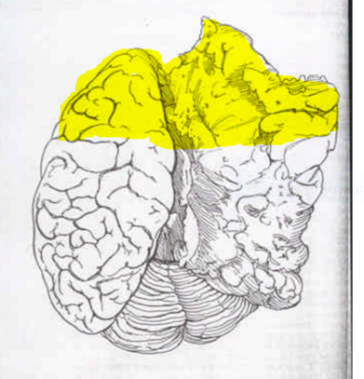
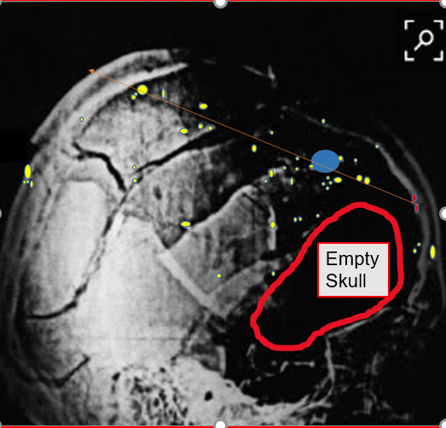
Choose one: The X-rays—or the photos?
The supplement brain exam described the “longitudinal laceration” seen here, but Boswell claimed that the Nov 22 brain was “so torn up it would not have shown a tract (sic).”
The X-rays show no brain in the yellow area.
The two teams of forgers failed to communicate.

Slide 59
More about the “Official” Brain
Humes stated that the brain was not perfused (i.e., preservative was not inserted via major vessels).
The Blumberg Report: Finck stated that the brain looked different at the supplemental exam than it did at autopsy. [It wasn’t the same brain!]
Horne: “According to numerous medical professionals, this is a very well-fixed brain. It appears very gray and very firm (i.e., it is not pink at all, and does not appear to be soft in any way) and seems as it would appear after at least 10-14 days of fixation.”
Since Humes directed the weekly brain cutting sessions, he would have had no shortage of substitute brains to use. No one needed to volunteer for this.
Notes:
So, the autopsy brain could not have been fixed by the next Monday.

Slide 60
Missing Body Parts
Besides JFK, these luminaries are also missing body parts: Einstein, Beethoven, Galileo.
The Moral: Plan a head (a pun)—and requiescat in pace (not in pieces)

Slide 61
Immaculate, freshly washed hair (!) vs. bloody shirt
The back wound was superficial and could not cause such profuse bleeding.

Slide 62
Two authentic fragments: The left one is 6.5 mm—but what is the right (JFK) one?

Slide 63
Data were taken from the lateral X-rays.

Slide 64
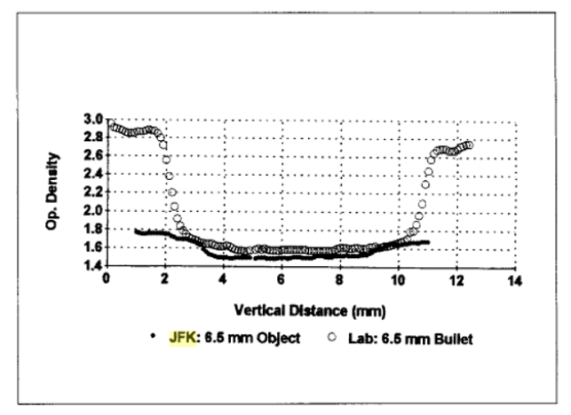
Optical Density: A Profound Difference Between Real and Fake Objects (10 data points/mm)
All JFK data were taken at NARA from the extant X-rays.
My peer-reviewed article:
“JFK 6.5 Saga”

Slide 65
Greg Henkelmann, MD: physics major and radiation oncologist (for 30+ years):
Dr. Mantik’s optical density analysis is the single most important piece of scientific evidence in the JFK assassination. Unlike other evidence, optical density data are as “theory free” as possible, as this data deals only with physical measurements. To reject alteration of the JFK skull X-rays is to reject basic physics and radiology. Dr. Mantik has a PhD in physics and has practiced radiation oncology for nearly 40 years; he is thus eminently qualified in both physics and radiology..

Slide 66
Henkelmann, MD (radiation oncologist): His Review on Amazon
“Dr. Mantik’s optical density analysis is the single most important piece of scientific evidence in the JFK assassination. Unlike other evidence, optical density data are as “theory free” as possible, as this data deals only with physical measurements. To reject alteration of the JFK skull X-rays is to reject basic physics and radiology. Dr. Mantik has a PhD in physics and has practiced radiation oncology for nearly 40 years; he is thus eminently qualified in both physics and radiology.”

Slide 67
Brugioni Disagrees with the Extant Zapruder Film
https://www.youtube.com/watch?v=J_QIuu6hsAc

Slide 68
Brugioni was a Photo Expert
Notes:
He interpreted the images of the Cuban missiles for JFK.

Slide 69
Photofakery in the USSR

Slide 70
The lateral X-ray superimposed on Z-312, as composed by David Josephs

Slide 71
The White Patch Magically Appears (the pre-mortem is on the left)
Notes:
Note the petrous bone, which surrounds the ear canal. It is the densest bone in the body.

Slide 74
JFK’s Two Lateral X-rays
JFK pre-mortem: Chesser data in blue
JFK post-mortem: Mantik data in red (shown on the left)

Slide 75
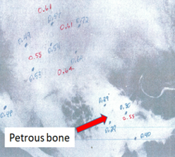
A Magnified View

Slide 76
Humes: On the lateral X-rays
That the White Patch was indeed not on the original X-rays is consistent with Humes’s weird reaction to these X-rays during his ARRB deposition:
“I don’t understand why that is…. You’d have to have some radiologist tell me about that. I can’t make that out…. I don’t understand this great void there. I don’t know what that’s all about.”

Slide 77
The Magic Rabbit Appears
Notes:
Even Larry Sturdivan does not believe the 6.5 mm object represents authentic metal.

Slide 78
A JFK Photo Paradox: Double Exposures
JFK: The 6.5 mm bogus object
Fielding: Special Effects Cinematography
Double Exposure
Notes:
A metal fragment is visible INSIDE the 6.5 mm fake!

Slide 79
Why could I see a double exposure that no other radiologist could see?
Ironically, because I was nearly blind!

Slide 80
High myopia is like wearing a low power microscope
Notes:
Although my wife was director of our emergency room, when my children had splinters in their fingers, I was called upon—because with my glasses off, I could see them!

Slide 81
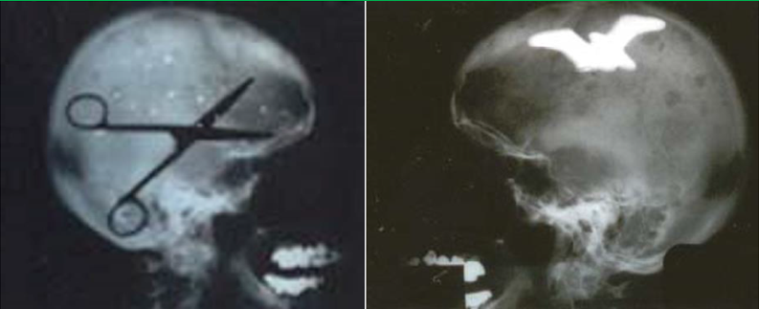
My X-ray Double Exposures: 1963 Variety

Slide 82
A Darkroom Escapade

Slide 83
Larry Sturdivan (HSCA expert in physics) on the 6.5 mm object
“As radiologist David Mantik points out…there is no corresponding density on the lateral x-ray.”
“…the apparently metallic fragment…was just as mysterious as when we went in” [to the Archives].
In a previous e-mail he had declared that this object could not represent an authentic metal fragment.

Slide 85
This is not a smoking gun; rather, a la Moses, this is a burning bush!

Slide 86
The T-shaped Inscription
An original film must show missing emulsion under the T.
Steve Tilley removed the film from its transparent envelope and I viewed each side separately under many angles of illumination.
No emulsion was missing—on either side.
Conclusion: This can only be a copy film—which opens the door wide to alteration.
And: where is the original?

Slide 87
Z-232: Costella’s Impossible Blur
Watch the animation here: http://johncostella.com/jfk/intro/blur.html

Slide 88
Zapruder Frame 232
Z-232 was published within the first week in LIFE’s Memorial Edition—which I retrieved from my mother.
Costella notes that the blurring of the background and the blurring on the limousine (due to motion) must add to a specific number (0.13°)—but they don’t. This can only mean film alteration—or else a violation of the laws of physics.
See his discussion in The Great Zapruder Film Hoax, p. 183.

Slide 89
LIFE Memorial Edition: Z-232

Slide 90
One Magic Bullet—or Two Bullets at the FBI?

Slide 91
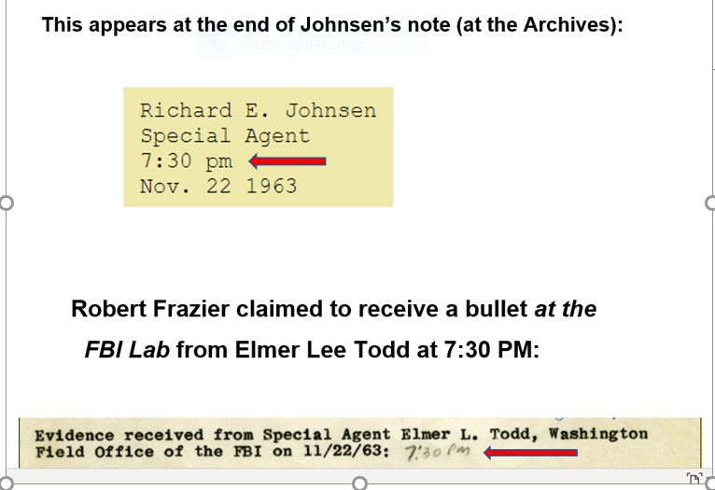
Richard Johnsen (SS) delivers a bullet to USSS Chief Rowley at 7:30 PM

Slide 92
At the White House, Elmer Lee Todd receives a bullet at 8:50 PM from USSS Chief Rowley. He places his initials on the bullet.

Slide 93
At the FBI: Who’s on First?*
Frazier says the bullet arrived at 7:30 PM. Todd took possession of a bullet at the White House at 8:50 PM.
How could Frazier receive a bullet in the lab from Todd at 7:30 PM if Todd did not have the bullet until 8:50 PM?
Frazier acknowledged receiving the Todd Bullet by putting his personal mark (RF) on the 8:50 PM Todd envelope.
*Abbott and Costello: https://www.youtube.com/watch?v=kTcRRaXV-fg

Slide 94
“The Mystery of the 7:30 Bullet” by John Hunt
CE-399 cannot be the same bullet that Todd handled on 11/22/63.
So, a second bullet was delivered to the FBI Lab.

Slide 95
John Hunt Concludes
Hunt: “The historic CE-399 bullet introduced into evidence before the Warren Commission is not the same bullet SA Todd handled on the day of the assassination.”
Hunt: “Unfortunately, whatever bullet Todd actually handled that day has apparently been lost to history.”
http://www.jfklancer.com/hunt/mystery.html

Slide 96
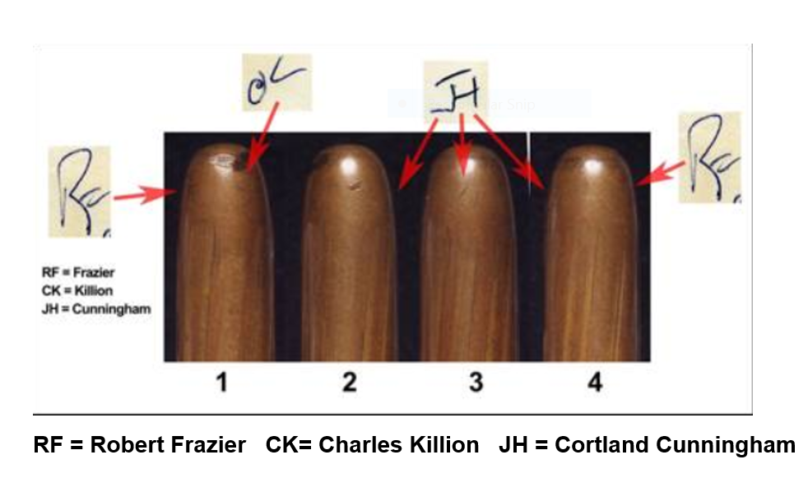
Elmer Lee Todd’s initials are not on the Magic Bullet. This NARA photograph was labeled by John Hunt. At NARA in June 1994, while viewing the actual bullet, David Mantik and astronomer Steve Majewski confirmed that Todd’s initials were missing.

Slide 97
This incision was not seen in Dallas— so, who did this?
Notes:
Supposedly, all photographs were taken before any work at Bethesda!

Slide 98
Boswell to the ARRB: “An incised wound”
“…there was an incised wound up there that extended into the right eye socket and then back across his temporal and frontal bone.”
--http://jfkassassination.net/russ/testimony/boswella.htm, p. 65
Scalpels cause incisions; bullets cause wounds.

Slide 99
The Two Limousine Fragments
These are the supposed nose (CE Exhibit 567) and tail (CE Exhibit 569) of the WC’s (sole) head bullet. At any rate, such were the conclusions of Robert Frazier, the WC ballistics expert. The reader can decide exactly where to insert the 6.5 mm object between these two metal fragments—which is what the WC claimed. The WC wisely refrained from this wacky exercise (WC Volume XVII).

Slide 100
Notes:
My friend, Tink Thompson, has just published Last Second in Dallas—and he accepts the blue trajectory. So be wary of his view of his medical evidence.

Slide 101
The temporal bone inside the skull—it extends from side to side

Slide 102
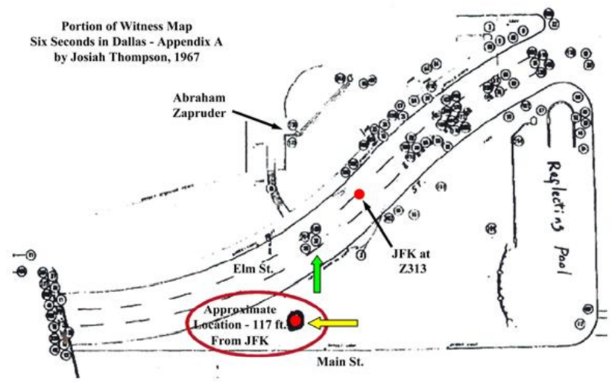
Billy Harper marked this map

Slide 104
At the FBI: The Harper Fragment
Exterior
Interior
Notes:
This is a much higher resolution photograph than the one just published in Last Second in Dallas.

Slide 105
HF X-ray by the FBI

Slide 108
F8: The Mystery Photo

Slide 109
HF: 15 Clues to its Occipital Origin
1. Most witnesses saw a large occipital hole.
2. Three Dallas pathologists described HF as occipital.
3. Boswell’s sketches (both autopsy and ARRB) showed missing occiput.
4. The original catalog description of F8 (the mystery photo) was occipital.
5. Humes’s selected entry site for the ARRB implied an occipital hole.
6. Intrinsic features of HF imply occipital bone—especially the intersecting suture lines.
7. The ill-matched adjacent borders of the two bones with metallic debris: mismatch implies that HF cannot be parietal.
8. Small, visible dark areas on the AP X-ray (confirmed by OD data): these outline the HF defect.
9. Absent medial lambdoid sutures on the AP X-ray imply an occipital hole.
10. An abrupt change in OD at the back of the skull on the lateral X-ray is consistent with the HF defect.
11. HF is a very dubious fit for the parietal defect.
12. Dr. Cairns suspected an entry near the metallic smear; he also described vascular grooves near the “base of the skull.”
13. The metallic smear on the outside of HF.
14. Fat pads (from the Y-incision) are seen in F8.
15. Cerebellum was seen via occipital hole.

Slide 110
HF: A Short List of Occipital Clues

Slide 111
Via the stereoscope, I saw fat pads in photo F8— as confirmed by Dr. Kirschner for the ARRB (and now also by Dr. Chesser)
At NARA, abdominal fat pads are seen here— confirmed by Kirschner for the ARRB (and now also by Dr. Chesser).
Even a nipple protrudes from the chest (on stereo views).
Conclusion: this must be a posterior view. The large hole is seen on your right.

Slide 112
HF in blue; lambdoid suture in cyan

Slide 113
Original autopsy catalog description of F8
#17-18. 4x5” negative depicting missile wound over entrance in posterior skull, following reflection of the scalp (2 contact and 2 8x10” prints)

Slide 114
An occipital hole appears just inferior to the red fragment.
Date

Slide 115
HF Hole: Bone is missing inferior to the metal fragment (in red).
Missing bone

Slide 118
On the X-rays—unlike the Clark Panel—he saw no large metallic fragment, but he stopped talking to me when I asked about the 6.5 mm object.

Slide 121
Three Successful Headshots—as first proposed by Doug Horne

Slide 122
Evidence Table for 3 Head Shots

Slide 123
Another Myth: The Fragment Trail
The largest fragment in the trail stops well short of the posterior skull.
Because the fragment trail does not leave the skull, it cannot explain the occipital hole—but a temporal shot explains the hole.
Also note that this trail begins in the forehead—not in the temporal area.

Slide 124
At NARA: My Survey of all Metallic Fragments

Slide 125
More Myths
The White Patch does not cover the occipital hole. The hole (in the occipital bone) lies too far posterior for that.
Also: the fragment trail does not lead to the White Patch. They have no relationship.

Slide 126
Did a mercury bullet strike JFK’s forehead?
The Day of the Jackal by Frederick Forsyth: A mercury bullet was constructed to assassinate DeGaulle—in 1963!
For soft metal bullet results, watch
https://www.youtube.com/watch?v=dhbWfhBDNzk
https://www.youtube.com/watch?v=vZ_7bqP2dso
Evidence for a JFK mercury bullet:
Multiple round fragments with fuzzy borders— unlike the distinct borders of the known metallic debris (on the same X-ray)
Many, many, very tiny fragments near the forehead
The limited range of all the fragments
The amorphous debris is very atypical of solid metal
Tiny fragments are widely scattered—even on the left side
The marked head explosion and the skull devastation does not fit a full-metal jacketed bullet (as Russell Morgan feared).

Slide 127
Daniel Kahneman: Thinking Fast and Thinking Slow (Nobel Prize for his work in psychology)
Myth #1. The shots that killed JFK were fired from the sixth floor.
DK: “A reliable way to make people believe in falsehoods is frequent repetition, because familiarity is not easily distinguished from truth.”
Myth #2: A bullet struck the back of JFK’s neck and exited his throat. (Randy Robertson and Don Thomas each support a variant of the SBT.)
DK: “It is the consistency of the information that matters, not its completeness. Indeed, you will often find that knowing little makes it easier to fit everything you know into a coherent pattern.”
Myth #3. Three shots were fired.
DK: “The confidence we have in our beliefs depends mostly on the quality of the story we can tell even if we see very little. We often fail to allow for the possibility that critical evidence is missing—what we see is all there is.”
Myth #4. All the shots were fired by Lee Harvey Oswald.
DK: “They didn’t want more information. After all, it might spoil their story.”

Slide 128
JFK: The Medical Quest
The medical quest is over—we now understand the paradoxes.
Daniel Kahneman was right—for the media, a good story is all that matters.
Someone (perhaps Humes) removed bullet fragments (from 1-2 bullets).
Someone (likely Ebersole) doctored the X-rays.
Three head shots: forehead, right temple, and EOP.
The forehead shot cannot explain the occipital hole.
The temple shot cannot explain the fragment trail.
It was sheer madness for the HSCA to elevate the rear shot by 4 inches—and to accept the 6.5 mm fake as authentic.
Do not trust government committees.

Slide 129
Dr. Chesser has likewise now also been banned.

Slide 130
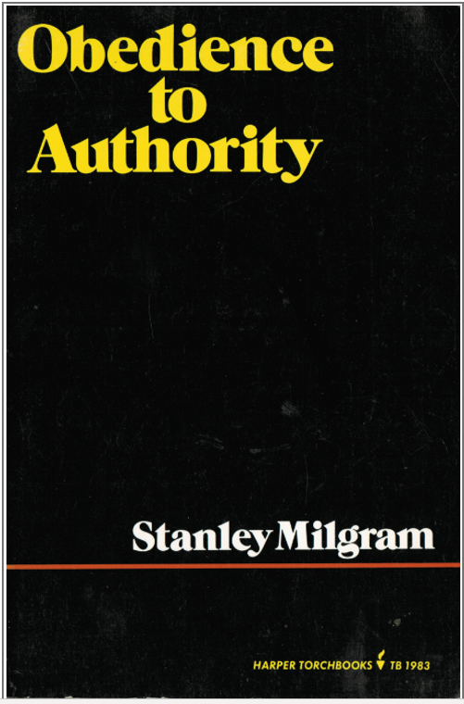
Conclusion
In 1963 Stanley Milgram showed how willingly humans follow orders from authority figures. James J. Humes (the chief pathologist) had a double dose of subjugation—one from the military (for 20 years) and another one from the Catholic Church, which he attended promptly after the autopsy. He did not even go home to sleep!
Notes:
We have also seen that well demonstrated during the COVID era.

Slide 131
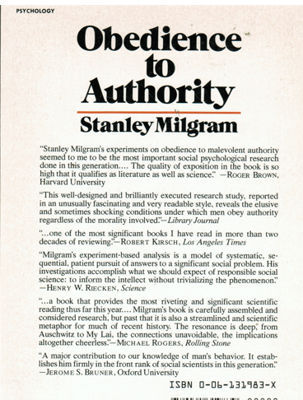
From the dust cover
Back of Milgram’s book

Slide 132
Does Doug Horne have connections? This is my recent rental car plate in Ohio.
Notes:
But he got the year wrong—JFK, like my mother, was born in 1917—just months before Lenin entered Petrograd.

Slide 133
Multiple sniper teams were isolated from one another
John West: The most important aspect was using contract killers, i.e., sniper teams with deniable connections. They included the Corsican mob, the American mafia, Cuban exiles, and domestic trigger men. These teams were compartmentalized, probably not in sync with each other—which compromised the operation.

Slide 134
After WW II, Hitler’s top commando (Otto Skorzeny) built his global assassination headquarters in Madrid—near Ava Gardner* and Juan Perón
Major Ganis, who I have met (and who my daughter has videotaped), describes the possible connections between William King Harvey, James Angleton (both CIA), and QJ/WIN.
Curiously, Ike is said to have kept Otto’s photo in the White House.
Otto may have directed one of the teams in Dealey Plaza.
*Ava once got into a catfight with Castro’s mistress and translator, Marita Lorenz—over Fidel.
https://www.vanityfair.com/hollywood/2020/06/ava-gardner-biography-frank-sinatra

Slide 135
The Parkland Doctors Documentary was Screened at Oswald’s Mock Trial

Slide 136
A Short List of Believers in a JFK Conspiracy
• Lyndon Baines Johnson, President of the United States • Richard M. Nixon, President of the United States • John B. Connally, Governor of Texas • J. Edgar Hoover, Director of the FBI • Clyde Tolson, Associate Director of the FBI • Cartha DeLoach, Assistant Director of the FBI • William Sullivan, FBI Domestic Intelligence Chief • John McCone, Director of the CIA • David Atlee Phillips, CIA disinformation specialist (Chief of Covert Actions, Mexico City, 1963) • Stanley Watson, CIA, Chief of Station • The Kennedy family 73 • Admiral (Dr.) George Burkley, White House physician • James J. Rowley, Chief of the Secret Service 74 • Robert Knudsen, White House photographer (who saw autopsy photos) • Jesse Curry, Chief of Police, Dallas Police Department • Roy Kellerman (heard JFK speak after supposed magic bullet) • William Greer (the driver of the Lincoln limousine) • Abraham Bolden, Secret Service, White House detail & Chicago office • John Norris, Secret Service (worked for LBJ; researched case for decades) • Evelyn Lincoln, JFK’s secretary • Abraham Zapruder, most famous home movie photographer in history. • James Tague, struck by a bullet fragment in Dealey Plaza • Hugh Huggins, CIA operative, conducted private investigation for RFK • Sen. Richard Russell, member of the Warren Commission • John J. McCloy, member of the Warren Commission. • Bertrand Russell, British mathematician and philosopher • Hugh Trevor-Roper, Regius Professor of Modern History at Oxford University • Michael Foot, British MP • Senator Richard Schweiker, assassinations subcommittee (Church Committee) • Tip O’Neill, Speaker of the House (he assumed JFK’s congressional seat) • Rep. Henry Gonzalez (introduced bill to establish HSCA) • Rep. Don Edwards, chaired HSCA hearings (former FBI agent) • Frank Ragano, attorney for Trafficante, Marcello, Hoffa. • Marty Underwood, advance man for Dallas trip • Riders in follow-up car: JFK aides; • Kenny O’Donnell and Dave Powers Sam Kinney. • Secret Service driver of follow-up car Paul Landis, passenger in Secret Service follow-up car. John Marshall, Secret Service • John Norris, Secret Service • H. L. Hunt, right-wing oil baron • John Curington, H.L. Hunt’s top aide • Bill Alexander, Assistant Dallas District Attorney • Robert Blakey, Chief Counsel for the HSCA • Robert Tanenbaum, Chief Counsel for the HSCA • Richard A. Sprague, Chief Counsel for the HSCA • Gary Cornwell, Deputy Chief Counsel for the HSCA • Parkland doctors: McClelland, Crenshaw, Stewart, Seldin, Goldstrich, Zedlitz, Jones, Akin, and others • Bethesda witnesses: virtually all of the paramedical personnel All of the jurors in Garrison’s trial of Clay Shaw • Bobby Hargis, Dealey Plaza motorcycle man • Mary Woodward, Dallas Morning News (and eyewitness in Dealey Plaza) Maurice G. Marineau, Secret Service, Chicago office • Most of the American Public • Most of the world’s citizens.

Slide 137
From the homeland of Brave New World: The Daily Mail (UK)—November 22, 2020
More than a QUARTER of [UK] students 'self-censor' their opinions because they fear their university's woke cancel culture - and 40% are afraid their careers will be ruined if they speak out. (Humes would have understood this.)

Slide 138
Abraham Lincoln
"America will never be destroyed from the
outside. If we falter and lose our freedoms,
it will be because we destroyed ourselves."

Slide 139
“JFK Assassination Paradoxes: A Primer for Beginners”
https://escires.com/articles/Health-1-126.pdf
The article is also at my website:
themantikview

Slide 140
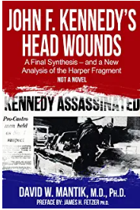
Mantik e-book on Amazon
Notes:
We will next view about 10 minutes of Humes before the HSCA in 1977.

