Slide 1
The State of Texas vs. Lee Harvey Oswald
November 16-17, 2017. South Texas College of Law-Houston.
Citizens Against Political Assassinations (CAPA)

Slide 2
The JFK Autopsy Skull X-rays
All data was obtained at NARA—from the official X-rays.
The X-rays shown here are from the HSCA’s enhanced version.
All autopsy X-rays at NARA have emulsion on both sides.
David W. Mantik, MD, PhD (physics)
Board Certified by the American College of Radiology

Slide 3
Standard Double Emulsion X-ray Film
Emulsion (gel)
Plastic base
Emulsion (gel)
Note emulsion (gel) on both sides.
The relative thicknesses are to scale.
The emulsion can easily be scraped off.

Slide 4
The JFK Autopsy X-rays Contain Three Major Anomalies
No government investigation examined these three anomalous images:
The T-shaped Inscription
The White Patch
The 6.5 mm Object

Slide 5
1. The T-shaped Inscription
This T appears only on the left lateral X-ray.
That X-ray is not in the public record.
We shall see later why this T is so bizarre.

Slide 6
Anonymous patient—not JFK

Slide 7
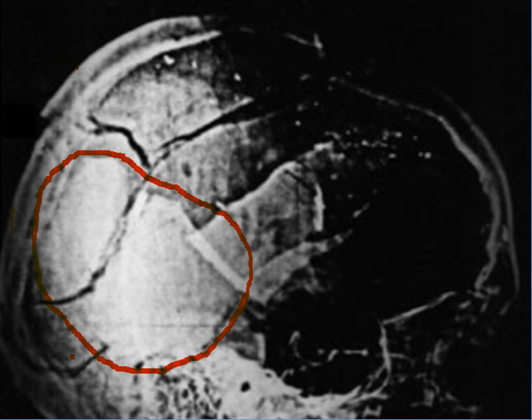
2. The White Patch
The optical density (OD) is almost the same as the petrous bone (the densest bone in the body—at the yellow arrow).
The OD implies bone from side to side (a bonehead)—an anatomic impossibility.
No object corresponds to the White Patch on the AP (frontal) X-ray, a physical impossibility.
A real object must appear on all X-ray views.
White Patch
Petrous Bone

Slide 8
An Aside: Optical Density (OD)
OD describes the amount of transmitted light (through a point) on an X-ray.
OD = 0.0: all of the light gets through.
OD = 0.6: 1/ 4 of the light gets through (e.g., 6.5 mm object)—it looks white.
OD = 3.0: 1/10 of the light gets through—it looks very dark (like air).

Slide 9
2. The White Patch
It is present on both laterals.
It is not present on JFK’s pre-mortem X-ray.
White Patch

Slide 10
JFK Pre-mortem X-ray: No White Patch!
Patients do not have White Patches—nor did JFK.
Mike Chesser, MD, has measured the ODs on the original X-ray at the Kennedy Library in Boston.
Compared to the post-mortem X-ray, there is a huge difference (in ODs) in the area of the White Patch.

Slide 11
3. The Metallic-like Object within the Right Orbit (6.5 mm)
Note the semi-lunar object inside JFK’s right orbit—at the cyan arrow.
It looks like the cross section of a Mannlicher-Carcano (6.5 mm) (i.e., purported to be Oswald’s carbine)
It “seems” to lie at the back of the skull.

Slide 12
1968 Clark Panel Review
This 6.5 mm object was first reported by the Ramsey Clark Panel.
It does not appear in the autopsy report.

Slide 13
Problems with the 6.5 mm Object
1. No one saw it at the autopsy.
2. It is far too transparent (i.e., white) for the cross section of a bullet.
3. It has no realistic counterpart on the lateral X-ray.
4. The nose and tail of this same bullet were found in the limousine.
5. In his entire career (20,000+ cases) Larry Sturdivan (an HSCA ballistics consultant) never saw such a cross section left behind on a skull—nor has Cyril Wecht, MD, JD (forensic pathologist).
6. It first appeared in the Clark Panel Review in 1968—just before the Clay Shaw trial (February 1969).
7. The three official pathologists did not recall it (for the ARRB).
8. John Fitzpatrick, the forensic radiologist for the ARRB, could not explain it.
9. It is precisely the caliber of “Oswald’s” Mannlicher-Carcano carbine (6.5 mm) and it “seems” to lie on the back of the skull.

Slide 14
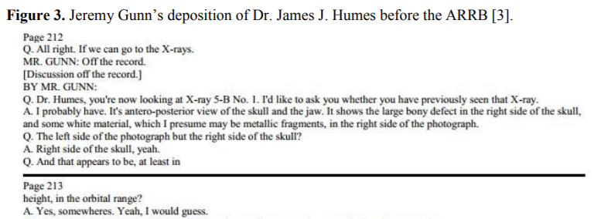
Pathologist Humes was Deposed by the Assassination Records Review Board (ARRB—Feb 1996) http://jfkassassination.net/russ/testimony/humesa.htm

Slide 15
Humes Did Not See the 6.5 mm Object (nor did pathologists Boswell or Finck)

Slide 16
What Larry Sturdivan Said (the HSCA ballistics expert):
“It [the bullet] cannot break into circular slices, especially one with a circular bite out of the edge. As radiologist David Mantik points out…there is no corresponding density on the lateral x-ray.”
The JFK Myths (2005), p. 193

Slide 17
The Best Expert: John Fitzpatrick, Forensic Radiologist (ARRB—Feb 1996) https://www.maryferrell.org/showDoc.html?docId=145280#relPageId=225&tab=page

Slide 18
The Next Image (after this one) Shows This 6.5 mm Object—but Greatly Magnified.
When I viewed this X-ray at NARA I was extremely myopic, so my vision was like a normal person using a magnifying glass.

Slide 19
This is What I Sketched of the 6.5 mm Object (while at NARA)
Ghost image
Ghost image
This is what I saw--before I had Lasik surgery.
I could see the original metal fragment (cross-hatched here—note the blue arrow). It lies on the back of the skull.
A tiny metal fragment (upper red arrow) lay inside the 6.5 mm object .
Several (real) metal fragments lay right outside of the object (three lower red arrows).
The circumference of the 6.5 mm object precisely matched the real fragment on the back of the head.
Therefore: the 6.5 mm (fake) object was deliberately superimposed over the pre-existing, real metal fragment.
All fragments in this image represent reality (even the ghost images), except for the 6.5 mm object.
“The [superposition] effect is that of a ‘phantom’ or ‘ghost’ image, in which [real] background detail is seen through the superimposed image….” –The Technique of Special Effects (1965), Raymond Fielding, p. 71.

Slide 20
JFK Lateral X-ray
Posterior skull fragment: it is visible through the 6.5 mm object on the AP X-ray
The real, but very tiny metal fragment is identified by the cyan arrow. It is almost imperceptible.
An authentic cross section of a M-C bullet should be obvious.

Slide 21
An Authentic Skull, with an Authentic Mannlicher-Carcano Cross Section (by Mantik)
I purchased this human skull, and used a sawed-off M-C bullet.

Slide 22
JFK (left) vs. Authentic Skull (right) with an Authentic M-C Bullet Cross Section
JFK Autopsy
Mantik Reconstruction

Slide 23
A Real M-C Bullet Slice vs. the Tiny Piece of Metal on JFK’s X-ray (on the back of the skull)
OD data from the two lateral skull X-rays
M-C cross section
l
Each graph contains about 100 data points, at intervals of 0.1 millimeter.
This graph tells us that JFK’s fragment is very thin (side to side)--but the M-C is very thick, as it should be.
JFK X-ray
This data implies the amount of metal (from side to side.

Slide 24
JFK’s Dental X-rays
These pre-mortem X-rays were published by the HSCA; they are identical to the post-mortem X-rays.
White areas are mercury-silver amalgams (fillings).
At NARA, on the frontal X-ray, I could compare the ODs of the 6.5 mm object to the ODs of the overlapping fillings.
The dental ODs can tell us (relatively) how much metal there is in the 6.5 mm object (from front to back) as compared to the overlapping fillings (front to back).

Slide 25
The T: Emulsion was Scraped Off the Original X-ray. (The purpose of the T is unknown, but that is not relevant.)
If emulsion is missing it should be trivial to see.
But at NARA, no emulsion is missing!
Only one explanation exists: this is a copied film.
Because: The copied film retains the original image (of the T), but the copied film must retain emulsion on both sides. (After all, no one scraped it off that film.)

Slide 26
So why was the White Patch added?
It implies that brain was mostly present in the posterior skull (which was not true).
On the lateral X-rays the front of the skull is extremely dark, which implies no frontal brain (true).
The White Patch, and the very dark frontal area, both imply that brain exited from the front—and that implies a posterior headshot.

Slide 27
My Nine Visits to NARA: More Problems with the 6.5 mm Object
10. It is a double-exposed image.—we can see the real fragment on the back of the skull through the 6.5 mm object.
11. Optical density (OD) data imply that it is very long (front to back), but we can see on the lateral that it is very thin (front to back). It should contain more metal than all of the overlapping fillings.
12. It is not a random image: the left edge is precisely matched to a pre-existing fragment.

Slide 28
Implied vs Actual Thickness: 6.5 mm Object vs. Dental Amalgams
The overlapping amalgams have an OD of 0.76.
But the 6.5 mm object has an OD of 0.60 (it looks whiter).
Therefore this object should be longer (front to back) than all of the overlapping amalgams, i.e., >40 mm long.
But we can see (on the lateral) that it is really only 3-4 mm long (from front to back).
Therefore, it is 10 times shorter than it should be.

Slide 29
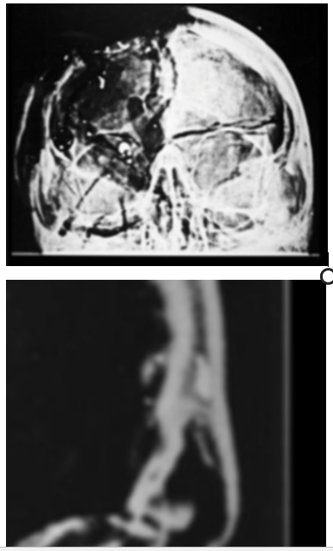
The Forehead Fragment: Implied vs Actual Thicknesses Agree
Forehead Fragment
Its OD is 1.44 on the AP X-ray.
This implies that is very thin (front to back).
And we can see on the lateral X-ray that
it is indeed very thin (2 mm).
It is consistent—like any real object (Humes removed it).
Its thickness on the lateral X-ray is similar to the posterior fragment on the AP X-ray (i.e., both are real).
AP X-ray
Forehead Fragment
Magnified View of Forehead—Lat X-ray

Slide 30
The Original and a Copy—from Cahoon’s 1965 Textbook (p. 56)
Indistinguishable copies could be made, or “By variations of the copying time, one may even improve on the original”—Cahoon, p. 55.
Formulating X-ray Techniques, John B. Cahoon, Jr., © 1953, 1956, 1961, 1965

Slide 31
ECONOMY 14X17 X-RAY FILM DUPLICATOR (online—Sep 2017)
In 1965 similar duplicators were becoming available (but home-made versions were common much earlier).
A second exposure is simple.
Development of the film is a separate step—unlike a photocopier.

Slide 32
If copying is possible, then…
…a second exposure is feasible—and so is alteration.
And the second exposure can add any object to any part of the film.

Slide 33
A “Birdbrain” Double Exposure (by Mantik)
The pteranodon was borrowed from my daughter’s tracing kit.
The dark spots are due to my patient’s multiple myeloma.
Also notice the absence of a White Patch.

Slide 34
Pteranodon Template for the Second Exposure
Template (hole) cut out of the cardboard
During the second exposure, light passed through this template (hole) in the cardboard—onto the copied film.
The 6.5 mm object was produced by a similar double exposure, using a template.
Standard key--for reference
This is a piece of (blue) cardboard.

Slide 35
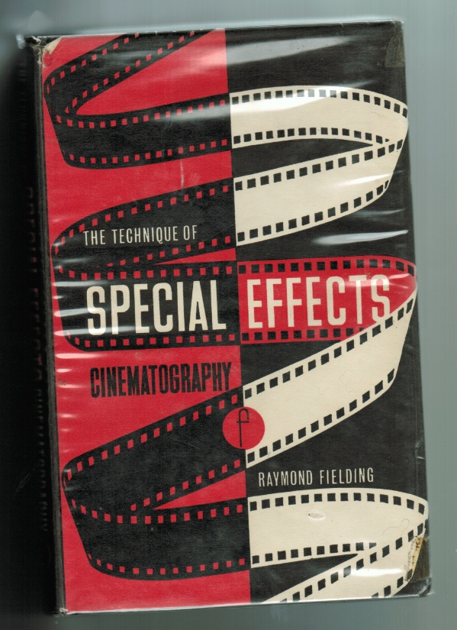
A Typical Hollywood Double Exposure (an online image)
“If the ghost image is too brightly exposed, it will be ‘burned in’ a solid white, thus destroying the transparent effect” (p. 73).
This reminds us of the extreme whiteness of the 6.5 mm object—its second exposure was too long.

Slide 36
Another Double Exposure (by Mantik)
The tiny white spots were produced (during a second exposure) by multiple small holes in a single piece of cardboard.
A metal scissors was merely placed over the film (during the first exposure) so that it cast a dark shadow. (A real scissors would appear white.)

Slide 37
Summary: Previous Government Investigations Did Not Successfully Address These Three Anomalies (The ARRB tried, but failed.)
The Clark Panel and the HSCA reported the 6.5 mm object but…
both groups failed to note that the pathologists had not seen it and…
neither group was able to explain it.

Slide 38
Summary: The JFK autopsy X-rays contain three decisive anomalies. These are unique in history—so that is why all of the experts were mystified. No one thought about (or had ever before seen) double exposures.
The T-shaped inscription has no missing emulsion—so it must be a copied film.
The White Patch resulted from a double exposure.
The 6.5 mm Object was another double exposure (but overdone).

Slide 39
These anomalies arose from a single process. Double exposures in the darkroom produced these anomalies.
There is even more evidence of misconduct:
My discussion with Dr. Ebersole
My discussion with Kodak experts
Missing autopsy skull X-rays (2-3 films—likely obliques)
After 1963, Kodak produced duplicate film (with emulsion on only one side)—and then later added a greenish dye, which prevented such forgeries.
Jerrol Custer’s experience on Saturday, Nov. 23, 1963
Dr. Ebersole’s visit to the Secret Service at the White House

Slide 40
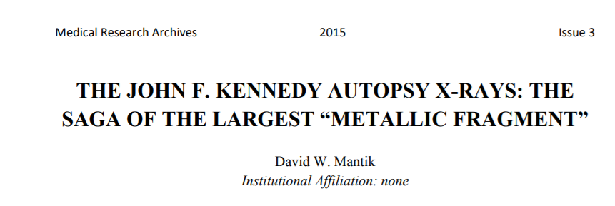
The 6.5 mm Object was Reported in the Professional Literature (by Mantik)
http://journals.ke-i.org/index.php/mra/article/viewFile/177/78

Slide 41
Conclusion: The JFK X-rays Were Altered
To avoid evidence of conspiracy (the White Patch)
To implicate Oswald (the 6.5 mm Fake)

Slide 42
Final Questions to Ponder
The Secret Service controlled the X-rays.
But why would they try to frame a “guilty” man?
And: If the X-rays were altered, what other evidence was distorted?

Slide 43
Addendum on the OD Graph (Slide 23) --thanks to a query from Jim DiEugenio and Albert Rossi
On these two lateral X-rays, the ODs (in the center) of the JFK fragment and the control M-C cross section are almost the same. That does not mean that their physical thicknesses were almost the same. On the contrary, that is a coincidence. In fact, the two films represent two quite different exposures. If the same exposure had been used for each, the OD of the M-C would have been much lower (implying a much greater thickness).
The major emphasis instead should be on how much the OD changed from inside to outside. For the control M-C it changed a lot (implying a large thickness), whereas for the JFK fragment the change was tiny. That major discrepancy is the real paradox—and implies a major difference in thicknesses between the two objects.

