Slide 1
With Profound Appreciation to…
DOUGLAS P. HORNE

Slide 2
A Closer Look at the Zapruder Film:
The Case for Alteration
David W. Mantik
The JFK Assassination at 60.
The Cyril H. Wecht Institute of Forensic Science and Law.
22nd Annual Symposium, November 15-17, 2023

Slide 3
The Limo Stopped
Walter Cronkite: the car “stopped momentarily.”
Bob Clark: the car “came to an immediate stop.”
Clark was an eyewitness—he was with the three camera cars following LBJ.
(1346) Walter Cronkite - Bob Clark - Limo Stop - Assassination of JFK - YouTube
https://insidethearrb.livejournal.com/2023/11/06/

Slide 4
The Cronkite-Clark Audio

Slide 5
If the film is authentic…
1. What happened to the limo stop?
2. Why does the film suggest only one headshot?
3. Why did Clint Hill report a headshot after Z-313?
4. Why do we not see the turn onto Elm St.?
5. Why do the WC drawings and data tables disagree with the film?
6. Why do early SS reconstructions show a shot well past Z-313?
7. Why did no promptly debriefed witness report a head snap?
8. Why did Rather and DeLoach see JFK’s head go forward?
9 .Why does the Stemmons Freeway Sign show no pincushion effect?
10. Why two compartmentalized NPIC events that weekend?
11. Why did John Hicks (the NPIC Director in 1975) overreact when he saw Brugioni’s briefing boards from Saturday night, November 23?
12. Why did 72 of 75 Hollywood film experts agree that the Black Patch is a fake?

Slide 6
If the film is authentic…
1. What happened to the limo stop?
“Master List of [72] Witnesses Who Stated that the Limo Slowed or Stopped”
Honest Answers (2021) by Vince Palamara

Slide 7
If the film is authentic…
2. Why does it suggest only one headshot?
“Master List of [202] Witnesses Who Indicated that JFK was Shot from the Right Front”
Honest Answers (2021) by Vince Palamara

Slide 8
If the film is authentic…
3. Why did Clint Hill report a headshot after Z-313?
24:30: "As I approached the vehicle there was a third shot. It hit the President in the head, upper right rear of the right ear, caused a gaping hole in his head, which caused brain matter, blood, and bone fragments to spew forth out over the car, over myself….”
Who's telling the truth: Clint Hill or the Zapruder film? - JFK Assassination Debate - The Education Forum (ipbhost.com)

Slide 9
If the film is authentic…
4. Why do we not see the turn onto Elm St.?
Zapruder claimed that he starting filming when the limousine rounded the corner. And he had plenty of film for this. The extant film is only about 6 feet, whereas the physical film length was 25 feet.
His secretary agreed with him. Marilyn Sitzman (despite her name) was standing behind him to counteract his chronic vertigo.

Slide 10
If the film is authentic…
5. Why do the WC drawings and data tables disagree with it?

Slide 11
Newsweek: November 22, 1993

Slide 12
If the film is authentic…
6. Why do early SS reconstructions show a shot well past Z-313?

Slide 13
SS Reconstruction of 3 Shots

Slide 14
If the film is authentic…
7. Why does no promptly debriefed witness report a head snap?
For example, Erwin Schwartz (Zapruder’s partner) denied seeing a head snap in the film that weekend.

Slide 15
If the film is authentic…
8. Why did both Rather and DeLoach see JFK’s head go forward in copies of the film that weekend?
So did Altgens—in real time: (1343) Ike Altgens Photo Interview – YouTube
Since 1963, why has no one reported a forward head movement in the film?
Did you see JFK’s head go forward?

Slide 16
If the film is authentic…
9. Why does the Stemmons Freeway Sign show no pincushion effect?
John Costella has shown that Zapruder’s lens routinely stretched all images outward (toward the four corners), but the Stemmons Sign alone escapes these laws of optics.
He concludes that the sign was inserted into the image after the film was developed.
The JFK assassination (johncostella.com)

Slide 17
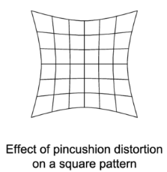
The Pincushion Effect

Slide 18
If the film is authentic…
10. Why two compartmentalized NPIC events that weekend?
The film was diverted from LIFE’s office in Chicago → NPIC
(Saturday night) → Rochester (most of Sunday) →
NPIC (Sunday night).
Copies were then sent, possibly late Sunday or very early on Monday, to LIFE (in Chicago) in time for their Nov 29 edition.

Slide 19
If the film is authentic…
11. Why did John Hicks, the NPIC Director in 1975 (during the Rockefeller Commission), overreact when he saw Brugioni’s briefing boards from Saturday night (November 23)?
This is discussed in the documentary,
THE ZAPRUDER FILM MYSTERY on YouTube

Slide 20
If the film is authentic…
12. Why did 72 of 75 Hollywood film experts agree that the Black Patch was a fake?
We might also ask this: Why does the Black Patch so closely match the White Patch on the lateral skull X-ray films?

Slide 21
If you still trust the government…
GOOGLE: Shane O’Sullivan’s
“THE ZAPRUDER FILM MYSTERY”
It is 85 minutes long on YouTube.
It has had 2.6 million views.

Slide 22
Sydney Wilkinson Enters the Fray
November 2008. She purchased a third generation copy of the forensic
version of the film from NARA. (The original is generation zero.)
This was a 35 mm, duplicate negative, with no defects removed.
She created digital files of each frame in 6144 x 4668-pixel format. [6,144 = 6.144k, commonly called 6k.]
Each frame contained 114.7 Mb.
Compare this to a home HDTV, with 1920 x 1080 pixels and 9.7 Mb per frame.
So, Sydney had nearly 12 times as much information in each frame—as compared to an HDTV frame.

Slide 23
Sydney Wilkinson Used Logs!
Home HDTVs, computers, and movies use linear color space. All have had contrast and color balance adjusted.
But Sydney scanned in logarithmic space, which means that all available information was retained.
To a human eye, logarithmic color looks a bit “muddy,” but all the data is there. This is optimal for analysis.

Slide 24
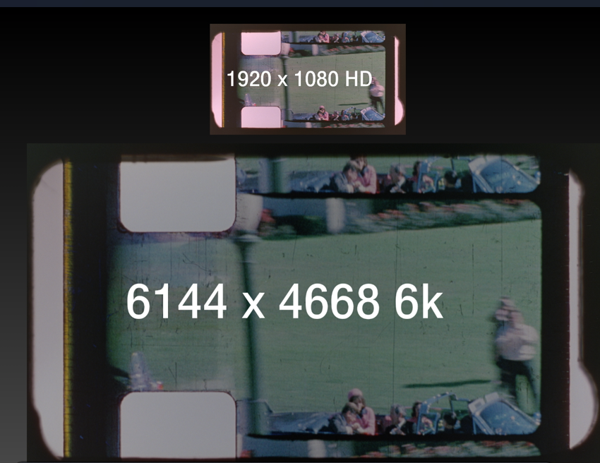
Scans: 2k vs. 6k

Slide 25
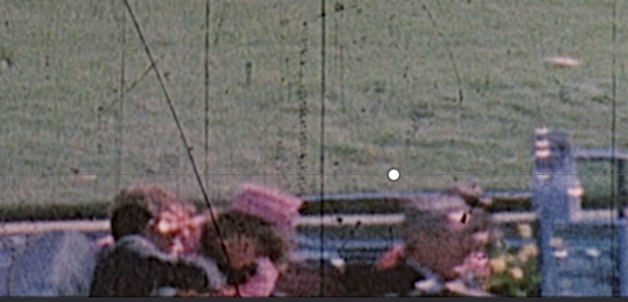
Z-317

Slide 26
A Color Analysis Prepared at NASA

Slide 27
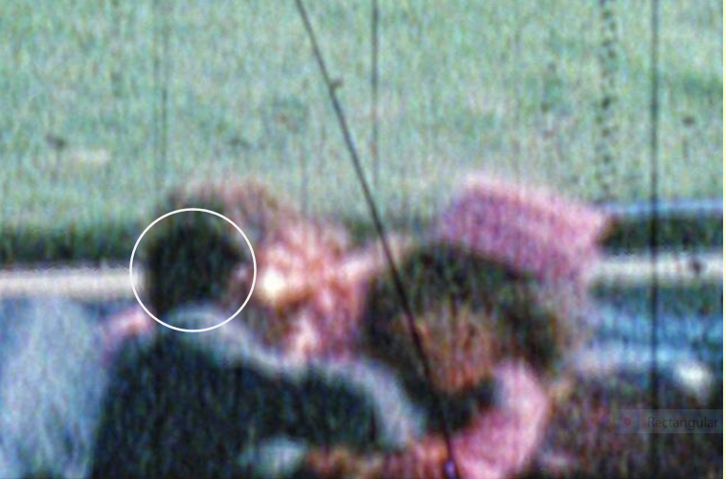
Magnified: Z-317

Slide 28
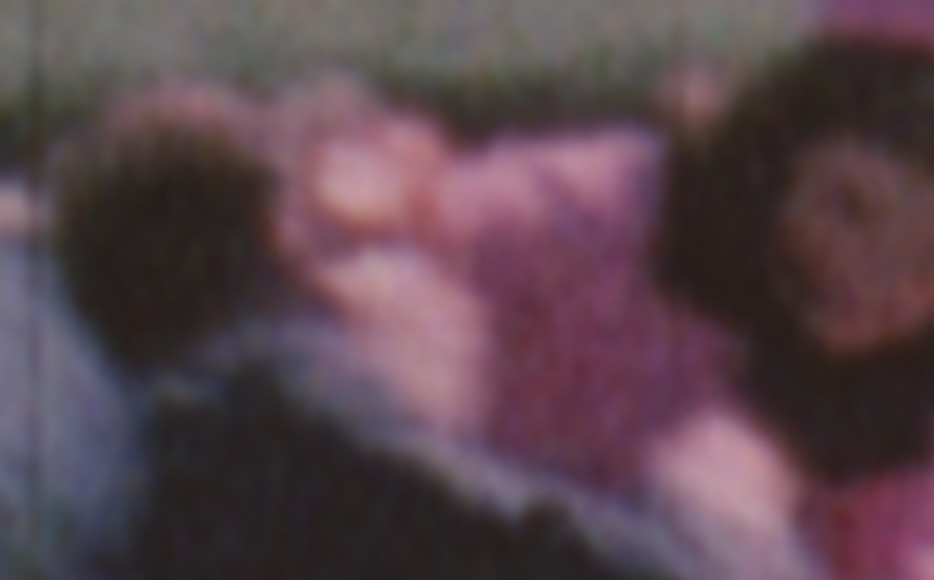
Z-321

Slide 29
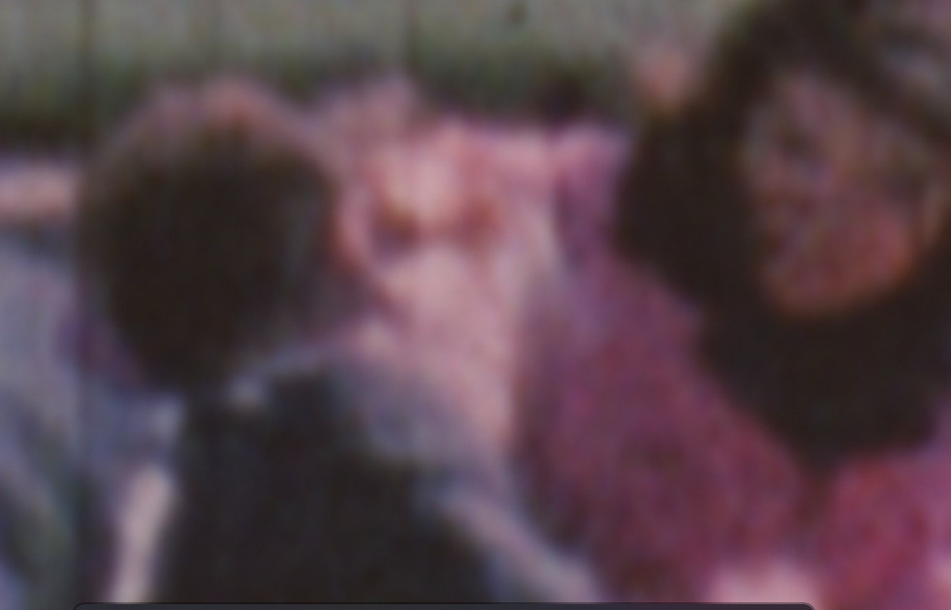
Z-323

Slide 30
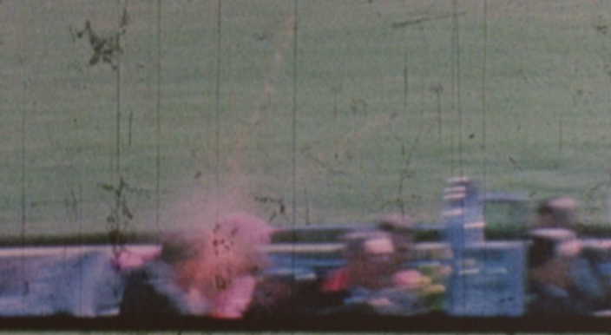
Z-313
This is the first image that Rutan addresses in his interview.

Slide 31
Paul Rutan, Jr.
Paul
The Good, the Bad and the Ugly (1966)
Spartacus (1960)
Path to Paradise: The Untold Story of the World Trade Center Bombing (1997)
The restoration of The Yellow Submarine
And

Slide 32
Garrett J. Smith
Vice president for production technology and digital mastering operations at Paramount Pictures. During his 24-years there, Garrett participated in DVD, HDTV and Digital Cinema Initiatives.
Previously, he had been post-production supervisor for “Ripley’s Believe It or Not”; director of post-production for Columbia Pictures Television; and manager, film services at CBS Television Network.
He is an adjunct associate professor at the USC School of Cinematic Arts.
Of the 72 Hollywood experts who saw the Black Patch as a fake, these are the only two who would go on the record. They had not even previously met.

Slide 33
The Rutan-Smith Documentary
Play Disk!

Slide 34
An Expert Voices an Excited Utterance
Douglas Horne:
A Hollywood editor, colorists and restoration experts (Ned Price and two others) were with me. Ned was Head of Warner Brothers Restoration in 2009. When he saw the Black Patch he said, “Oh my God, I can’t believe they made such a bad fake.”
David Mantik:
That was precisely my reaction when I saw the MPI image of the Black Patch at the Sixth Floor Museum. I nearly laughed out loud. My gifted daughter, at age 7, would surely have done better.
The Federal Rules of Evidence:
An excited utterance is a statement about a startling event, made by the declarant when still under stress from the event. Excited utterance is an exception to the hearsay rule.

Slide 35
Brugioni Documentary
Play disk!

Slide 36
Dino Brugioni
Wiki: “Even after retirement, Brugioni was considered to be the world's foremost imagery intelligence analyst.”
Wiki states that Dino considers the extant Z-film to be altered.
He and Arthur Lundahl co-founded the NPIC.
Via the U-2 images, he identified the Cuban missiles.
He was NPIC’s Chief Information Officer—i.e., the briefing board czar. He prepared the Cuban missile boards for JFK.
He was one of the first historians to present photographic evidence of Auschwitz.

Slide 37
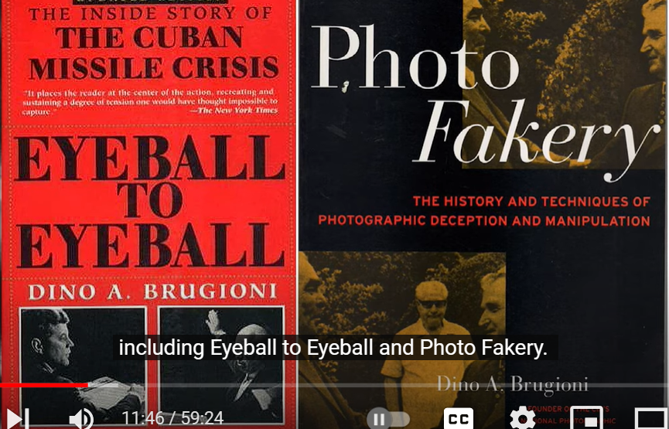
Brugioni’s Books

Slide 38
Film Alteration: Two SS Agents Agreed with Dino
Bill Carter reports on the “raw footage” of the Zapruder film—as shown to him by the Secret Service:
"...the portion that was so graphic had been cut out..."
--Get Carter (2005), Bill Carter, p. 55

Slide 39
Film Alteration: Two SS Agents Agreed with Dino
Marty Venker (from his memoir):
“They [the Secret Service] showed you the gruesome version [of the Zapruder film during training] that the public usually didn't see, where parts of President Kennedy's brain sprayed all over Jackie...”
Confessions of an ex-Secret Service Agent (1988) by George Rush, pp. 24-25.
With credits to Honest Answers (2021), by Vince Palamara, p. 177

Slide 40
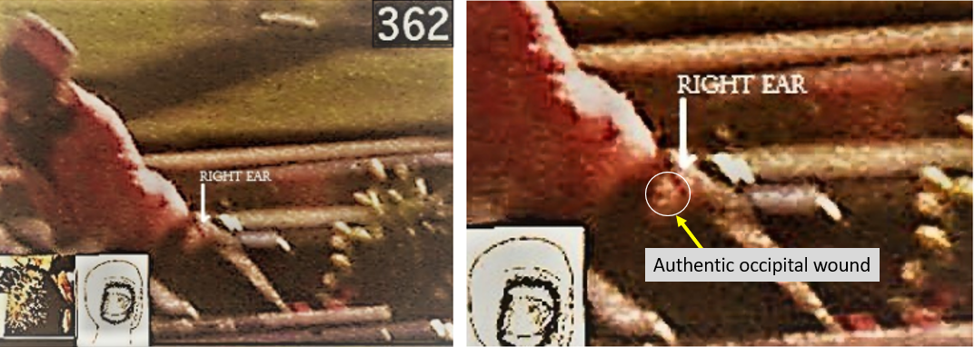
Hawkeyeworks Missed this Hole
Images provided by Doug Mizzer.

Slide 41
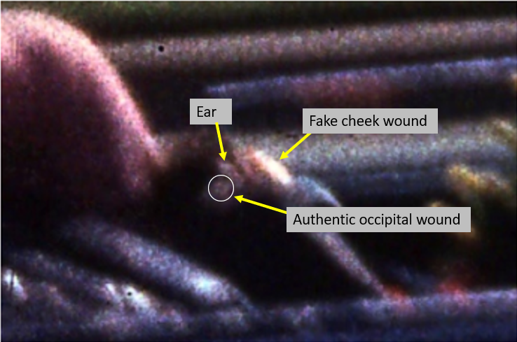
Mizzer: Another Miss at Z-369
Roderick Ryan (a Hollywood technical award winner) told Noel Twyman that he agreed—the globule on JFK’s cheek is a fake. It was not seen at Parkland, so who washed it off?

Slide 42
The MPI Images
The Deed of Gift (from Zapruder’s company) is dated about Dec 30, 1999.
These images were received in January 2000, per Mark Wrolstad in The Dallas Morning News.
They are first generation!

Slide 43
Horne Triggers Our Visit to Dallas
Late November 2009. Horne publishes Inside the ARRB.
This contained an image of the Black Patch in Z-317.
November 20, 2009. Sydney and I view the MPI images.
It is our impression that no public person had viewed these images before Sydney and I did.

Slide 44
Wilkinson and I See Two Different Sets of Images at MPI!
November 2009. Sitting together with Gary Mack, Sydney and I see extremely high-resolution (first generation) images. We are both stunned by the trapezoidal Black Patch, with sharp edges.
November 2010. With her husband, Wilkinson sees a clearly different set of film images, similar to those in the public domain. She is extremely distraught when she calls me about this.
November 2012. I have the same experience with Peter Janney. I pointedly asked Megan Bryant if these were the same images that we had seen in 2009. She assured me that they were. (Gary Mack was absent that day—perhaps for good reason. He died three years later, at age 68.)

Slide 45
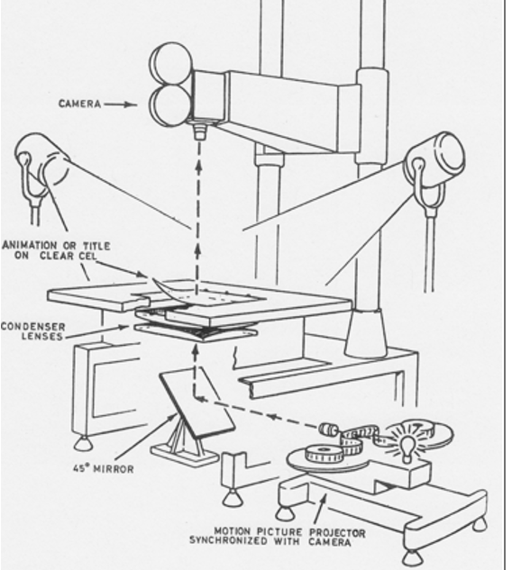
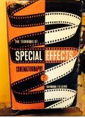
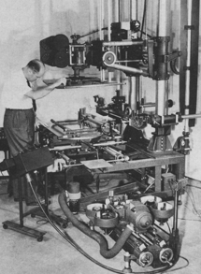
The Technique of Special Effects Cinematography-- January 1, 1965, by Raymond Fielding
With Professor Herb Farmer at USC, we toured their museum of these dinosaur-like machines.

Slide 46
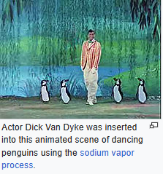
Mary Poppins: Filmed May–Sept 1963

Slide 47
Conclusion: The Provenance of the Film
GOOGLE: “The Zapruder Film Mystery”
Nov 23-24. Chicago (LIFE) → NPIC (Brugioni sees 8 mm on Saturday night)
→
Rochester (altered at Hawkeyeworks within 12 hours on Sunday)
→
NPIC (McMahon and Hunter see 16 mm film on Sunday night)
→
Copies to LIFE and then displayed in the Nov 29 issue as B&W images
NPIC’s only purpose was to make briefing boards of before
and after images. They were only photoanalysts. They did not alter the film.

Slide 48
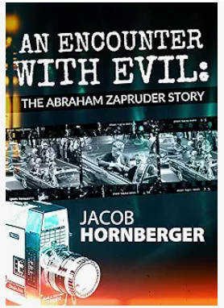
Read the Rutan-Smith Transcript

Slide 49
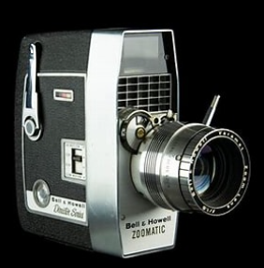
Bell & Howell Model 414
The Model 414 PD held 16mm film which was first run in one direction, with half of the width of the film exposed. The reel would then be removed from the camera (in subdued light). The feed and take-up reels were then swapped and reloaded so that the second half could be exposed. There was no audio.
P=Power Zoom (8-27 mm) D=Electric Eye
Focal Length = f 1.8

Slide 51
Conclusion: Zavada I
Horne: “He [Zavada] only said that the edge print was CONSISTENT WITH authenticity, i.e., it was exposed on Kodachrome II film manufactured in 1961; the edge print indicated it was indeed developed in Dallas. The ARRB did not ask him to analyze IMAGE CONTENT, beyond the ‘ghost images’ in the intersprocket area, because that was outside of his expertise.”
In fact, Zavada once asked Leo Zahn (my Rancho Mirage neighbor and professional film editor) how alterations might have been done!
Zavada was beholden to Kodak for his pension. He needed the funds to keep flying his private plane.

Slide 52
Conclusion: Zavada II
On July 24, 1997, I asked Bruce Jamieson in a telephone call, whether a copy film could be distinguished from the original without a side- by-side comparison. He agreed that it would be difficult.
--Assassination Science (1998), p. 271.
Zavada admitted that copying showed “tremendously effective retention of resolution throughout many generations. This would make it more difficult to discriminate between generations zero and one. Even the Director of the NPIC Color Lab, Homer McMahon (who saw the altered copy), thought it was the original.
Zavada initially admitted (in print) that the film (and all 3 copies) had been split to 8 mm at Kodak in Dallas. For this, he relied on the first-hand eyewitness testimony of the two ranking Kodak officials: Phil Chamberlain and Tom Nulty. Zavada later reversed his opinion and threw both under the bus.
On the other hand, the Sixth Floor Museum received three unslit copies in January 2000. Where did they come from?
Zavada also noted that the first 60 batches of Kodachrome II were especially notable—for its lower contrast and longer exposure latitude. Detection of a copy is therefore even more challenging.

Slide 53
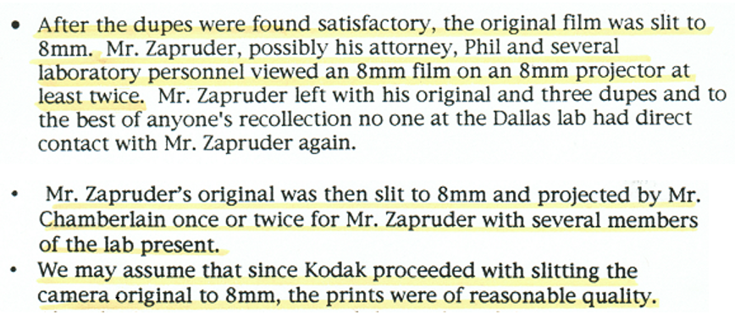
The Zavada Report: Direct Excerpts
Also recall that Zapruder showed his film that weekend—via an 8 mm projector!

Slide 54
Chamberlain’s Personal Memoir— from the Zavada Report

Slide 55
Harry Livingstone Interviews Rollie Zavada
This is a long, astonishing, and sometimes disheartening interview (for Rollie). I am also cited for my work, usually favorably.
Anyone seriously interested in film authenticity should not even claim an opinion until they read this interview.
In Murder in Dealey Plaza, I have also commented extensively on the film maps. On the other hand, the “high priests” of film authenticity never comment on these detailed and technical film maps. We have no idea whether they have ever even examined this evidence.
--The Hoax of the Century: Decoding the Forgery of the
Zapruder Film (2004) by Harrison Edward Livingstone, pp. 278-321

Slide 56
Conclusion: Mysteries of the Film Maps
1. The original home movie segment has vanished—only copies remain.
2. By itself, this raises a question about the location of the original motorcade sequence. Many of us believe that it is also missing from the Archives.
3. Routine Kodak practice was to punch an ID number at the end of the second side. In this case, on the extant film, the number 0183 should appear after the motorcade sequence. It does not.
4. The Zavada Report reminds us that the original was processed without removing the initial 4-foot leader. But this 4-foot leader is seen in neither the extant film nor in the SS copy #2.

Slide 57
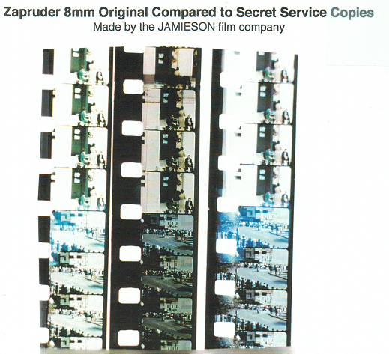
Comparison of “Bracketing” Exposures

Slide 58
The Zavada Report: An Admission about Bracketing

Slide 59
What Jamieson Said about Bracketing
Harry Livingstone: “Jamieson told me that Zavada recently told him that he [Zavada] had seen both good prints in the Archives and that one was over-exposed.”
Bruce Jamieson: “It can’t be mine because we used the same exposure on all three prints.”
--The Hoax of the Century (2004) by Harrison Edward Livingstone, p. 266.
Mantik: Shortly thereafter, Zavada threw Jamieson under the bus.

Slide 60
Inter-sprocket images—but why none for the motorcade?
The red arrow identifies the baby’s head in the inter-sprocket area. For the motorcade (in the 3 copies), all inter-sprocket areas are totally black.

Slide 61
The Operator and the Expert Agreed
Robert Colley, who operated the Jamieson machine, and USC Professor Herb Farmer both “…have indicated that the motorcade side of the first day original copies should contain inter-sprocket images, but there are none.”
The Hoax of the Century: Decoding the Forgery of the Zapruder Film (2004) by Harrison Edward Livingstone, p. 454

Slide 62
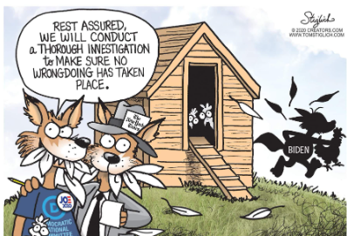
Conclusion: A Fox* “Guarded” the Henhouse
C. D. Jackson bought the Z-film for LIFE
1942 -1945. Deputy Chief, Psychological Warfare Division, SHAEF
1945 -1949. Managing Director of Time-Life International
1952. Liaison between the newly-created CIA and the Pentagon
1953 - 1954. Presidential adviser on psychological warfare
1953 -1954. Helped establish the Bilderberg Group
1960. Publisher of LIFE
* Another fox, CIA officer George Joannides, served as the liaison to the HSCA

Slide 63
Conclusion: Why Was Brugioni Kept Out of the Loop?
Brugioni:
Lundahl knew that “I was too honest to be part of a scheme.”
Mantik:
Dino was a mirror image of Otto Otepka, who was tenaciously investigating Oswald’s security credentials for the State Department. For his efforts he was illegitimately fired by Dean Rusk 17 days before the assassination. Otepka’s direct bosses were later fired for perjury that was effectively used against him.

Slide 64
So Why Leave in the Head Snap?
Edge prints (“KODAK SAFETY FILM”) appeared at regular intervals.
A copied film would show both the original edge prints and those from the copy film.
Two such sets would clearly imply that this was a copy film.
So, all edge prints from the copy film had to be excised.
This left speed glitches wherever such multiple frame excisions occurred.
One of them occurred during JFK’s backward head movement—which was thereby (unavoidedly) turned into a head snap.

Slide 65
The population density under this (government) bus was even greater than Nazareth during the Nativity.

Slide 66
Who was thrown under the bus—to preserve “National Security”?
SS agents Marty Venker and Bill Carter, SS surveyors who saw flying debris in multiple frames, SS who re-enacted the shots, Clint Hill, “Deke” DeLoach, Dan Rather, Ike Altgens, Phil Chamberlain, Tom Nulty, Bruce Jamieson, John Hicks, Art Lundahl, Bob Clark, Walter Cronkite, Dino Brugioni, all the Parkland doctors, 72 limo-stop witnesses, and 202 frontal shot witnesses.
I would personally add John Ebersole, MD, who created the White Patch, but at least he knew when to stop talking.
We could even add the three pathologists who were co-opted by fake images on the photographs and X-rays.

Slide 67
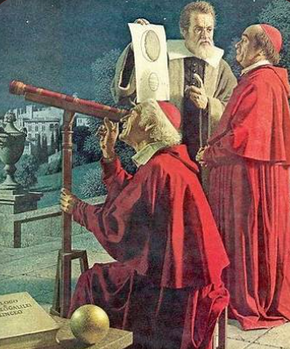
Conclusion: Galileo and the Catholic Church
Galileo’s enemies refused to look through
his telescope at the moons of Jupiter.
Today, we have high priests* of the
film who will not examine
Wilkinson’s 6k images.
Galileo was finally cleared of heresy by the
Church on October 30, 1992 [i.e., not 1692].
*One of these two “priests” has never asked to see these images. The other priest was offered free transportation and housing, but later declined due to health reasons.

Slide 68
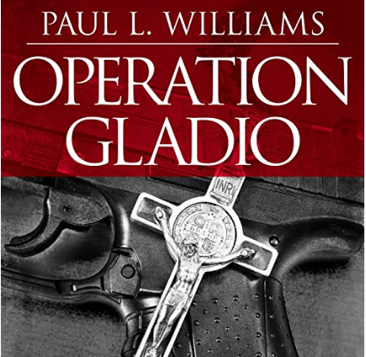
The Vatican, the CIA, and the Mafia
Operation Gladio: The Unholy Alliance between the Vatican, the CIA, and the Mafia (2015) by Paul L. Williams, Michael Prichard, et al.
William Colby, Director of the CIA, using his insider status as a devout Catholic, is also infamous for planting microphones throughout the papal apartments. This listening did not stop until 1984.

Slide 69
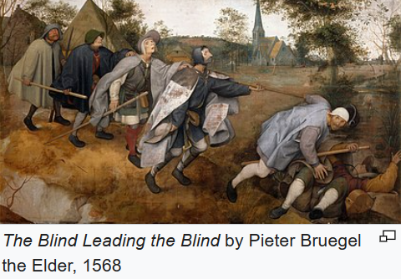
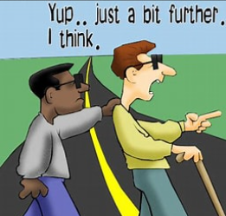
Conclusion: This is an Ancient Tradition--The Blind Leading the Blind
“Abiding in the midst of ignorance, thinking themselves wise and learned, fools go aimlessly hither and thither, like blind led by the blind”— Katha Upanishad (800 BC).
Matthew 15:13-14

Slide 70
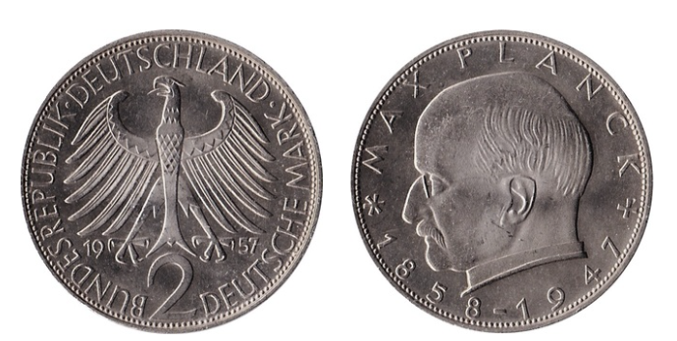
Conclusion: Planck’s Principle Still Applies
Max Planck was the founding father of quantum mechanics.
“A new scientific truth does not triumph by convincing its opponents and making them see the light, but rather because its opponents eventually die, and a new generation grows up that is familiar with it ....”
As a reminder for me, this coin is displayed on my bookshelf at home.

Slide 71
Mark Twain Agrees
“The glory which is built upon a lie soon becomes a most unpleasant incumbrance.... How easy it is to make people believe a lie, and how hard it is to undo that work again!”
Autobiographical dictation, 2 December 1906. Published in Autobiography of Mark Twain, Volume 2 (University of California Press, 2013)

Slide 72
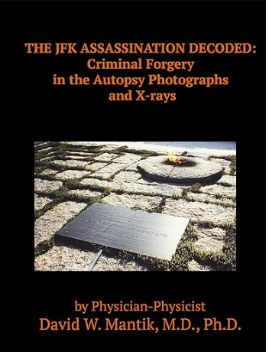
Masquerade at the Museum

Slide 73
L'image 313: A New French Documentary
This new documentary, with English subtitles, is an hour long, builds on the work of Douglas Horne, and focuses on the chain of custody of the film.
https://www.youtube.com/watch?v=9A5VPkazX8A

Slide 74
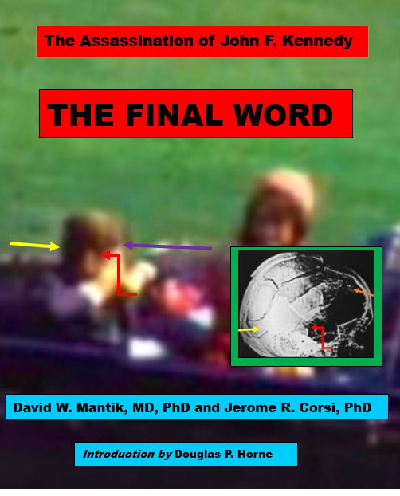
A Tentative Book Cover
The expected publication date is December 2023

